Slide 1
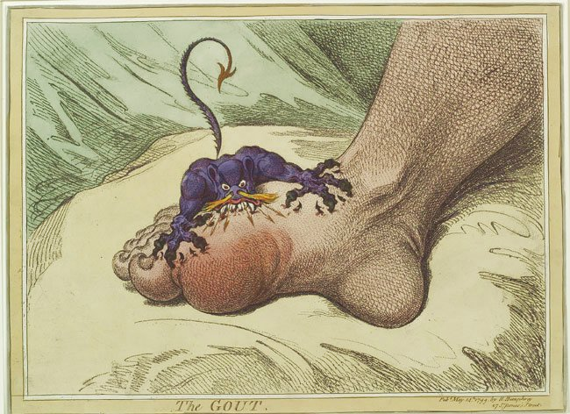
Desorders of nucleotides metabolism
Notes:
1

Slide 2
Purine Metabolism
de novo pathway
  Phosphoribosylpyrophosphate (PRPP) synthetase superactivity,
Salvage pathway
  adenosine deaminase (ADA) deficiency
Catabolic pathway
  HGPRT deficiency

Slide 3
Case
47 year old male
Severe pain in right great toe – wore open toe sandals to clinic
Began previous evening and kept him up through the night (acute onset)
Taking extra-strength acetaminophen to keep the pain under control
Unable to bear weight on his right foot
No history of injury to right foot

Slide 4
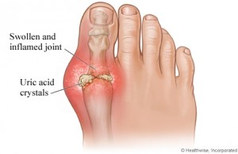
What is Gout?
Characterized by hyperuricemia (elevated plasmic uric acid concentrations) and severe, recurrent bouts of arthritis caused by monosodium urate (MSU) crystals deposited in the joint spaces.
Syndrome of abnormal purine metabolism or excretion.
Existed for over 2,000 years and used to be known as “disease of kings”
Usually not life-threatening, but can be painful, chronic, and disabling.

Slide 5
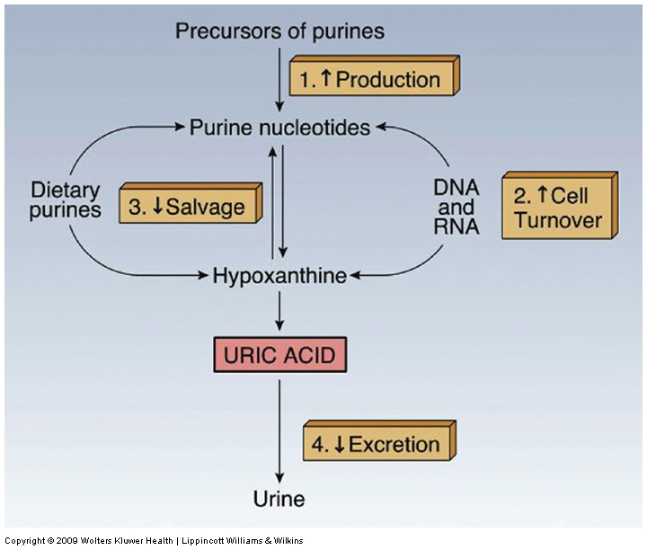
Pathophysiology

Slide 6
The greater the degree and duration of hyperuricemia, the
greater is the likelihood of gout and the more severe are the symptoms.
Urate levels can be elevated because of:
•Decreased excretion.
•Increased production.
•Increased purine intake.
Pathophysiology
There are two types of gout :
• 1- Primary gout .
• 2- Secondary gout , due to other diseases eg cancer ,
renal dysfunction , Metabolic syndrome (the combination of
hypertension, diabetes, dyslipidemia, truncal obesity, increased
cardiovascular disease risk).

Slide 7
Primary gout
• It is caused by an excessive formation of uric
acid due to inborn defect in enzymes.
• Molecular basis :
1- Mutations in PRPP synthetase (hyperactive)
2- Partial deficiency of HGPRT enzyme .
3- Glycogen storage disease type I .

Slide 8
PRPP synthetase Hyperactivity: increased production of PRPP causes increased synthesis of purines.
HGPRT deficiency: Decreased salvage leads to increased breakdown of purines. Also, there is reduced feedback inhibition of de novo pathway causing increased production.
G6PD deficiency: Increased G6P is diverted to purine synthesis

Slide 9
Secondary Gout
Diet: Increased purine intake
Rapid cell turnover: Leukemias, Chemotherapy, Hemolysis, Rhabdomyolysis
Reduced excretion of uric acid:
  Renal failure, Htn, DM, Lactic acidosis
Alcohol:
  Increased breakdown of ATP causes increased uric acid production
  Also causes increased lactic acid, reducing excretion of uric acid

Slide 10
CLINICAL FEATURES
Gout usually presents as recurrent attacks of acute inflammatory
arthritis (red tender, hot, swollen joint).
The joint that is most commonly affected is the first
metatarsalphalangeal joint at the base of the big toe.
Prolonged or acute elevation of blood urate leads to precipitation, as
crystals of sodium urate, in the synovial fluid of joints. These
precipitates cause inflammation.
People with long-standing hyperuricemia can have tophi (uric acid crystal deposits) in tissues. These are usually hard, non-painful deposits .
Elevated levels of urine uric acid can lead to uric-acid crystals
precipitating in the kidneys which may form kidney stones and lead to
urate nephrophathy.

Slide 11
Urate and Uric Acid
pKa of Uric acid: 5.7
Serum pH: 7.2-7.4
Urine pH: 5.8 and above
Solubility of uric acid is very less, saturation at 7 mg/dl
Normal Serum uric acid: 3-6 mg/dl

Slide 12
As conc. of Uric Acid crosses 7, it precipitates
In urine, ph decreases, Urate is formed.
It combines with Sodium and forms MSU crystals
These precipitate and form stones
Diagnosis:
  Serum urate levels
  Synovial fluid analysis: Needle shaped negatively birefringent urate crystals

Slide 13
Treatment
Treatment with allopurinol, which inhibits xanthine oxidase .
Probenecid: Causes increased excretion of uric acid
Avoid purine rich foods:
red meat and organ meat (liver, kidneys)
high fluid intake
Alkalinization of urine
Anti-inflammatory drugs
.

Slide 14
A patient with acute lymphocytic leukemia is treated appropriately with anticancer drugs. Inhibition of which enzyme will help prevent side effects of this therapy?

Slide 15
A 57 year old sales representative has a history of alcohol abuse and hyperuricemia. He attends an out of town conference and binges on meat rich foods. Next day, he develops a painful swelling in his big toe. Which things could have contributed to this episode.

Slide 16
A 4 year old retarded child hurls himself into walls and bites his fingertips so severelt that they must be bandaged. The child most likely has a deficiency of:
Cystathionine synthase
Hexosaminidase A
HGPRTase
Phenylalanine hydroxylase

Slide 17
Lesch-Nyhan Syndrome
• Due to severe or complete deficieny of Hypoxanthine
Guanine Phosphoribosyltransferase (HGPRT) .
• Recessive X-linked genetic disease .
• This disorder is an example for loss of normal feedback
inhibition .
• This disorder is characterized by :
• Choreoathetosis ( movement disorder ) .
• Severe neurologic disease, characterized by self-mutilating
behaviors such as lip and finger biting and/or head banging.
• A severe gouty arthritis .
• Early death may be due to kidney failure.

Slide 18
A 6 years old girl presented with repeated episodes of respiratory infections since the age of 2 years. Frequency of such attacks were variable. However, minimum two such episodes were noticed per month. There was no specific time of occurrence or any weather predilection. There was no history of loose motions, skin lesions, anorexia, weight loss, contact with patient suffering from Tuberculosis or family history of asthma or allergy. Response to antibiotics and bronchodilators was temporary at best.

Slide 19
Adenosine Deaminase Deficiency
Severe combined immune deficiency
(SCID)
• Autosomal recessive disease .
• Both B and T lymphocytes are affected .
• Patients are susceptible, often fatally, to infectious diseases because of an inability to
mount an immune response to antigenic
chanllenge.
• Infants with this deficiency have a high fatality
rate due to infections .

Slide 20
TREATMENT OPTIONS:
GERM FREE ENVIRONMENT
BONE MARROW TRANSPLANT
ROUTINE INJECTIONS OF ADENOSINE DEAMINASE ENZYME (ADA)
GENE THERAPY USING SUBJECTS OWN CELLS (RETROVIRUS CONTAINING ADA TO “INFECT” SUBJECTS BONE MARROW STEM CELLS)

Slide 21
OROTIC ACIDURIA
Excessive excretion of orotic acid in urine
Autosomal recessive disorder
Orotate phosphoribosyl transferase
Orotidylate decarboxylase
Presentation:
  Growth failure
  Developmental retardation
  Megaloblastic anemia
  Increased orotic acid in urine
Treatment
  Uridine supplementation

