Slide 1
Reticulocyte count
Dr Nikhil Rabade Consultant Hematopathologist
SRCC Children’s Hospital Mumbai

Slide 2
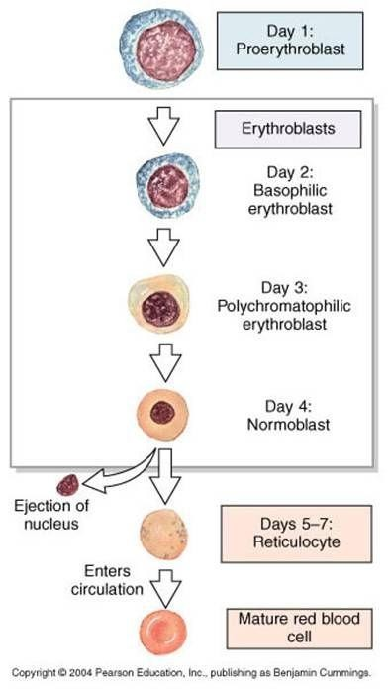
Red cell development
Bone marrow – 3 days
Peripheral blood – 1 day
90 % of the reticulocytes present in the bloodstream are mature stages
Erythropoiesis stimulation leads to a “left shift”

Slide 3
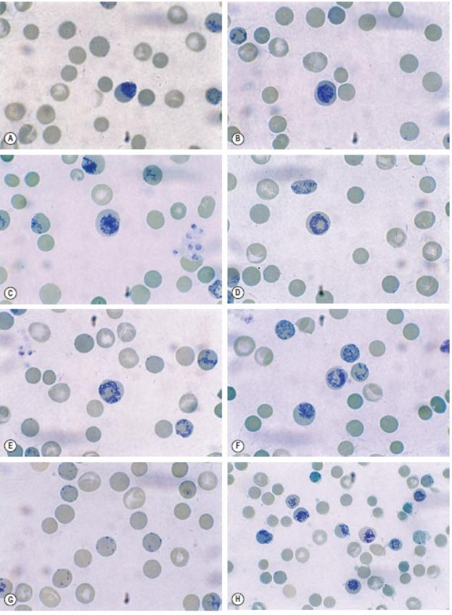
Heilmayer stages
Stage | Morphological description | Frequency
 | Orthochromatic normoblast
I | Dense clots of reticulum (A,B) | <0.1%
II | Extended network of loose reticulum (C,D) | ~10%
III | Scattered granules with diffusely arranged reticulum (E,F) | ~30%
IV | Scattered granules (G) | ~60%

Slide 4
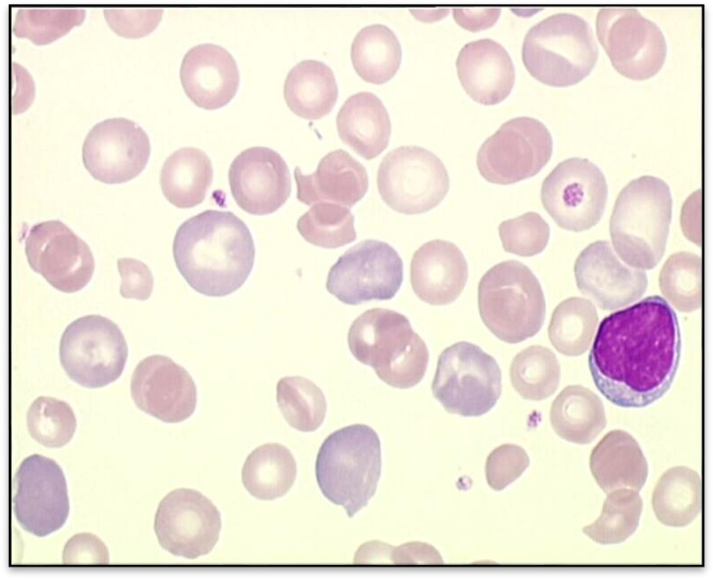
Supravital staining
🟔PRINCIPLE:
RNA within the ribosomes reacts with basic dyes such as azure B, brilliant cresyl blue or New methylene blue to form a blue precipitate
This reaction only occurs in ‘vital’ unfixed preparations
🟔On Romanowsky stains: Reticulocytes
appear as polychromatophilic (grey/blue) cells

Slide 5
Staining solution
1% Brilliant cresyl blue or 1% New methylene blue
Dissolve 1gm of BCB / NMB in 100ml of 3% trisodium citrate-saline
Check pH
Filter with Whatmann’s No.1 filter
Keep in dry bottle
Stable for 4 – 6 weeks

Slide 6
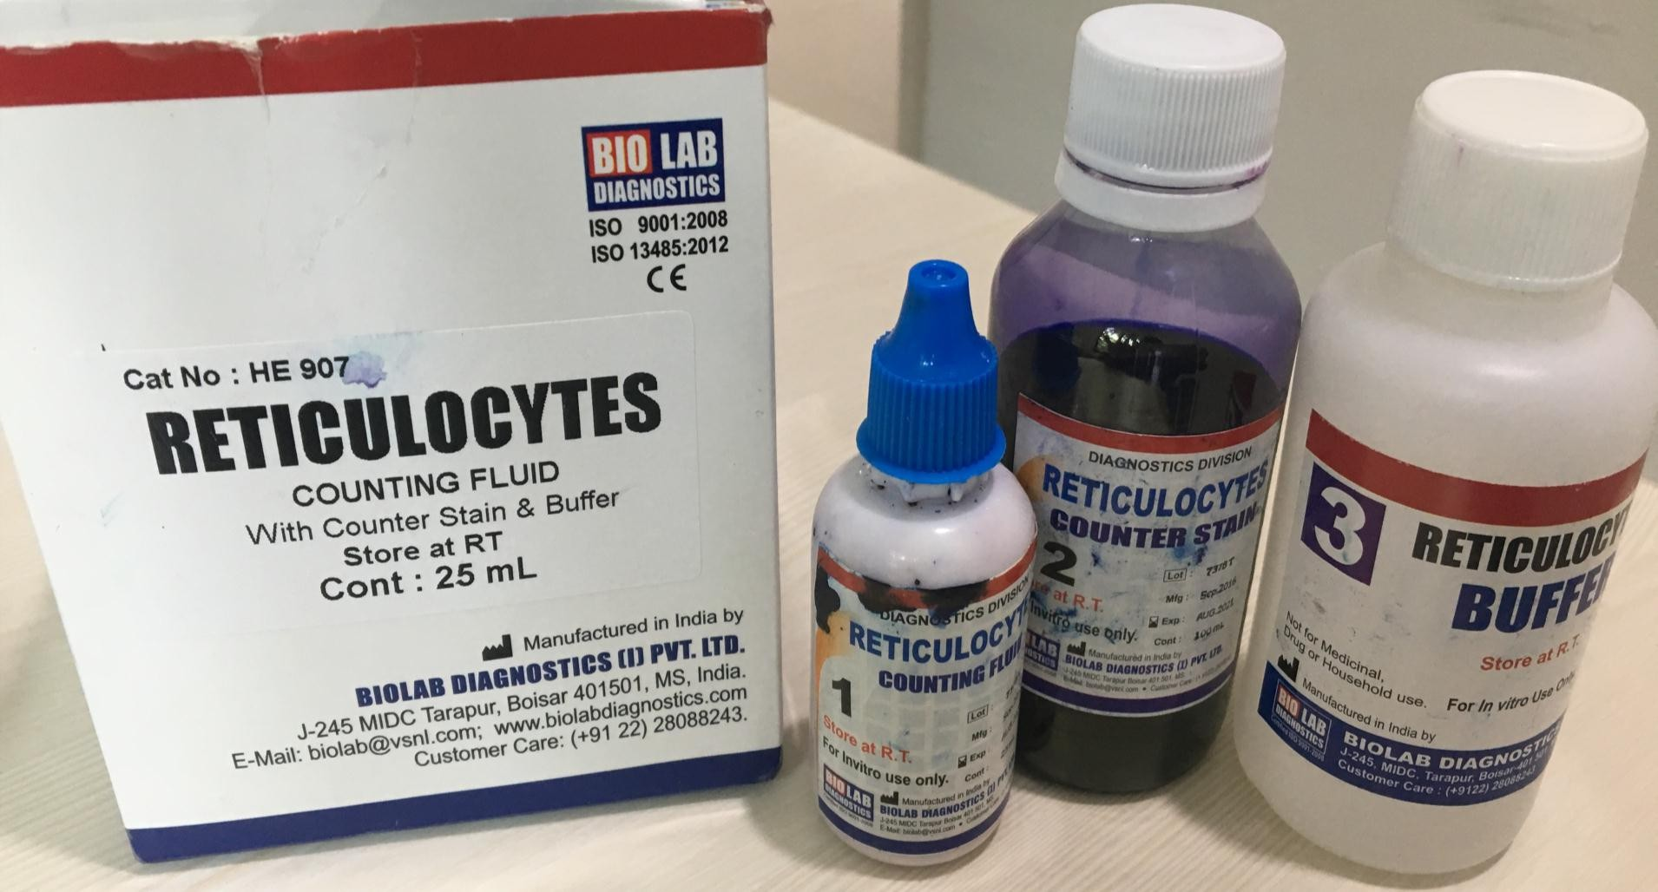
Retic Kits

Slide 7
Procedure
Mix equal quantities of EDTA anticoagulated blood & retic stain
Incubate at 37°C for 15-20mins
Thin smears, dried and observed under oil immersion objectives
Counter stain to avoid rapid fading

Slide 8
To be placed in one of the ocular lenses for reticulocyte counting
B
A

Slide 9
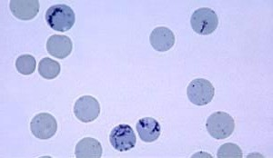
Counting reticulocytes
Choose an area with no RBC overlap or distortion
Cells must contain at least two blue staining particles or one particle linked to a filamentous thread

Slide 10
Average of two results
% Reticulocytes = Number of reticulocytes(A) × 100
1000 (No of RBC's observed)(B)
EXAMPLE: 25 reticulocytes in 1,000 total RBC’s
Reticulocyte count =25 x 100= 2.5%
1000
Normal range: 0.5-1.5%

Slide 11
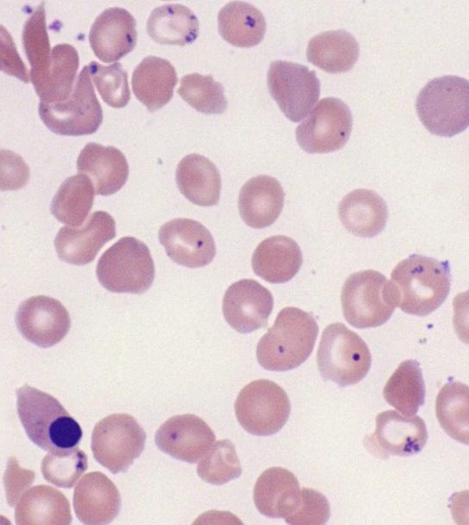
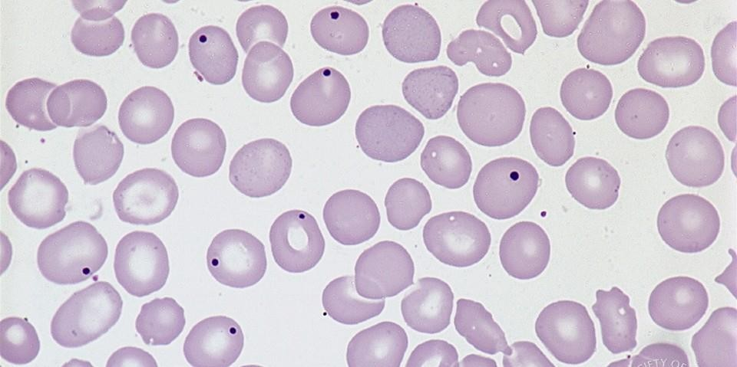
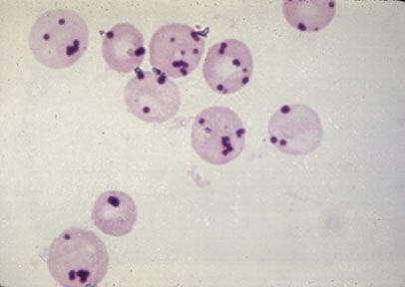
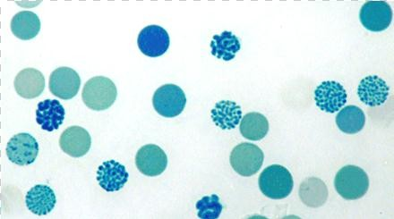
Pappenheimer bodies
Howell-Jolly bodies
Heinz bodies
Hemoglobin H inclusion
Potential errors

Slide 12
Automated Reticulocyte Count
Analyzer | Dye | Technology
ADVIA 2120i | Oxazine 750 | Absorbance
CELL DYN 4000 | CD4K 530 | Fluorescence
SYSMEX | Acridine orange | Fluorescence

Slide 13
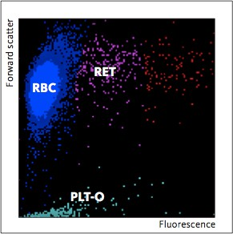
Automated counts
RNA binding dye such as Acridine orange
Rapid, highly reproducible results with low CVs
Gold standard

Slide 14
Implications
Fairly accurate reflection of erythropoietic activity
Anemia workup (peripheral destruction vs failure of production)
Response to therapy (iron, vitamin B-12, folic acid supplementation)
Bone marrow recovery after bone marrow transplantation or intensive chemotherapy

Slide 15
Hemolytic anemia
Nutritional anemia after treatment
Acute and chronic blood loss
Pregnancy

Slide 16
Untreated nutritional anemia
Aplastic anemia
Exposure to radiation or radiation therapy
Chronic infection
Chemotherapy

Slide 17
Reticulocyte index (RI)
Increase in counts may be relative
The reticulocyte percentage may not be a true reflection of reticulocyte production
Correction with reference to normal hematocrit is required

Slide 18
Reticulocyte production index (RPI)
Reticulocyte production index is a factor that is adjusted for both the degree of anemia and the maturation time of reticulocytes

Slide 19
RPI
Helps evaluate erythropoiesis efficiency and thus bone marrow productivity
RPI evaluation | RPI value
Normal | 1
Anemia with adequate response | >3
Anemia with inadequate response | <2

Slide 20
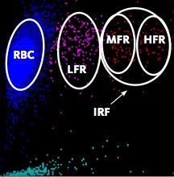
Immature reticulocyte fraction (IRF)
Early marker for evaluating the regeneration of erythropoiesis
Monitoring treatment response
IRF and retic count used as monitoring parameters for bone marrow transplant
Fluorescence

Slide 21
Take home message
Reticulocyte count is a simple, easy to perform and inexpensive test
Along with CBC, reticulocyte count is one of the first tests to be performed while investigating anemia.
Appropriately stained and evenly smeared slide is essential for proper interpretation.
Newer promising parameters.

Slide 22
