Slide 1
PLASTER TECHNIQUES

Slide 2
MATERIALS AVAILABLE FOR PLASTER CAST
Plaster of Paris
Plaster of Paris with melamine
Materials which undergo polymerisation
a. Water activated :- These are materials which are coated onto fabric or glass cloth to form bandages. Contact with water initiates polymerisation so that the bandages set. [ Baycast, scotchcast, crystona ]
b. Non water activated :- The material can be coated onto fabric and be activated by a chemical solvent or by the addition of a catalyst. U.V. light of a wavelength not harmful to eyes , is the activating agent for one photosensitive resin ( Lightcast )
4. Low temperature thermoplastics :- These are inert plastics which become pliable when heated and harden when cooled. These are mouldable but there use restricted to modifying casts or splints rather than re-using the material for different patients.
Among these POP is the most commonly used material for plaster techniques in orthopaedics

Slide 3
Plaster Of Paris- POP
POP has been used since early egyptian times for decorating walls, but it is being used for orthopaedics since the 1800s.
The Term Plaster of Paris originated from an accident to a house built on a deposit of gypsum, near Paris. The house burnt down. When rain fell on baked mud of the floors it was noted that footprints in mud set rock hard.
Casting properties of POP first observed when a house in paris built on gypsum burnt down. It was found after rain fell, that the footprints in the mud were caked upon drying .
Pop bandages were first used in fracture by Antonius Matthysen,A Dutch army surgeon in 1852.

Slide 4
Physiochemical Properties of POP
To make plaster of paris , Gypsum is heated to 120 Degree to drive off water
CaSO4.2H2O 2 ( CaSO4. ½ H2O ) + 3H2O
Gypsum POP
POP is CaSO4.1/2 H2O in its anhydrous form impregnated in gauge which has been pre strengthened with starch or dextrose.
Hydration of POP converts it from powder form to crystalline form which gives rise to caste. This is the process of setting and is an Exothermic reaction.

Slide 5
Setting time :- time taken to change from powder form to crystalline form.
Drying time :- time taken to change from crystalline form to anhydrous form.
Average setting time :- 3-9 minutes
Average drying time :- 24-72 hours
  Factors decreasing setting time :-
  Hot water 2. Salt 3. Borax 4. Resin
Factors increasing setting time :-
  Cold water
  Sugar

Slide 6
Classification
A. Based on :- Pattern of application
Slab- POP Encloses Half Of Circumference
Caste- Pop Encloses Full Circumference Of Limb
Spica – Included Trunk And More Limb
Splintage- Which Can Allow Movement At Adjacent Joint
B. Based on interposition of material
- Unpadded
. No material is interposed b/w POP and skin
. Practiced by Bohler
. Sir Charnley recommended its use in therapy of colle’ s fracture , scaphoid and bennet fracture
- Padded: Interposed material may be stockinette & wool or wool alone, this is in current practice.

Slide 7
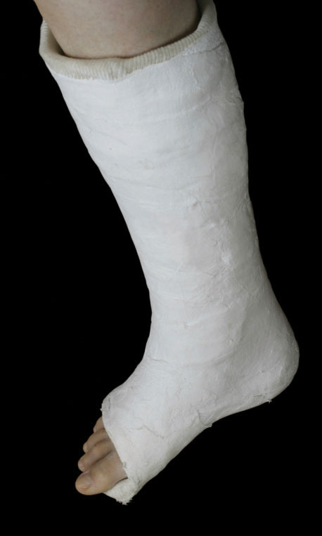
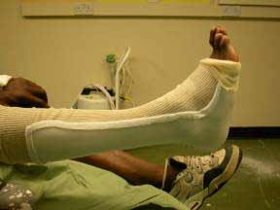
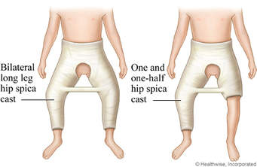

Slide 8
INDICATIONS
To support Fractured bones, controlling movement of the fragments and the damaged tissues
To stabilise & rest joints in ligamentous injury.
Reduced dislocations
To ensure rest of tissue in Musculoskeletal infections.
Deformity correction
Severe soft tissue injury especially across joints
Post tendon repair
To support & immobilise joints and limbs Post operatively to augment internal fixation until healing has occurred
Inflammatory condition

Slide 9
.
ADVANTAGE | DISADVANTAGE
Slower setting Infinitely mouldable when wet Cheap/ cost effective Non allergic Early moulded to different forms | Heavy Messy Significantly weakened if cast is wet Partially radio opaque Radio opaque so may occlude # lines Easily breaks when comes in contact with water

Slide 10
Patient Assessment
The surgeon should examine the limb and fracture site, documenting any skin lesions and neurovascular status
Radiographs should also be reviewed thoroughly to determine fracture pattern
The motions required to adequately reduce the fracture should be rehearsed ahead of commencement of procedure

Slide 11
Rules for guiding pop use
Apply pop one joint above and below
Joint should be immobilized in functional
Padding should be adequate esp. over bony prominences e.g. olecranon, ulnar styloid, fibular head , malleoli,heel
POP should be applied by the surgeon
Procedure requires an assistant
As a guide to appropriate size:
Arm and forearm : 6”
Wrist : 4”
Thumb and fingers: 3”
Thigh and leg: 8”
Ankle and foot: 6”

Slide 12
Rules for guiding POP use
POP shouldn’t be too tight or too loose
The plaster should be of uniform thickness through out
Check neurovascular status after cast application
Do check x-ray for acceptability of reduction

Slide 13
TECHNIQUE
PREPARE INJURED SITE
Fracture is reduced and assistant holds limb in position of function, in a manner that it is unobtrusive to the application
Stockinette is measured , extending 10 cm beyond determined limits of cast, and threaded over limb.
Upper limbs: 2-3” ; lower limbs: 4”
Wool padding is applied gently but snugly, starting from distal to proximal with 50% overlap b/w successive turns , extending 2-3 cm beyond edges of splint
Padding is applied generally in two layers , but may be increased where are bony prominences or if significant swelling is anticipated
Padding size: hand: 2” , Rest of upper limb : 3-4”, foot 3” , rest of lower limb: 4-6”

Slide 14
POP APPLICATION
  POP to be used is dipped completely with both hands into tepid or slightly warm water
  Prior to this , for slabs , the required length is measured and layered. On average 6-10 layers for upper limb and 12-16 layers for lower limb would suffice.
  It is then brought out and lightly squeezed to get rid of excess water.
  If a slab is to be created , the wet plaster is kept on a flat surface and the hand is run from one end to flat another to get rid of air bubbles which may cause slab to be brittle and the layers to separate when dry.

Slide 15
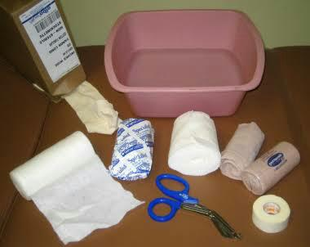
TECHNIQUE
INDICATION MET
MATERIALS
POP Bandage
Crepe bandage
Casting gloves
Basin of water
Padding
Sheets
Stockinette
Adhesive tape

Slide 16
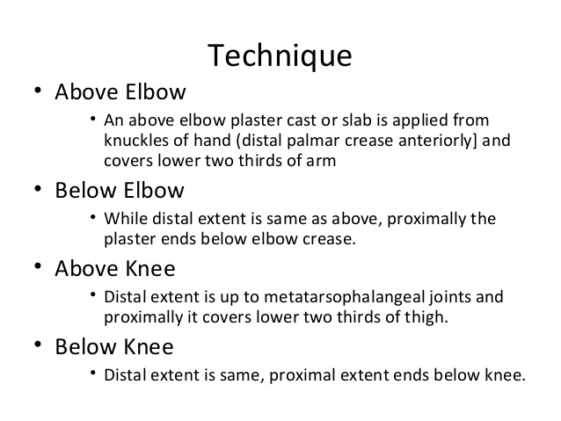

Slide 17
POP Slabs and Cast
Attention:
Examine carefully to accurately diagnose injury and need for immobilization.
Decide whether to use slab or cast If limb very swollen or still swelling — use slab for support until swelling resolves/lessens, to prevent compartment syndrome.
Give pain relief if needed before positioning limb, putting on plaster.

Slide 18
Triple sequence in plaster application
Phase 1: examination and rehearsal
Phase 2: plastering
Phase 3: reduction and holding

Slide 19
Applying
Messy — protect person’s and your own clothes
Starts to set in 3–5 minutes.
Full strength in 24–48 hours, Helper holds limb in place for about 3 minutes, or until plaster cast/slab hard enough to support injury.
Warn person it will feel quite hot as it dries.
Handle plaster bandage with care, wet or dry, or it will be damaged and weak.
Use flat of your hands to shape and smooth plaster.
Do not use your fingers — you will make dents in plaster that press into person's flesh.
Never tip POP waste down drain. Line water container with plastic bag, drain off water after use, throw away waste

Slide 20
Water
Use wide bowls deep enough for plaster bandage to be fully submerged.
Water temperature will affect POP setting time.
Do not use hot water — plaster will set too fast, may cause thermal burns.
Do not use very cold water — plaster will set too slowly.
Use cool water — time to lay and mould plaster before it dries

Slide 21
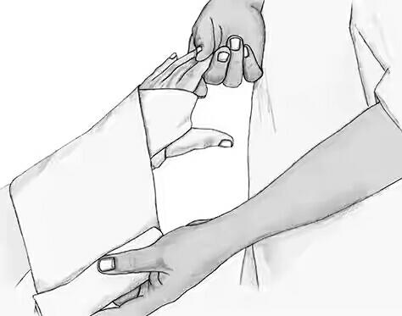
Protecting skin
Put on stockinette
Do not use product containing elastic-it may Loosen or may cut in (constrict), cause swelling
3–5cm longer than area plaster will cover, to fold back over rough ends of plaster
Put on plaster wool:
Lay gently around limb .
Do not pull tight, make creases or ridges.
Each layer should overlap previous by about half.
Usually 2 layers for arm, 3–4 layers for leg
Tear to shape around joints
Use 2 extra layers to protect joints or prominent areas
Bandage 5cm further than area plaster will cover, to fold back over rough ends.
Positioning limb: Make sure limb in right position before you start to plasterMoving limb after cast/slab is on makes creases in plaster that can damage skin, cause pressure areas

Slide 22
PLASTER OF PARIS SLABS
General principles:
Used to immobilize injured limb or suspected fracture during transport, while waiting for x-ray, until swelling lessens
Can be used as main support for soft tissue injuries
These procedures are just some of the basic methods
Application steps:
Stockinette and plaster wool
Slab
Crepe bandage
Attention:
Slabs need to be wide enough to fit around curve of limb like a shallow bowl, but not cover more than ⅔ of limb circumference

Slide 23
Before you wet Plaster Bandage :- Make sure
Right length — allow extra 10% as plaster bandage shrinks when wet
Shaped, e.g. fanned if needed
Person’s limb is in correct position
Remember:
Use flat of your hands to shape and smooth plaster.
Do not use your fingers
Circulation and sensation — after putting on plaster check hands/fingers, feet/toes for color, warmth, sensation, movement, capillary refill, peripheral pulses.If any not normal — take off slab or cast.

Slide 24
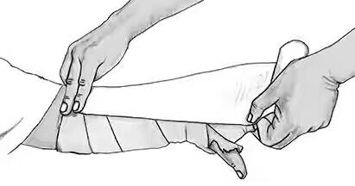
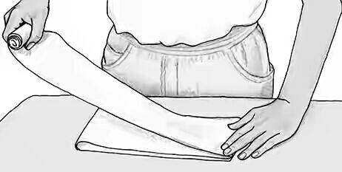
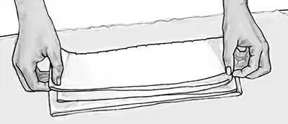
Measuring and cutting Slabs
Measure length of slab with crepe bandage or tape measure
Use uninjured limb if injury very painful
Lay dry plaster bandage on flat surface to measured length, layer backwards and forwards until right number of layers
If plaster bandage not wide enough for limb — layers can be fanned out to widen slab, Weakens slab, so use extra layers

Slide 25
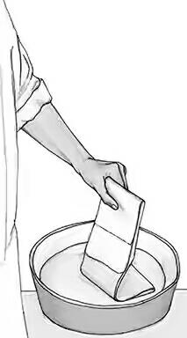
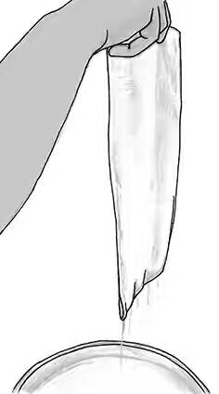
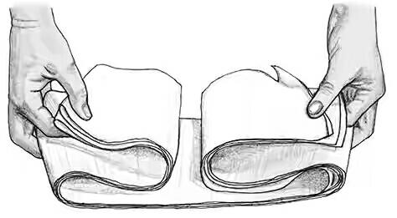
Wetting Slab
Lift slab by holding one looped end, lower into water until whole slab wet
Hold long slabs (eg full leg) in concertina shape so they fit in water bowl
Hold under water until bubbles stop
Lift slab out by holding upright
Run 2 fingers down length to squeeze out excess water

Slide 26
APPLYING
Check position of limb, fingers/toes.
Ask helper to hold, if needed Lay slab. Start at knuckles/wrist/toes (extremities) and go towards body
Use flat of your hands to shape around joints and smooth as you go. Smooth from fingers/hands or toes/feet towards body
Fold ends of stockinette and plaster wool back over ends of slab to protect skin
Bandage around slab and limb with damp crepe bandage to keep slab firmly in place. Bandage from end of limb/slab towards body
Hold limb in correct position for 3 minutes
Put arm in sling, keep leg lifted, e.g. on pillows
Clear away equipment
Check circulation and sensation
If slab being left in place as main treatment — tell person to undo bandage every day and rebandage firmly, or slab will get loose as swelling goes down
Organize specialist review

Slide 27
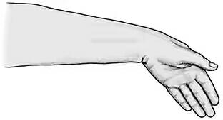
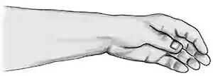
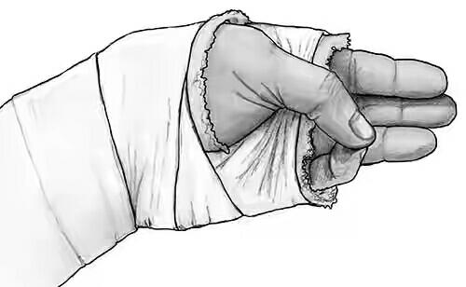
Lower arm slab — radial or universal Used for Colle’s or distal forearm fractures.
Applying
Wet plaster, lay slab on upper forearm from base of knuckles to 3 finger widths below elbow crease
Displaced Colle’s — ulna deviation and wrist flexion
Undisplaced Colle’s — neutral position (10° wrist extension)
Use flat of your hands to shape and smooth as you go, over wrist and up arm.
Thumb joint moves freely — thumb and little finger can touch.
Metacarpophalangeal joints have full 90° flexion

Slide 28
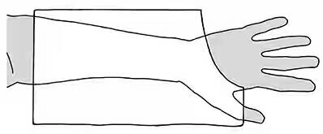
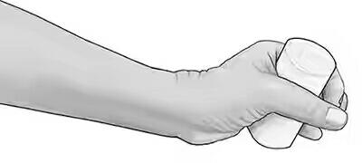
Lower arm Slab- Scaphoid
Used for fracture of scaphoid bone or first metacarpal that hasn't moved out of alignment (not displaced).Used for soft tissue injury to/around thumb.
What you do? Preparation :-
Person sits in comfortable chair or lies on examination couch, with arm as straight as possible
Put on stockinette and plaster wool — around thumb, across palm to middle of elbow
Put 2 extra layers of wool around thumb
Measure inside of arm from center of palm to 3 finger widths below crease of elbow — elbow joint must move freely
Make slab and cut to fit around thumb and clear knuckles — echidna template —Put arm and hand/fingers in line

Slide 29
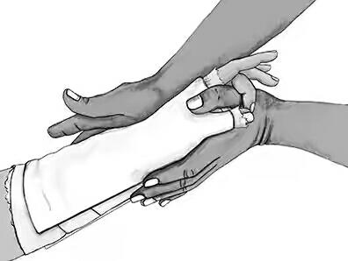
Applying :
Wet plaster, lay slab along thumb (radial) side of arm from just below middle joint of thumb and Centre of back of hand to 3 finger widths below elbow crease
Slight radial deviation, 20° wrist extension, thumb forward— Glass holding position.
Use flat of your hands to shape and smooth as you go, around thumb and up arm
Joint at base of thumb shouldn't move, but middle joint is free
Thumb and middle finger should just meet. Like holding a pen

Slide 30
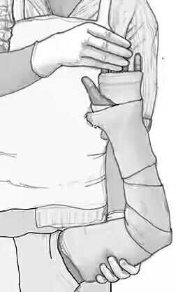
Full Arm Slab
Used for fracture of middle and proximal thirds of radius or ulnar or lower humerus that hasn't moved out of alignment (not displaced).
What you do ? Preparation:-
Person sits in comfortable chair.
Get helper to hold person’s elbow at 90°, fingers in air, in ‘nose thumbing’ position.
Put on stockinette and plaster wool — from fingers to 3 finger widths below armpit, and another layer of wool from tips of fingers to elbow
Put extra layer of wool around elbow
Put 2 extra layers of wool around wrist.
Measure from centre of palm, around outside of elbow, to 3 finger widths below armpit.

Slide 31
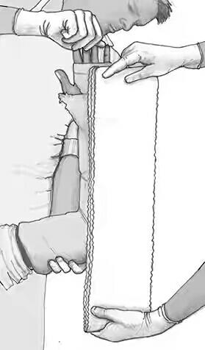
Make slab. Cut area for thumb, then cut longways slit half way up slab — elephant with 'legs' template

Slide 32
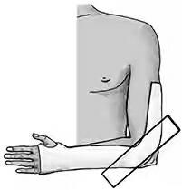
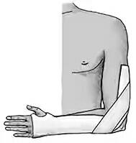
Applying
Wet slab, lay it starting at back of hand, opposite palmar crease
Shape end strips on either side of elbow. Make sure there is no plaster on elbow, ends don't meet
Use flat of your hands to shape and smooth as you go, over wrist and up towards armpit
Make reinforcing strip (5 layers thick) by measuring from mid forearm to mid upper arm. Apply as shown
Do not have plaster across elbow
Fold stockinette and plaster wool back over ends of plaster.
Bandage around slab with damp crepe bandage
Hold correct position for 3 minutes
Clear away equipment
Check circulation and sensation

Slide 33
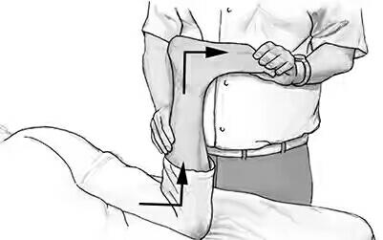
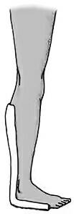
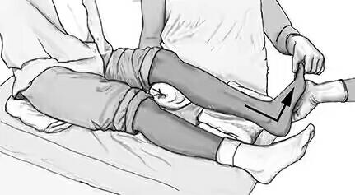
LOWER LEG SLAB
Used for soft tissue injuries to lower leg or foot.
What you do ?
Preparation: Person lies on bed on stomach with knee and ankle flexed (bent) to 90°
OR
Person sits up or lies back with injured foot over edge of bed and ankle flexed to 90°.
Use rolled towel to flex knee slightly (15–20°) on injured side
Used for fracture of distal tibia, fibula, tarsus or proximal metatarsals that hasn't moved out of alignment (not displaced)

Slide 34
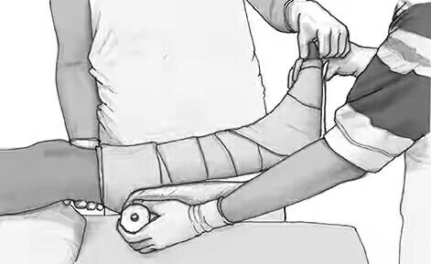
Put on stockinette and plaster wool — from tip of toes to middle of knee
Put 2 extra layers around ankle
Measure back of leg from base of toes to 3 finger widths below base of knee
Make slab. Fan plaster if legs large, or only narrow plaster rolls available
Check ankle at 90°

Slide 35
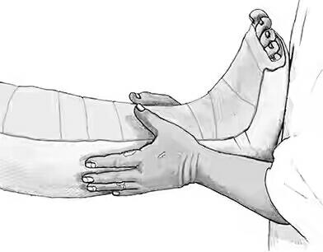
Applying
Wet plaster slab, lay on back of leg from bottom of toes to 3 finger widths below base of knee
Use flat of your hands to shape and smooth as you go, over ankle and up leg
Make sure slab isn’t cutting into toe creases
Fold stockinette and plaster wool back over ends of plaster
Bandage around slab with damp crepe bandage
Hold in position for 3 minutes. Make sure ankle kept at 90°Clear away equipment
Check circulation and sensation
Organise crutches
Get advice from plaster technician on how to make walking heels or plaster shoes suitable for out bush

Slide 36
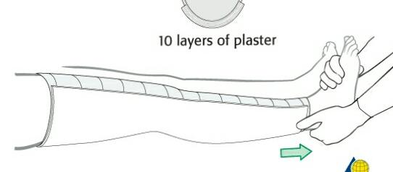
FULL LEG SLAB
Used for fractures of upper leg or knee
Attention
Leg must be set in alignment
Line up (align) from space between big and second toe, to middle of knee cap (patella), to hip bone (iliac crest)
Helper should watch to make sure this line is kept while you apply plaster

Slide 37
What you do ? Preparation:
Position person for lower leg slab first
Person lies on bed on stomach with knee and ankle bent to 90° (easier) OR Person sits or lies with injured foot over edge of bed, ankle flexed to 90°.
Use rolled towel to flex knee on injured side slightly (15–20°)
Helper needs to support ankle while lower leg slab applied, and leg while thigh slab applied
Put on stockinette and plaster wool — from tips of toes to groin
Put 2 extra layers around ankle, knee, head of fibula
Make slab in 2 halves

Slide 38
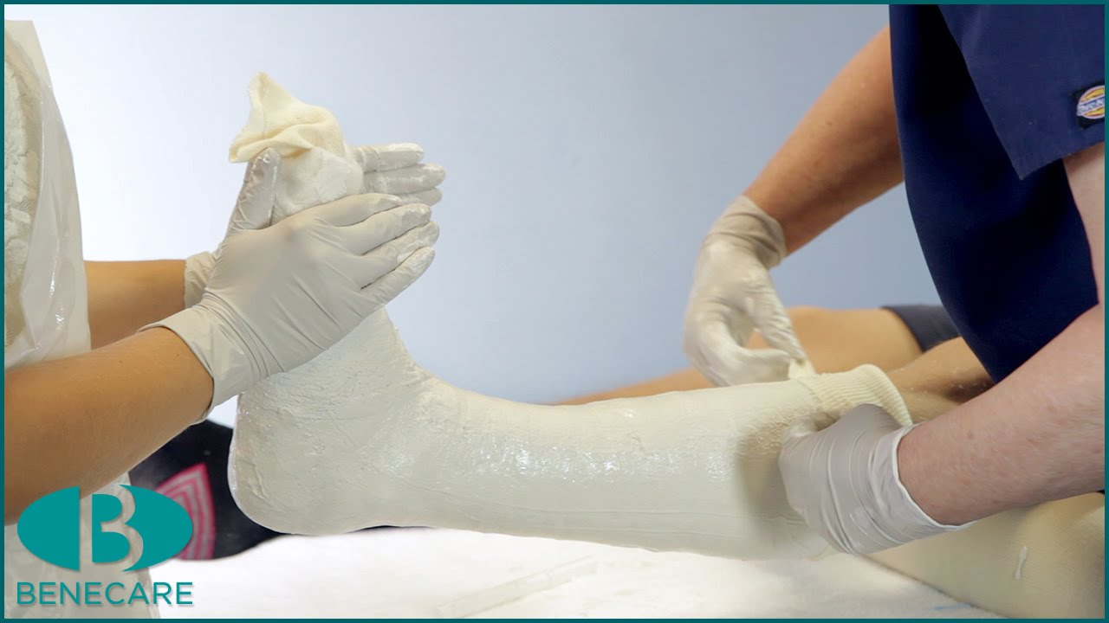
Lower leg slab —
Trim end to match slope of toes
Thigh slab — overlap lower leg slab from mid calf, extend to buttock crease.
Make sure it won’t cut into groin area
Use 10 layers of plaster.
Fan plaster if large leg, or using narrow plaster rolls

Slide 39
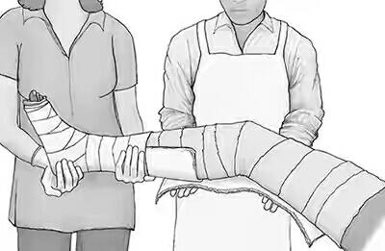
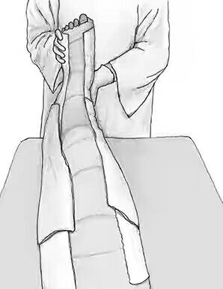
Applying
Check alignment of leg
Apply lower leg slabApply 10cm plaster as a stirrup across mid sole and up sides of slab to reinforce it against ankle flexion
Bandage around lower leg slab with single layer of crepe bandage, leave top half of calf bare to attach thigh slab
Have person on their back, knee bent slightly in 15–20° flexionWet thigh slab, apply to back of leg overlapping lower leg slab
Use flat of your hands to shape and smooth as you go, under knee and up towards body.
Make sure slab isn’t cutting into groin
To reinforce cast, apply 2 plaster strips (5 layers thick) to inside and outside of cast from mid-calf to mid-thigh
Fold stockinette and plaster wool back over ends of plaster
Bandage around both slabs with damp crepe bandages
Rest on pillows until plaster set — no pressure on heel (so plaster not indented), ankle at 90°, knee in 15–20° flexion

Slide 40
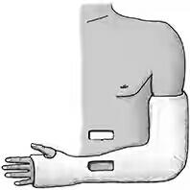
PLASTAR OF PARIS CASTE
General principles:- Used to hold broken bone still while it heals.
Do not put cast on until after broken bone seen on x-ray and checked by specialist, swelling has gone down.
Attention
Casts usually left on for 6–10 weeks.
Need to be strong and well made to last this long
Position limb carefully before putting on plaster
Helper must hold limb without pressing fingers into plaster
Work quickly so there is time to would plaster before critical setting period If wound under plaster cast that needs dressing — use plaster saw to cut window in plaster when it is dry.

Slide 41
What you need ?
Helper
Plastic apron
Blueys or plastic covers
Bucket/bowl lined with plastic bag and filled with cool water
Stockinette — big enough to fit loosely over limbPlaster wool — size and amount depends on limb
Main cast usually made using 6–8 layers of plaster
Short arm — 2 rolls of 7.5 or 10cm bandage
Long arm — 3 rolls of 7.5 or 10cm bandage
Below knee, non weight-bearing — 3 rolls of 10cm bandage
Below knee, weight-bearing — 4 rolls of 10cm and 1 roll of 7.5 cm bandage
Full leg — 6–8 rolls of 10cm bandag
Amounts vary depending on size of person’s limbs.
5. Do not have extra plaster around fracture or middle of cast.
6. Avoid laying down layers of plaster bandage directly on top of each other
7. Reinforce casts where they cross joints by adding plaster strips length ways along outside
Circulation and sensation — after putting on plaster check hands/fingers, feet/toes for colour, warmth, sensation, movement, capillary refill, peripheral pulses — F 10.1. If any not normal — take off slab or cast.

Slide 42
What you do ?
Preparation :-
Cover area around work site with blueys/plastic, put water nearby
Put stockinette loosely over whole area to be plastered and cut 3–5cm longer so it can be folded back over each end of cast
Put on plaster wool over stockinette
Get helper to hold and support limb
Dip plaster rolls in water on end — allows air to escape, allows complete soaking of plaster. Bandages ready when bubbling stops
Dip and remove all rolls of plaster from water at same time
Check position of limb

Slide 43
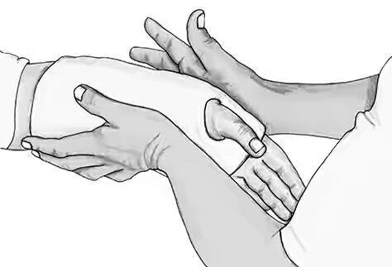
Applying
Start bandage from hand/foot, move up arm/leg towards body.
Bandage from inside to outside of limb with uniform thickness
Lay bandage down evenly by letting it roll onto limb
Do not pull or wrap tightly. Tight cast can cause swelling of fingers/toes and cut off blood/nerve supply
Overlap as you do in normal bandaging
Use flat of your hands to smooth and shape around joints, get a firm flat finish as you go.
Smooth each roll before starting a new one
Smooth from fingers/hand or toes/foot towards body
Do not crease POP. Creases can make cast too tight, cut off blood/nerve supply

Slide 44
Always tell person:-
Come straight back to clinic if pain gets worse, swelling or blueness of fingers/ toes, plaster feels too tight or too loose.
Cast needs to be removed
Do not put any weight on cast for at least 48 hours, and then only very light pressure
Do not put things down cast to scratch
Do not pull out padding
Do not get cast wet, knock or damage it
Put arm in sling, or tell person to keep leg lifted and resting on pillows when they get home
Organise crutches if needed
Record in file notes — type of cast, material used, modifications to cast, instructions given, if crutches given, date of next appointment

Slide 45
Instructions to patient in a plaster cast
Important :-
Report back to the hospital immediately at any time of the day or night if
You get increased pain, or pins and needles in the plastered limb
Your finger or toes become blue, white, badly swollen or numb
You are unable to move your fingers or toes.
you loose any object, such as a coin or pencil, under the plaster
Do not rest the plaster cast on a firm surface.
Do not hang the splinted limb down unless the limb is in active use.
Use the splinted limb as much as possible :- move your fingers and toes, and all other joints not immobilized by the plaster cast, a number of times every hour
Keep the plaster cast dry.
Report back to the hospital if the plaster cast becomes loose, cracked or soft

Slide 46
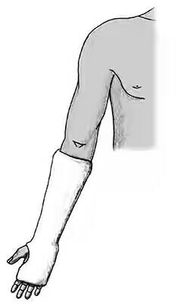
LOWER ARM CAST
What you do ?
Preparation:-
Person sits in comfortable chair, arm supported in normal position
Put on loose stockinette from middle of fingers to elbow. Make hole for thumb
Put on plaster wool — from middle of palm to 3 finger widths below elbow crease.
Tear hole for thumb, or cover thumb for scaphoid fracture
Put 2 extra layers around wristCheck hand and limb position
Used for Colles, scaphoid, distal forearm fractures

Slide 47
Applying :-
Wet 7.5cm plaster roll/s (1–2 rolls needed)
Start plastering at wrist, using bandaging a hand
To tidy thumb area, except for scaphoid fracture — bandage twice through space between thumb and finger, fold back stockinette, bandage twice more over the top of it
Keep plastering up arm to 3 finger widths below elbow crease
Use flat of your hands to shape and smooth as you go, over wrist and up arm
Thumb joint should move freely — except scaphoid fractureFor scaphoid fracture plaster thumb in placeShape hand into right position for fracture type
Colle’s Displaced — ulna deviation, wrist flexion
Colle’s Undisplaced — neutral position (10° wrist extension)
Thumb joint should move freely — thumb and little finger can touch Metacarpophalangeal joints have full 90° flexion

Slide 48
SCAPHOID
Slight radial deviation, 20° wrist extension, thumb forward.
Glass holding position
Joint at base of thumb shouldn't move, but middle joint is free
Thumb and middle finger should just meet. Like holding a pen
Fold stockinette and plaster wool back over ends of plaster
Hold in position for 3 minutes
Clear away equipment
Check circulation and sensation

Slide 49
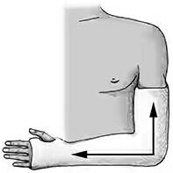
Full Arm Cast
Used for fractures of proximal forearm or mid-forearm.
Attention:-
Make sure thumb joint can move around fully (rotate) when wrist is plastered
Apply cast as high as possible without digging into armpit
What you do
Preparation:-
Person sits in comfortable chair with elbow bent to 90°
If fracture close to elbow — palm facing upwards
If fracture in mid-forearm — palm facing body
Put on loose stockinette from tips of fingers to top of shoulder.
Make hole for thumb
Put on plaster wool — from base of fingers to armpit, tear hole for thumb
Put 2 extra layers around wrist and elbow
Check arm and hand in correct position

Slide 50
Applying:-
Wet 7.5cm plaster rolls (3–5 rolls needed)
Apply lower arm castCheck elbow bent to 90°, get helper to hold still
Using 1–2 more 7.5cm plaster rolls, start plastering again from wrist, continue up to 7cm below top of arm, as high as comfortable
Plaster around elbow using bandaging an elbow technique
Use flat of your hands to shape and smooth as you go, over wrist and elbow, up arm
To strengthen elbow area, make 10cm slab of plaster 5 layers thick and put it over cast already there
Smooth down but be careful not to press or crease plaster
Using 1 more 7.5cm plaster roll, bandage again from wrist over elbow slab and up to where plaster finishes
Fold stockinette and plaster wool back over ends of plasterHold in position for 3–4 minutesClear away equipment
Check circulation and sensation

Slide 51
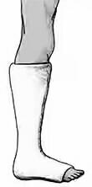
Lower Leg Cast
Used for fractures of lower leg, ankle, foot
Attention:-
Make all these casts ‘walkers’ as most people will try to walk with them
Get advice from plaster technician on how to make walking heels or plaster shoes suitable for out bush10.86
What you do?
Preparation
Person lies back on bed with pillow under knee on injured side
Ankle should be bent (flexed) to 90° and held by helper
Put on loose stockinette from tip of toes to middle of knee
Put on plaster wool over stockinette
Put 2 extra layers around ankle
Stand at end of bed and put person’s foot on your stomach to support it and keep 90° bend at ankle

Slide 52
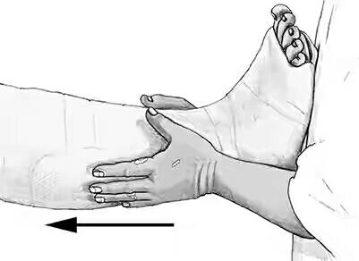
Applying
Wet 10cm plaster rolls (2–3 rolls needed)
Plaster from bottom of toes to 3 finger widths below knee (tibial tuberosity)
Use figure of 8 bandaging around ankle
Knee joint should move freely
Make sure slab isn’t cutting into toe creases or covering little toe
Keep going until all rolls are used
Use flat of your hands to shape and smooth as you go, over ankle and up leg
Fold stockinette and plaster wool back over ends of plaster
Hold in position for 3 minutes

Slide 53

Below Knee Walking Cast
Make slab from 10 layers of 10cm plaster bandage.
Apply to cast along sole of foot from base of toes to just past heel
Wrap 1 roll of 10cm plaster in figure of 8 fashion over this slab
Clear away equipment
Check circulation and sensation
Organise crutches

Slide 54
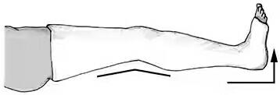
FULL LEG CAST
Used for fractures of bones in upper leg and knee.
Attention:-
Leg must be set in alignment
Line up (align) from space between big and second toe, to middle of kneecap (patella), to hip bone (iliac crest)
Helper watches to make sure this line is kept while you apply plaster
Always plaster as high up leg as you can without digging into groin to stop any twisting (rotation) of limb
Knee usually bent (flexed) at 20° but may vary with different injuries
Helper should stand at side of person’s injured leg to start with and then move to end of bed. Do not drop leg
Rest cast on pillows for 48 hours to dry properly, or it will crack. No weight-bearing

Slide 55
What you do ?
Preparation:
Put person in correct position on bed
Put pillows behind their back, under buttock and thigh of good leg
Put pillows under knee and ankle of injured leg
Foot on injured side should hang about 5cm over end of bed
Helper should stand on injured side holding person’s toes
Cut enough stockinette to cover whole leg plus 12cms
Take out ankle pillow and pull loose stockinette over leg as far as knee, leaving 8cm over toes for assistant to hold
While you support leg and foot, helper moves to end of bed to support person’s foot.
Put foot on helper’s chest so it can’t drop, or knee straighten
Take away knee pillow and pull stockinette up to groinPut on plaster wool — from toes to groin
Put 2 extra layers around ankle and knee
Put knee pillow backHold knee bent (flexed) at 20° and ankle at 90° with helper supporting

Slide 56
APPLYING
Wet 10cm plaster rolls (4–6 rolls needed)
Plaster from bottom of toes to centre of calf
Use figure of 8 bandaging technique around ankle
Make sure cast isn’t cutting into toe creases or covering little toe,Use 2–3 rolls
Use flat of your hands to shape and smooth as you go, over ankle and up leg
Take away knee pillow
Bandage over first plaster, starting at ankle and working over knee to top of leg
Use technique for bandaging a knee over knee, Use 2–3 rolls
Use flat of your hands to shape and smooth as you go, over ankle and knee, up leg towards groin
Fold stockinette and plaster wool back over ends of plaster
Put knee and ankle pillows back and rest cast for 10 minutes
Clear away equipment, Check circulation and sensation.Organise crutches

Slide 57
Hip Spica cast
A hip spica cast is a sort of orthopedic cast used to immobilize the hip or thigh. It is used to facilitate healing of injured hip joints or of fractured femurs.
Hip spica includes the trunk of the body and one or both legs.
A hip spica which covers only one leg to the ankle or foot may be referred to as a single hip spica, while one which covers both legs is called a double hip spica.
A one-and-a-half hip spica encases one leg to the ankle or foot and the other to just above the knee.
Contraindications :- -
-unacceptable shortening or angulation;
-open fractures;
-thoracic or intra-abdominal trauma;
-large or obese children (inability for parents to care for child);

Slide 58
Position of Hip Spica
Place affected thigh in 10 deg of abduction or in neutral position w/ opposite hip in moderate abduction to facilitate perineal hygiene;
To decrease muscle forces & to minimize amount of shortening, place the lower extremity in the relaxed position;
- w/ hip flexion, abduction, external rotation & knee flexion;
- common mistake is to place the fractured thigh in marked abduction w/ resulting lateral bowing due to the pull of strong adductors;
Consider placing the limb in the correct position before application of spica;
- proximal 1/3 frx:
- hip flexion : 45 deg
- hip abduction: 30 deg
- ext rotation: 20 deg
- mid shaft fractures:
- hip flexion: 30 deg
- hip abduction: 20 deg
- ext rotation: 15 deg
- distal 1/3 frx:
- hip flexion: 20 deg
- hip abduction: 20 deg
- ext rotation: 15 deg

Slide 59
Technique
Padding:
  Place a folded towel on the anterior thorax and abdomen and apply all padding and casting material over this towel
  Following cast application the towel is removed;
  This will create space between the cast and the thorax/abdomen and will avoid cast tightness and difficult w/ breathing;
  Using this technique, it is not necessary to window the abdomen of the cast;
  Its useful to place 2 layers of body stockinette over the patient's torso to ensure that the cast padding can be pulled up over the edges of the cast;
  Soft roll is preferable to cotton roll (soft roll can be cleaned if it gets soiled);
  Soft roll is placed, w/ care to evenly spread the cotton across the back and buttocks (including sacrum);
  A thick belt of felt is taped across the chest, just below the nipple line
  A second felt belt is fashioned to cover the sacrum, PSIS, and ASIS;

Slide 60
Reduction
Prior to cast application, use flouro to help determine the optimal position for reduction;
Distal femoral traction pin is inserted if fracture needs to be brought out to length;
Apply the cast, but apply minimal cast material around the injured thigh;
Once the cast is hard, bring in flouro and determine if the reduction is adequate;
If the reduction is not adequate, then circumferentially cut the cast at the level of the frx;
Then re-reduce the fracture under flouroscopic control;
Once the reduction is adequate, have an assistant quickly apply more casting material while the thigh is held in the reduced position.

Slide 61
cast re-enforcement:
Cast Care:
Apply a "broom stick" between the thighs and apply cast material over this, inorder to strengthen the cast and prevent cast breakdown at the hip joint;
Goretex liner allows the child and the cast to be washed;
A panty shield napkin can be applied to the perineum to prevent soiling of the cast;
Child is seen every 2 weeks for evidence of skin break down

Slide 62
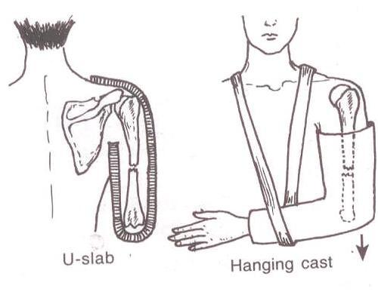
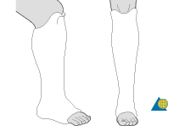
Special slabs and cast
Upper limb :- u slab/cast, cylinder slab cast, hanging cast
Lower limb :- PTB Weight bearing cast
Body cast :- to support/ immobilize the spine

Slide 63
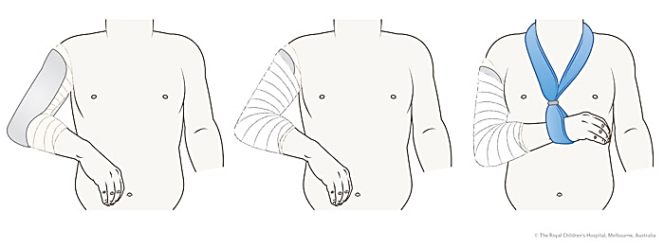
‘U’ SLAB
Middle third fractures of the humeral shaft are managed with a collar and cuff. Occasionally a hanging U-slab plaster of Paris (POP) is required. If a radial nerve injury is present, active manipulation is not recommended.
Humeral shaft fractures should be referred to fracture clinic at 1 week.
Healing generally takes 4-6 weeks depending on the age of the child, to reach a point when active mobilization will be commenced

Slide 64
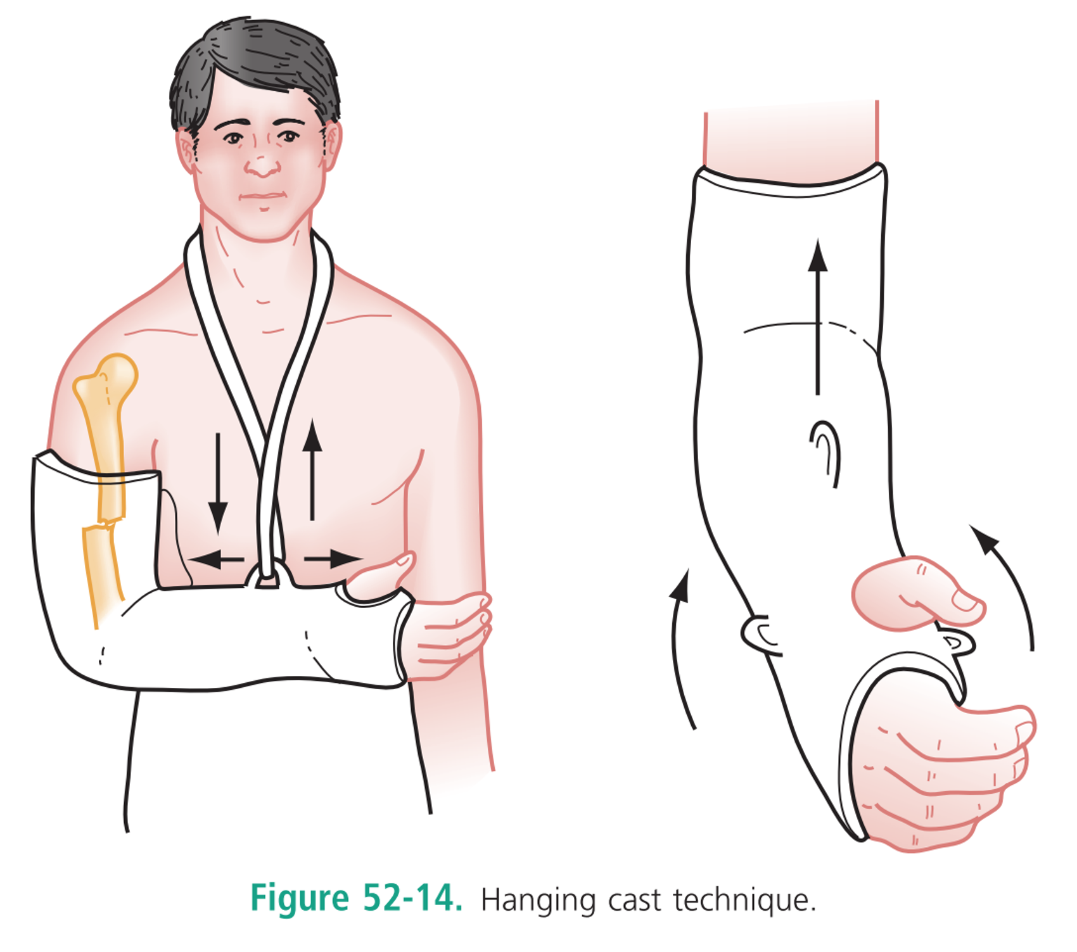
HANGING CAST
Caldwell (1933)
-used for displace frx of the humeral shaft with shortening, and also for oblique and spiral fractures;
Used for comminuted humeral frx
Distal humeral shaft frx
Cast must be light wt. And must extend from at least 1 inch proximal to the fracture site to wrist, w/ elbow at right angle & forearm in neutral rotation
Arm must lie dependent to provide a traction force;
Patient must sleep erect or semi-erect to avoid supporting elbow when seated;
Erect position is maintained during the day as much as possible;
There should be no support under the elbow, and nothing should compress the arm against the body (such as clothing);
Indications

Slide 65
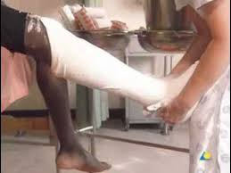
PATELLA TENDON BEARING CAST
A Sarmiento or patella tendon bearing cast (or PTB) is usually applied as the last stage of treatment for tibia fractures.
At 4-6 weeks post injury, the long leg cast is removed and a Sarmiento cast is applied.
The PTB is not suitable for proximal tibial fractures, but is a good conservative method of treating stable tibial fractures from the middle third downwards.
The principle of tibial PTB casting is the same as for the femoral cast brace. A well fitting below knee cast is applied and molded between the gastrocnemius heads. The actual weight is born on the patellar tendon region anteriorly. A rubber heel is applied and the patient is encouraged to weight-bear on the plaster.

Slide 66
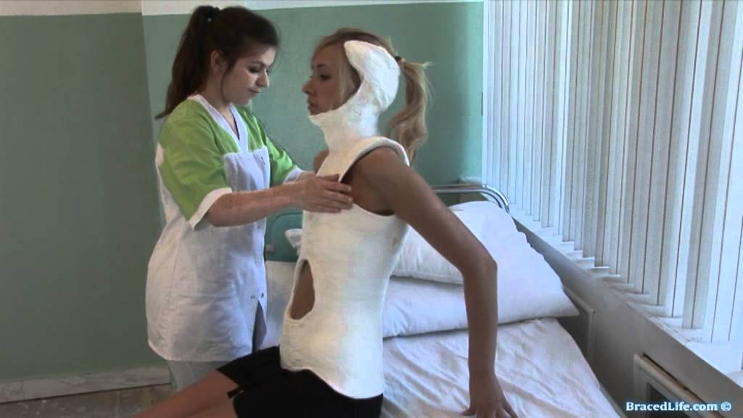
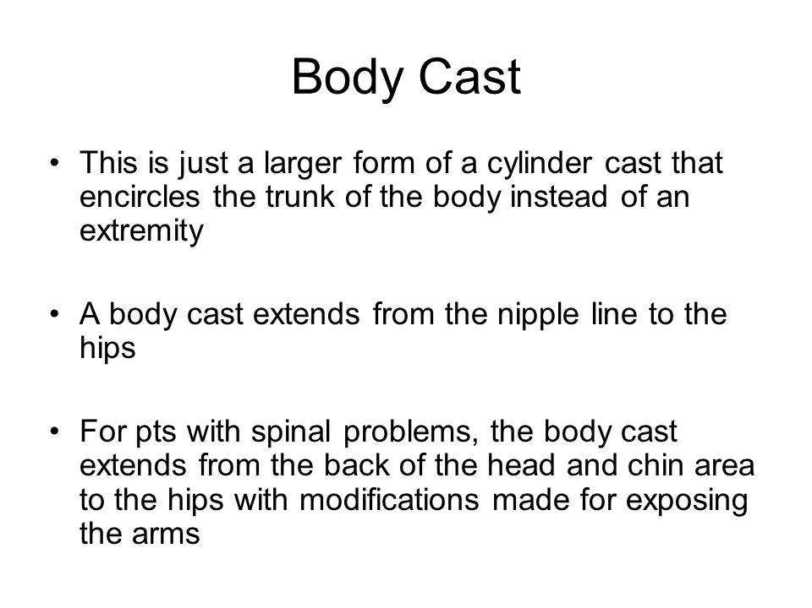
Body cast
It is used for a stable burst fracture of vertebrae.
In general, a stable burst fracture is one in which there is no neurologic injury, in which the angulation of the spine is less than 20 degrees and in which the amount of spinal canal compromise is less than 50 percent. In these patients, treatment with a brace may lead to an excellent result.
In general a molded turtle shell type brace (TLSO) or a body cast is required for the treatment of a burst fracture.
This brace is usually worn for eight to twelve weeks in order to ensure adequate healing.

