Slide 1
Basic
atology course
A Map
By: Karim El-ghanam
0ł0689S0053

Slide 2
ILOS
1. Why !
z. Job Description.
. How to deal with your team.
zt. Component of NICU
. Road map for most common cases.
6. What do you need to learn to be qualified.
7 History taking.

Slide 3
Money :D :D

Slide 4
Doctors are not poor !

Slide 7
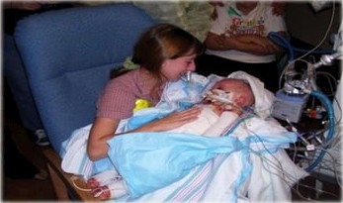
There is No Precious baby, All Babies are precious .

Slide 8
Job Description

Slide 9
You are a neonatologist resident !

Slide 10
1- Your consultant eyes !
z- Follow the instruction.
- Emergency situations.

Slide 11
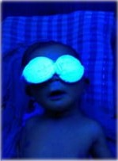
1- Your consultant eyes !
Good, Full detailed description of the cases !
Read More And More

Slide 12
2 Follow the instruction.

Slide 13
3- Emergency situations.
Medical Emergencies according to each case:
Arrest
Cyanosis
Convulsion
Hemorrhage ... etc.
New cases admission.

Slide 15
2- Communication with your team

Slide 16
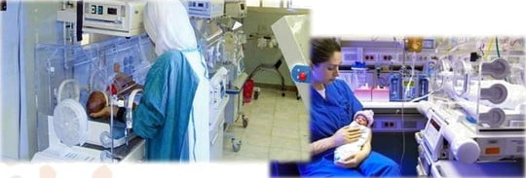
1- Nurses

Slide 17
2- Doctors

Slide 18
3- Consultant

Slide 19
Relatives

Slide 20
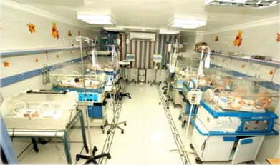
Components Of NICU

Slide 22
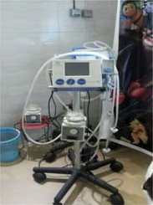
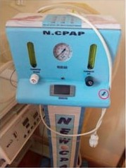
Ventilator
CPAP

Slide 23
!Suction .3

Slide 24
Most Common Cases

Slide 25
I. Respiratory distress.
II. Neonatal jaundice. III.Neonatal Sepsis IV.Pre-term.
Hemorrhagic diseases.
CNS problems.
Pre and post -operative cases.
.. Etc.

Slide 26
1- Respiratory Distress (RD)

Slide 27
Pulmonary Hypertension

Slide 29
1.Downs' score
Oxygen toxicity
Chronic lung ( Bronco-pulmonary dysplasia )

Slide 30
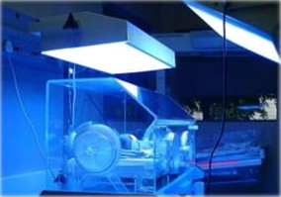
2- Neonatal Jaundice (NJ)
DD?
Specific cause?
General condition?
Levels of TTT?
Pathophysiology?

Slide 31
3- Neonatal Convulsions.
Hemorrhagic disease of the newborn.
Necrotizing enterocolitis (NEC)

Slide 32
Neonatal Sepsis
Early signs of Sepsis
ABs Regimen
Infection control
CRP

Slide 33
Complementary Topics
Fluid Balance. Drugs.
Feeding.
Normal values of:
- Blood pressure
— BIDod sugar
- Temperature
Infection control.

Slide 34
Complementary Topics
Interpretation of CBC
Interpretation of ABG
Reading X-Ray

Slide 35
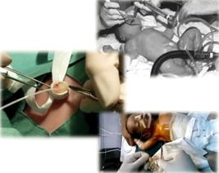
Procedures
Endotracheal tube (ET).
Chest butterfly.
Chest cannula.
Umbilical catheter.
Chest tube.
Blood Exchange.

Slide 36
History taking

Slide 37
1. Name: Mother name
Medico-legal !
2. Sex:
Male, Female or ambiguous genitalia!
Medico-lega! !

Slide 38
3. Sibling:
- History of other siblings.
- lUFU
- i\tetaboTic. gcnew ie diseases
Precious baby or not?
Similar condition
Mother experience !

Slide 39
4. Consanguinity :
For congenital abnormalities.
Degree of consangufn\ty.
Mode of delivery? NVD or CS
Full term, NT or preterm.
Calculation of the gestational age.
Ballard Maturational Assessment

Slide 40
7. Age of the Baby:
Jaundice
Maternal risk factors: ..
Parent history:
- Name:
Blood group:

Slide 41
5. Mode of delivery? NVD or CS

Slide 42
8. Maternal risk factors:
z- Maternal age:
less than 18 years or more than 35 years old
2- Socio-demographic factors:
Low educational status
Cigarette smoking
Drug addiction
Poor nutrition
PovertY
3- Obstetric factors:
Previous cesarean section
Multiple pregnancies
Prior infertility
Blood transfusion

Slide 43
8. Maternal risk factors:
§- Medical conditions:
Diabetes mellitus
Hypertension
Pregnancy induced hypertension {PIH)
Pre-eclamsia
Congenital heart disease
Auto-immune diseases
Infections

Slide 44
Referral Reports

Slide 45
Thanks
Hope Happiness finds you every
where !

