Slide 1


Sigma Matrix and 6 Sigma
Dr. Bubul Kalita
Post Graduate Resident
Department of Biochemistry
Gandhi Medical College, Bhopal

Slide 2

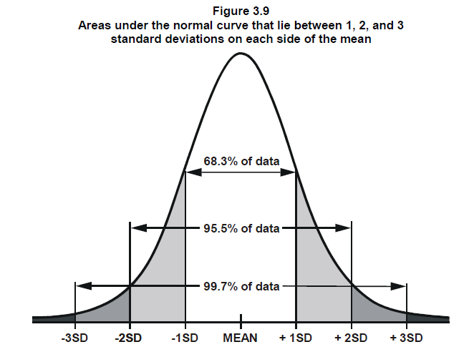
What is Six sigma?
Six sigma is a statistical approach to reduce variations (defects) in order to “Increase effectiveness”.
Sigma (σ) – Standard Deviation
Six sigma = 99.99967% effectiveness

Slide 3
More than 50% defect rate <<< sigma will be negative
-1
0
1
2
3
4
5
6
31.6%
3.4 DPMO
50% Defect rate
If defect reduces>>>>>>>> Sigma level increases

Slide 4
Lean
Lean is identification and elimination of waste from the process to “Increase Efficiency” without compromizing on the quality.
Example: Biomedical waste management

Slide 5



History of Six Sigma
TOYOTA MOTORS
MOTOROLA >>>>> 1986
CEO: Bob Galvin
Bill Smith
(Father of Six Sigma)
Dr. Mikel Harry
Dr. Mikel Harry started the first six sigma academy in 1996

Slide 6

General Electric (GE): 1995
He implemented 6 sigma in 5 different stages:
D (Define) : Selection of the right problem.
M (Measure): Collecting reliable data.
A (Analyze): To analyze Statistically to find the root cause.
I (Improve) : strategies to improve the problrm.
C (Control): Sustain the improvement.
D M A I C
CEO: Jack Welch

Slide 7
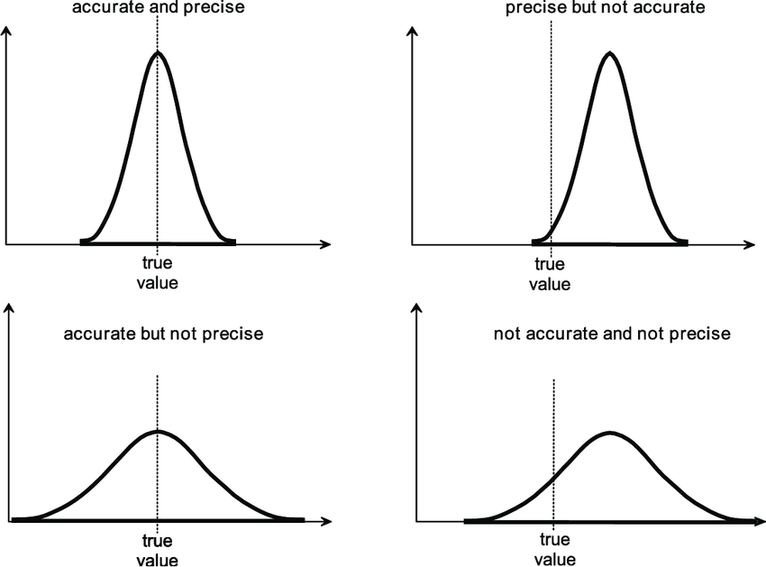
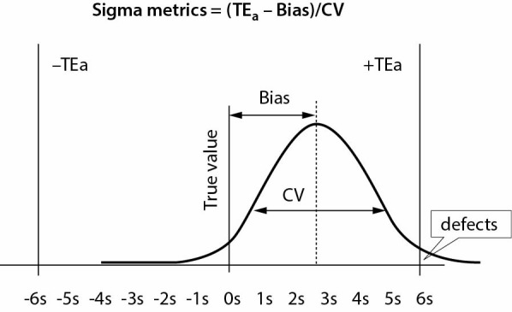
How do we calculate Sigma metric?
TE_{a} ̶ ׀Bias׀
Sigma =
Bias = Inaccuracy (Difference from reference value or peer group)
CV (coefficient of variation) = Imprecision/ reproducibility
TE_{a} = Total Allowable Error (or “Tolerance”) required for that analyte. According to CLIA (Clinical Laboratory Improvement Amendment)
CV

Slide 8
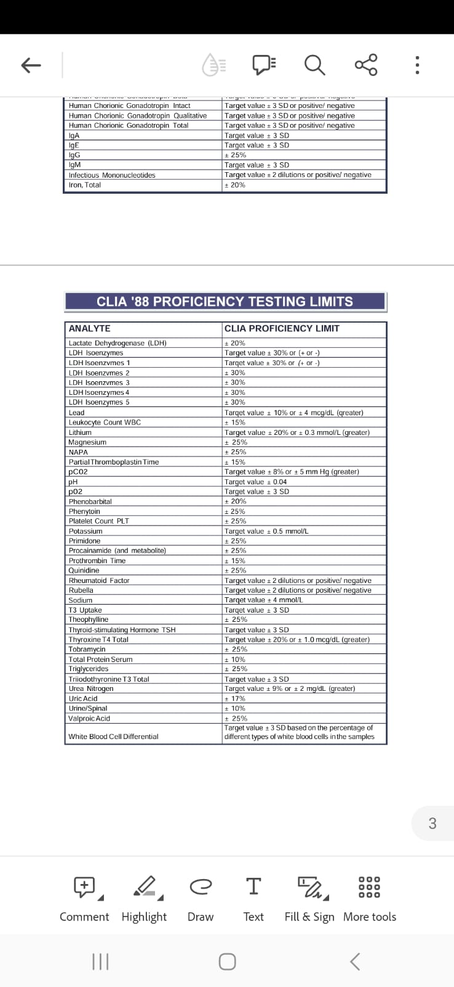
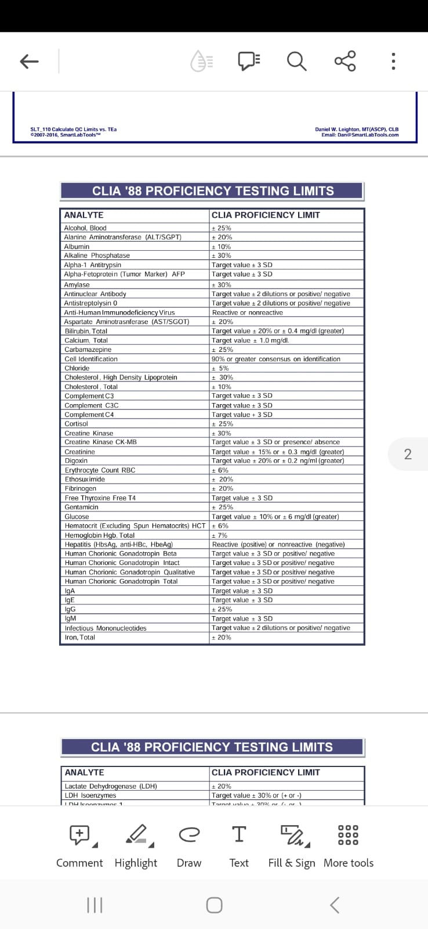

Slide 9
For Bias,
Individual Deviations:
∣Measured Value−True Value ∣
Average Deviation:
Express Bias as a Percentage:
Bias (%)= ×100
For TE_{a}
The Clinical Laboratory Improvement Amendments of 1988 (CLIA) Guidelines has given TEa of 85 analytes as per the criticality of the analyte.
∑ Individual Deviations​
Number of Measurements
Average Deviation
True Value
For CV,
CV = ×100
Standard Deviation (SD)
Mean

Slide 10
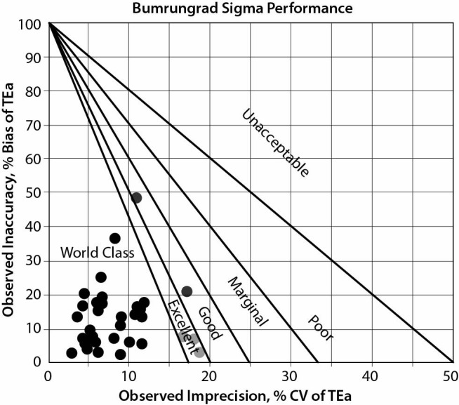
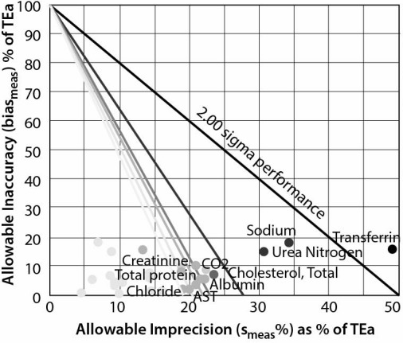
Method Decision chart
OPSpec Chart

Slide 11
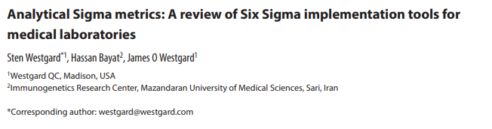
Assessing a single analyte across multiple system
The method decision chart is a tool used to assess a single analyte across multiple systems.
It helps in evaluating the performance of a single analyte across different testing methods and determining the best method for testing that analyte.

Slide 12
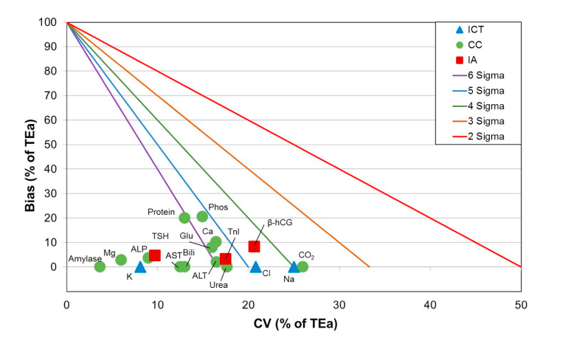
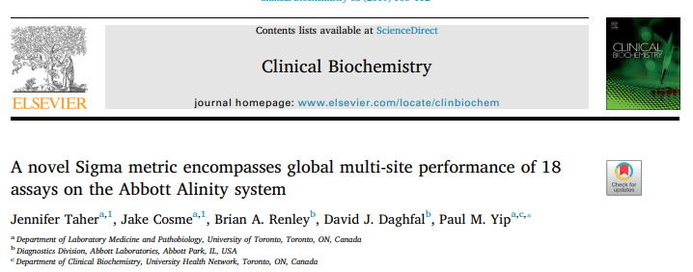
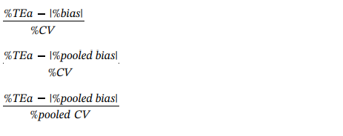
Assessing multiple tests on one system across Labs
Taher et. al., 2018 .
Multi-site study (11 Hospitals in 9 countries) evaluating 18 tests on the Alinity Assay System

Slide 13
10
For Cholesterol,
TEa = 10%, Bias = 3%, CV = 3%
Sigma = (TEa% – Bias %)/ CV%
= (10-3)/3
= 7/3 = 2.33
Sigma = (TEa% – Bias %)/ CV%
CV% = (TEa% – Bias %)/ Sigma
Bias% = TEa% – (Sigma *CV%)
So for Bias = 0%,
CV% = TEa%/ Sigma
For CV% = 0,
Bias = TEa% - (Sigma* 0) = TEa = 10
For Sigma = 2, CV% = 10/2 = 5
For Sigma = 3, CV% = 10/3 = 3.33
For Sigma = 4, CV% = 10/4 = 2.5
For Sigma = 5, CV% = 10/5 = 2
For Sigma = 6, CV% = 10/2 = 1.66
9
8
7
6
Allowable Inaccuracy (% Bias)
5
4
2.33
3
*
2
6σ
5σ
4σ
3σ
2σ
1σ
1
1
2
3
4
5
Allowable Imprecision (%CV)

Slide 14
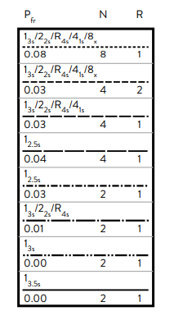
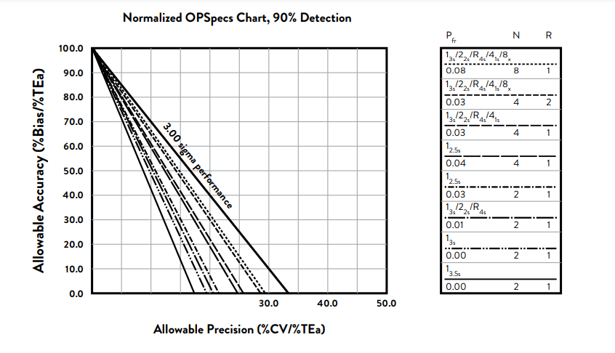
Normalized OPSpec Chart

Slide 15
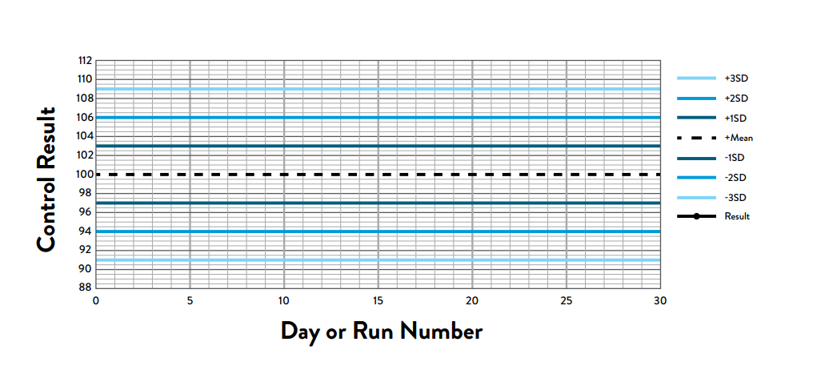
Levey-Jennings control chart

Slide 16
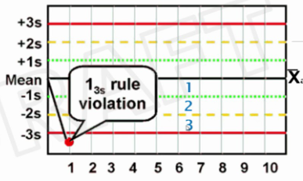
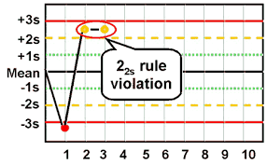
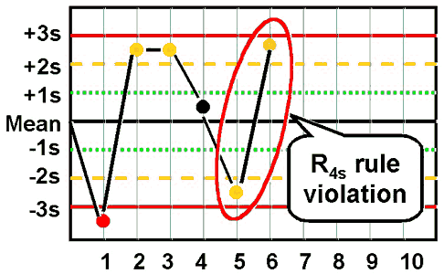
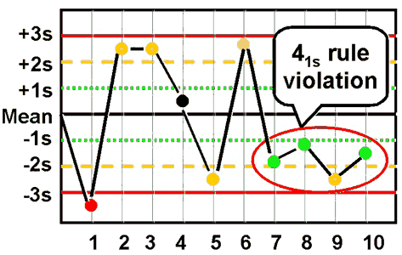
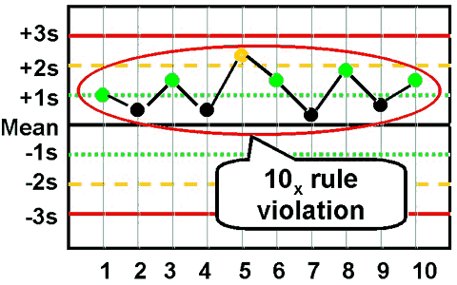
Westgard Rules

Slide 17
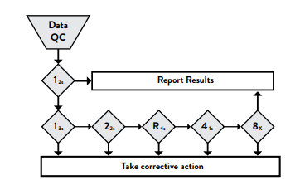
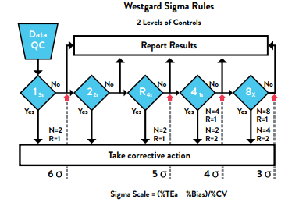
Evolution of Sigma Based QC
Original Westgard Rules, (March 1981)
Westgard Sigma Rules, (2014)
Westgard JO et. al. Clin. Chem. Mar: 27(3); 493-501
Westgard JO, Westgard SA,
Basic Quality Management System, 2014

Slide 18
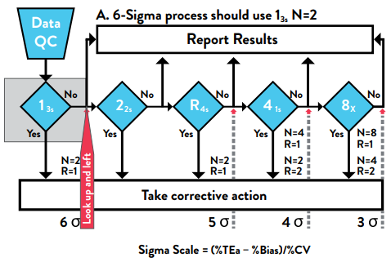
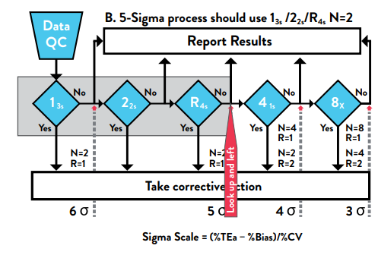
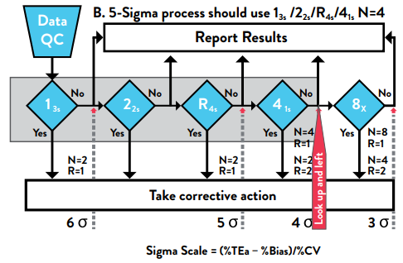

Slide 19
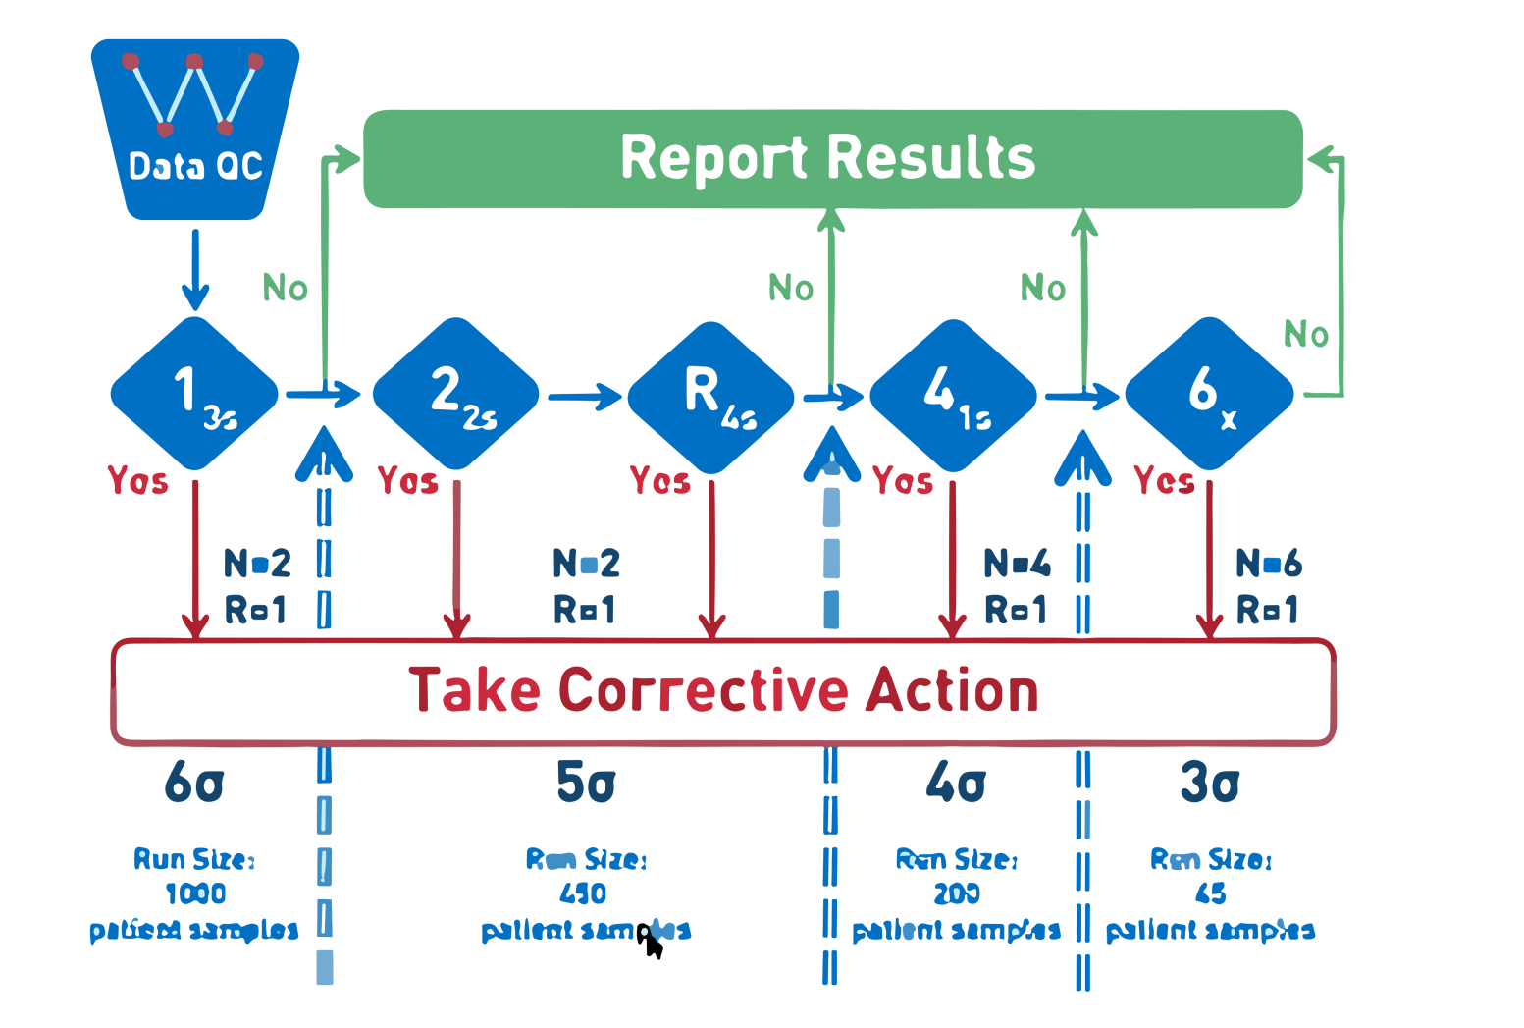
Westgard Sigma Rules with run size (2018)
Sigma metric | Control rule | QC frequency
6 | 13s, n=2 | 1 per 1000 patients samples
5 | 13s/22s/r4s, n=2 | 1 per 450 patients samples
4 | 13s/22s/r4s/41s, n=4 | 1 per 200 patients samples
3 | All “Westgard Rules”, n=6 | 1 per 45 patients samples

Slide 20
Measurement Uncertainty(MU)
The International Vocabulary of Metrology (VIM) defines measurement uncertainty as a "non-negative parameter characterizing the dispersion of the quantity values being attributed to a measurand, based on the information used.“
Measurement uncertainty is often expressed as a Standard Deviation (SD) or Coefficient of variation (CV).

Slide 21
Measurement uncertainty using Sigma Matrix
Sigma matrix = (TEa% - bias%)/ CV%
CV% = (TEa% - bias%)/ Sigma matrix
If want to provide world class quality, Sigma matrix = 6
CV% = (TEa% - bias%)/ 6
Sigma matrix 4.5 is for providing standard quality
CV% = (TEa% - bias%)/ 4.5
Example: For Cholesterol, TEa = 10, Bias = 3
CV% = (10-3)/6 = 1.166
CV% = (10-3)/4.5 = 1.55
In the clinical laboratory, there are some test parameters like Bilirubin, Sodium, Potassium; where maintaining CV% at very low level is very difficult. For such parameters SD is targeted.
SD = (TEa - bias)/ 4.5

Slide 22
Impact on the laboratory
Poor quality:
More QC measurements and more rules to detect any deviation.
More delay, more repeat, more results.
Clinician and patient dissatisfaction.
Financial impact.
Mahmood TS et. al. The Application of Six Sigma Methodology to Improve Service Quality: A Case Study in an Iraqi Retail Company. 2021 [cited 2024 Jan 15]
Sigma Level | DPMO | COPQ (Cost of Poor quality)
1 | 6,90,000 | > 40% of Revenue
2 | 3,08,537 | > 40% of Revenue
3 | 66,807 | 24 to 40% of Revenue
4 | 6,210 | 15 to 25% of Revenue
5 | 233 | 5 to 15% of Revenue
6 | 3.4 | < 1% of Revenue

Slide 23
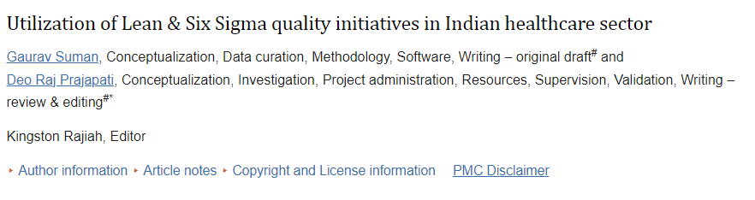
Status in India
(Suman and Prajapati. Utilization of Lean & Six Sigma quality initiatives in Indian healthcare sector. Rajiah K, editor. PLOS ONE. 2021 Dec 23;16(12):e0261747)
Nearly 40% of the hospitals surveyed did not apply any quality initiatives, and only 15 hospitals implemented Lean techniques, while 14 hospitals implemented Six Sigma techniques
The major reasons for not implementing Lean and Six Sigma initiatives in Indian healthcare are a lack of knowledge and availability of resources.
The implementation of Lean and Six Sigma in the Indian healthcare sector can lead to improved healthcare quality, reduced medical errors, and enhanced patient satisfaction.

Slide 24
Thank You

