Slide 1
The learner will be able to:
Mention the significance of transamination and transdeamination.
Describe the formation of ammonia.
Outline the urea cycle.
Enumerate urea cycle disorders.
Mention the urea level in blood and excretion in urine.
Explain the genesis of hyperammonemia and the clinical sequelae.

Slide 2
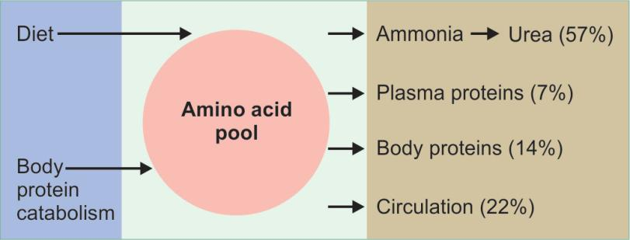
Amino acid pool.

Slide 3
Inter-Organ Transport of Amino Acids
Breakdown of muscle protein is the source of amino acids for
tissues while liver is the site of disposal.
In Fasting State
The muscle releases mainly alanine and glutamine of which alanine is taken up by liver and glutamine by kidneys.
Liver removes the amino group and converts it to urea and the carbon skeleton is used for gluconeogenesis.
Glucose-alanine cycle, under gluconeogenesis.
The brain predominantly takes up branched chain amino acids.

Slide 4
In the Fed State
Amino acids absorbed from the diet are taken up by different
tissues.
Both muscle and brain take up branched chain amino acids, and release glutamine and alanine.
The glutamine is delivered to kidneys to aid in regulation of acid-base balance, while alanine is taken up by liver.

Slide 5
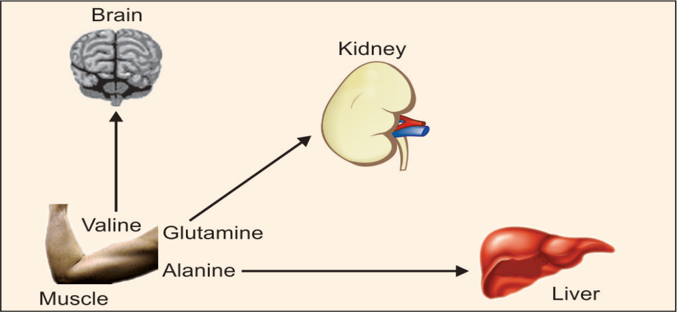
Inter-organ transport of amino acids during fasting conditions

Slide 6
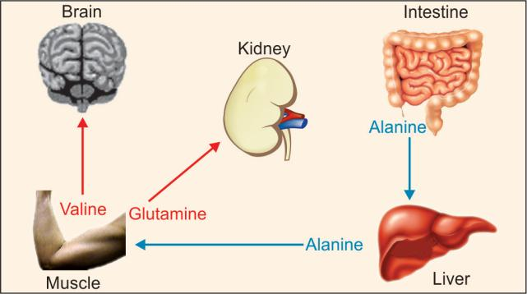
Inter-organ transport of amino acids after taking food (post-prandial condition)

Slide 7
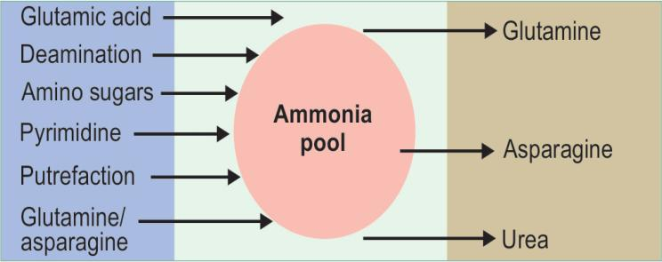
Sources and fate of ammonia

Slide 8
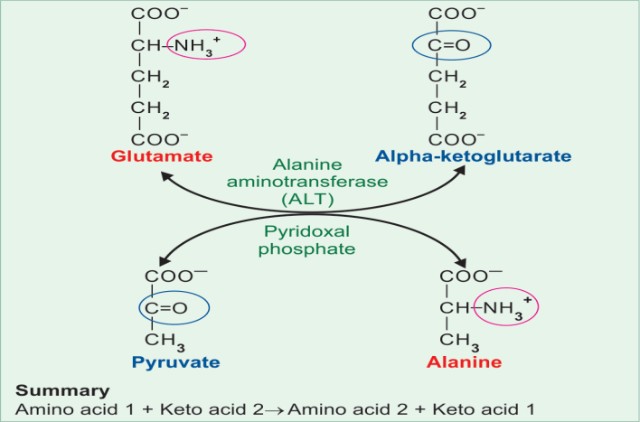
Transamination reaction. In this example, the enzyme is alanine aminotransferase (ALT) and the coenzyme is pyridoxal phosphate. The reaction is readily reversible.

Slide 9
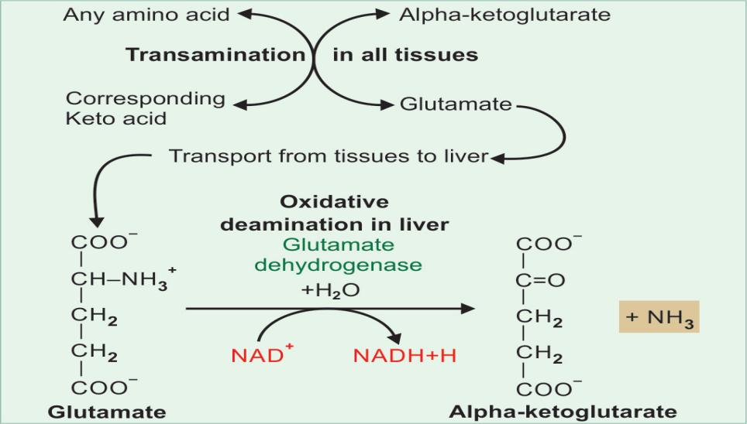

Slide 10
ns
Transamination - First Step of Catabolism
In this first step, ammonia is removed, and the carbon skeleton of the amino acid enters into catabolic pathway.
Transamination + deamination = transdemination
Transamination in all tissues
Deamination only in liver

Slide 11
Clinical Significance of Transamination
Aspartate amino transferase (AST) and Alanine amino transferase (ALT) are induced by glucocorticoids, which favour gluconeogenesis.
AST is increased in myocardial infarction and ALT in liver diseases.

Slide 12
Biological significance of transamination -
Synthesis of Non-essential Amino Acids
By means of transamination, all nonessential amino acids can be synthesized by the body from keto acids available from other sources.
For example, pyruvate can be transaminated to synthesize alanine.
Similarly oxaloacetate produces aspartic acid.
Alpha ketoglutarate is transaminated to form glutamic acid.
Those amino acids, which cannot be synthesized in this manner, are therefore essential; they should be made available in the food.

Slide 13
Interconversion of Amino Acids
If amino acid no.1 is high and no. 2 is low; the amino
group from no.1 may be transferred to a keto acid to give amino acid no. 2 to equalize the quantity of both.
This is called equalization of quantities of non-essential amino acids.

Slide 14
Oxidative Deamination of Glutamate
Oxidative deamination of glutamate –
Only liver mitochondria contain glutamate dehydrogenase
(GDH)
Amino acids are first transaminated to glutamate, then deaminated at the rate of about 50–70 gram per day.
During the transamination reaction the amino group of all other amino acids is funneled into glutamate.
Hence, the glutamate dehydrogenase reaction is the final reaction, which removes the amino group of all amino acids. It needs NAD+ as coenzyme.

Slide 15
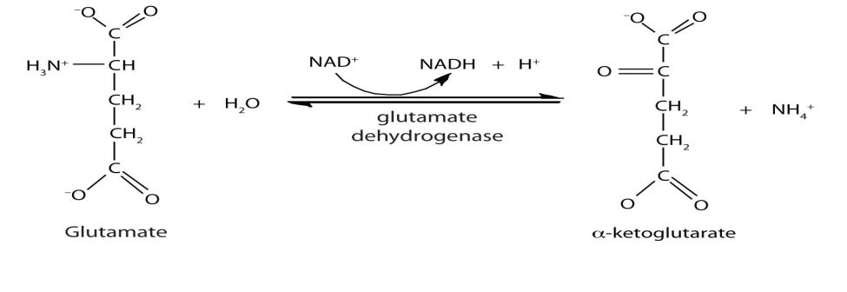
It is an allosteric enzyme; it is activated by ADP and inhibited by GTP.

Slide 16
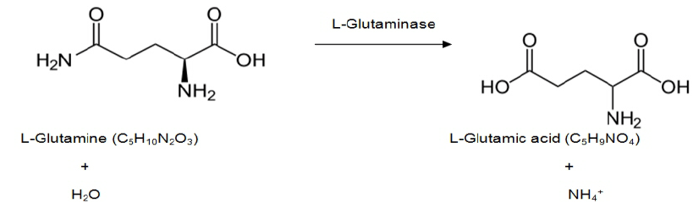
The hydrolysis of glutamine also yields NH3 but this occurs mainly in the kidney where the NH4+ excretion is required for acid-base regulation.

Slide 17
Formation of Ammonia
Formation of ammonia -
The first step in the catabolism of amino acids is to remove
the amino group as ammonia. major source of ammonia.
Ammonia is highly toxic especially to the nervous system.
Detoxification of ammonia is by conversion to urea and excretion through urine.

Slide 18
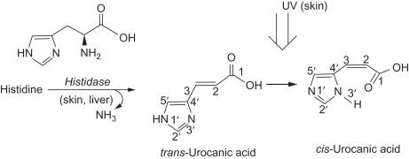
Minor pathway of Ammonia Production -
Histidine to urocanic acid and NH₃ by histidase
Asparagine to aspartate and NH₃ by asparaginase
Serine and threonine to pyruvate and alpha ketobutyrate respectively by dehydratases

Slide 19
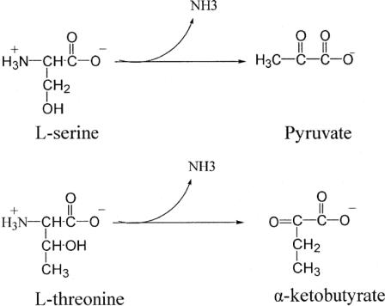
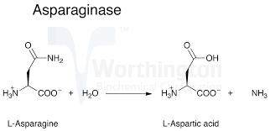

Slide 20
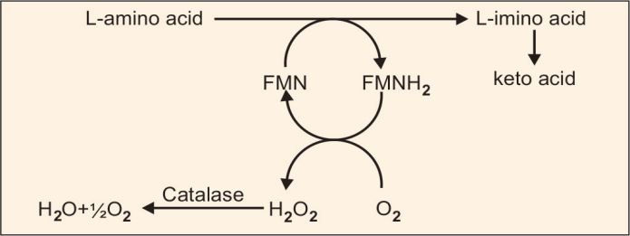
L amino acid oxidase a flavoprotein also releases ammonia from amino acids.
Ammonia may also be produced in the gastro-intestinal tract by bacterial putrefaction, bacterial metabolism which reaches the liver through portal vein.

Slide 21
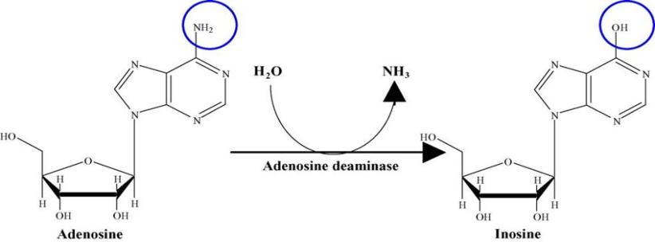
Ammonia is also released during the purine nucleotide cycle (adenylosuccinase), purine catabolism (ADA and guanase) and pyrimidine catabolism.

Slide 22
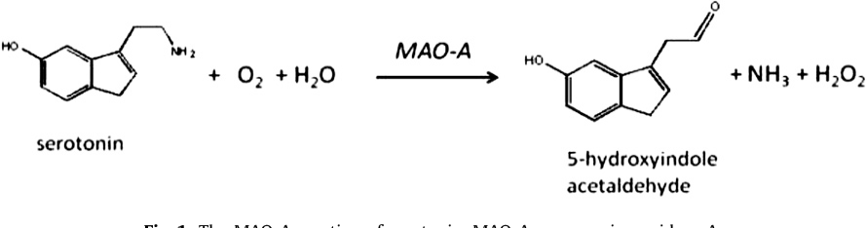
Ammonia may be formed in the body through minor reactions like oxidation of monoamines by MAO (mono amine oxidase).

Slide 23
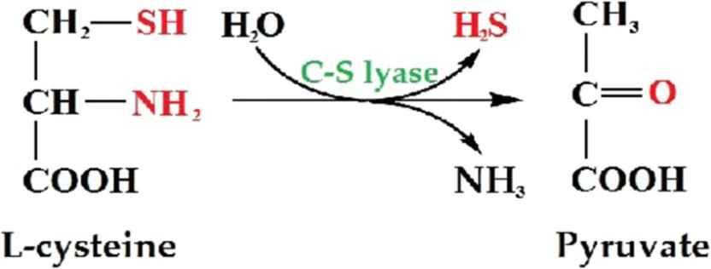
Cysteine undergoes deamination and simultaneous trans-sulphuration to form pyruvate by the enzyme desulfhydrase.

Slide 24
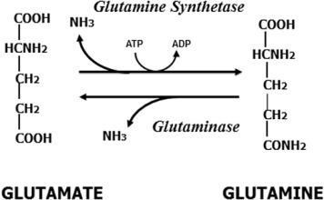
The hydrolysis of glutamine to NH₃ and glutamate in the
kidney where the NH₄⁺ excretion is required for acid base regulation.

Slide 25
Detoxification of Ammonia
Reduced production
Ammonia trapping
Urea synthesis

Slide 26
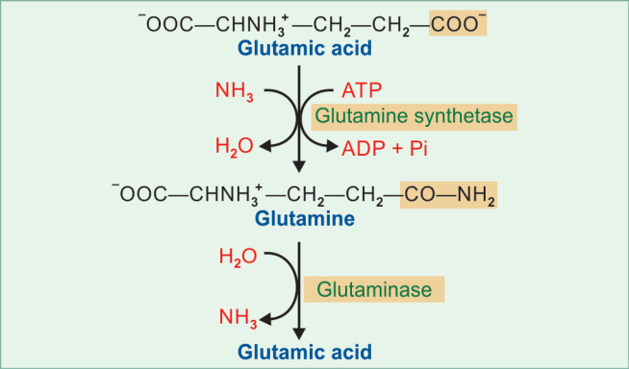
Ammonia trapping as glutamine.

Slide 27
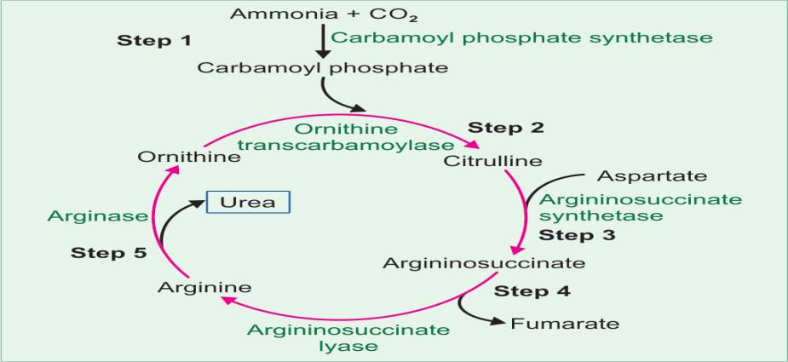
Urea Cycle Ornithine Cycle Krebs-Henseleit Cycle
End product of Protein metabolism
Summary of urea cycle

Slide 28
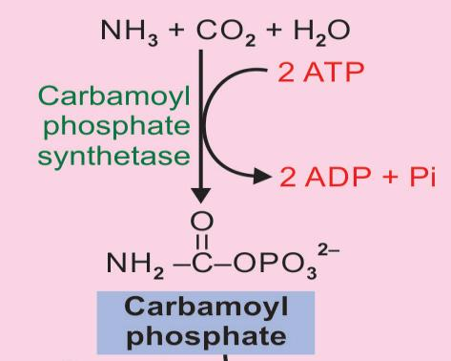
Urea Cycle
First and Rate limiting step of the urea cycle.

Slide 29
Comparison of CPS I and II enzymes
 | CPS-I | CPS-II
1. Site | Mitochondria | Cytosol
2. Pathway of | Urea | Pyrimidine
3. Positive effector | NAG | Nil
4. Source for N | Ammonia | Glutamine
5. Inhibitor | Nil | CTP

Slide 30
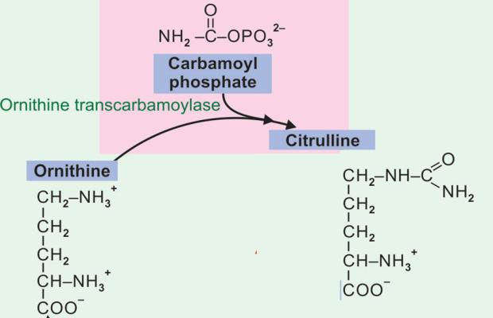
Step 2

Slide 31
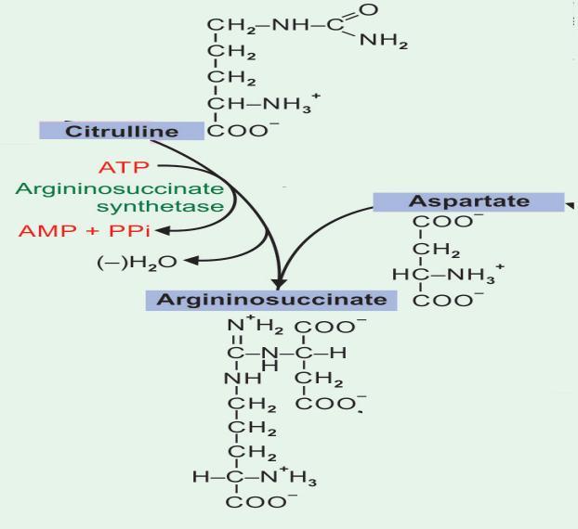
Step 3

Slide 32
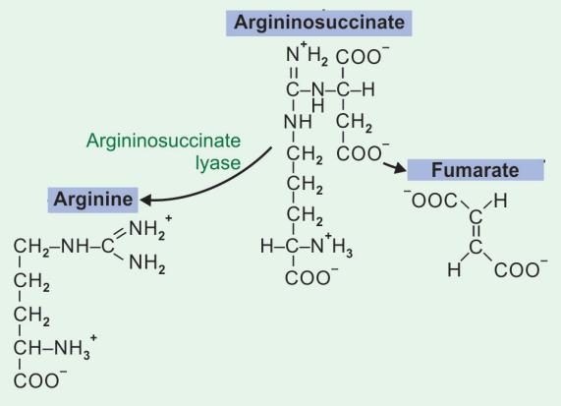
Step 4

Slide 33
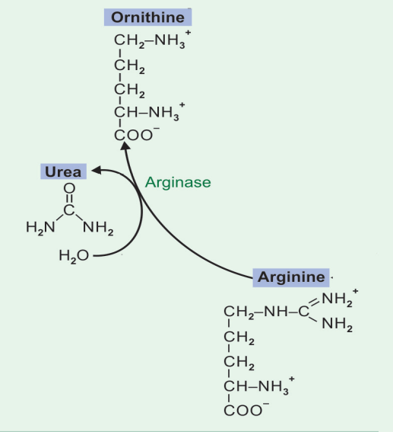
Step 5

Slide 34
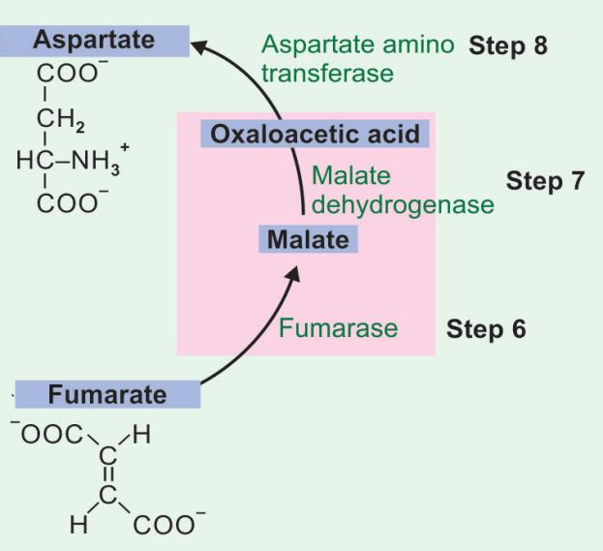

Slide 35
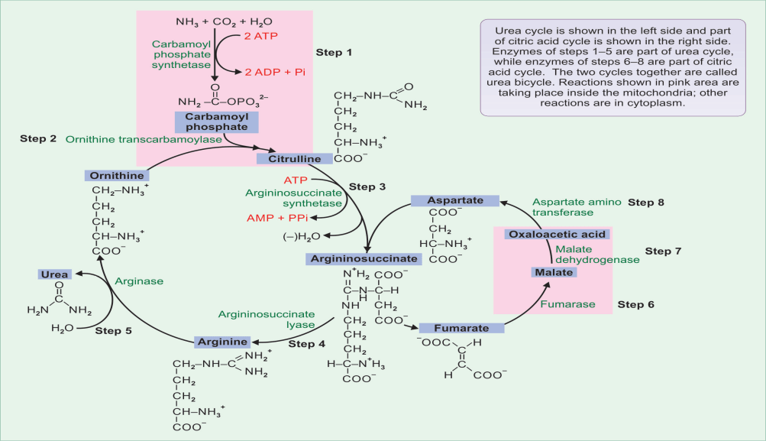

Slide 36
Energetics of Urea Cycle
Energetics of urea cycle
The overall reaction may be summarized as:
NH3 + CO2 + Aspartate → Urea + Fumarate
In the urea cycle 2 ATPs are used in the first reaction.
Another ATP is converted to AMP and PPi, which is equivalent to 2 ATPs.
The urea cycle consumes 4 high energy phosphate bonds.
However, fumarate formed in the 4th step may be converted to malate.
Malate when oxidized to oxaloacetate produces 1 NADH equivalent to 2.5 ATP.
So, net energy expenditure is only 1.5 high energy phosphates.
The urea cycle and TCA cycle are interlinked, and so, it is called as "urea bicycle".

Slide 37
Regulation of the Urea Cycle
Regulation of urea cycle
Coarse Regulation
During starvation, the activity of urea cycle enzymes is
elevated to meet the increased rate of protein catabolism.
Fine Regulation
The major regulatory enzyme is CPS-I. N-acetyl glutamate (NAG) will stimulate this reaction.
It is formed from glutamate and acetyl CoA.
Arginine is an activator of NAG synthase.

Slide 38
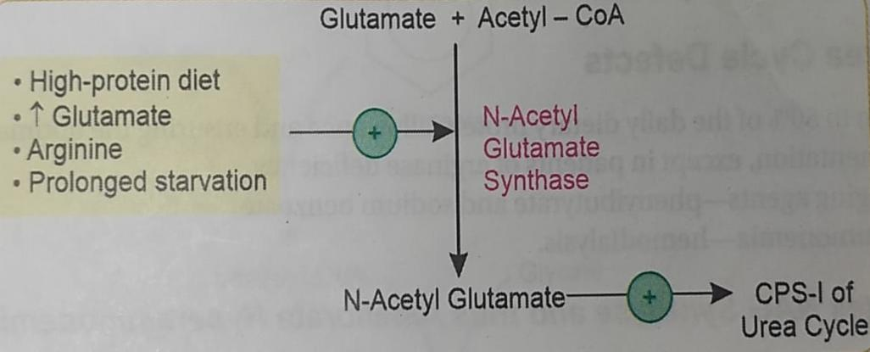

Slide 39
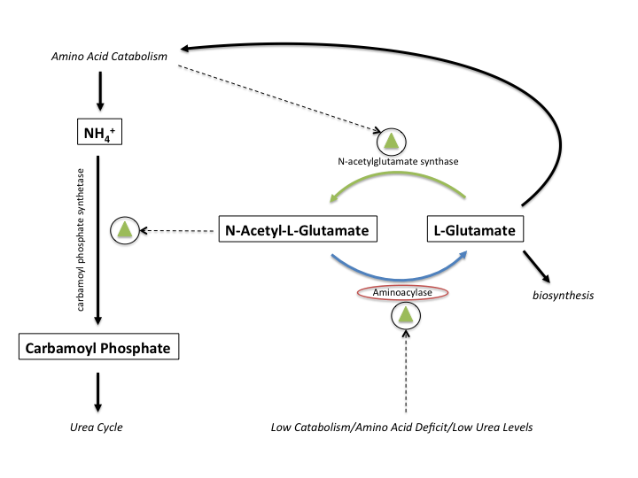

Slide 40
Free Ammonia is toxic to brain –
Depletes α-KG and ATP.
Brain is very sensitive to ammonia. Hepatic Encephalopathy.
low protein diet and frequent small feeds are given. (<0.5g/kg/day)
Lactulose – Osmotic laxative.
Antibiotics – Rifaximin, Hemodialysis and Liver Transplantation.
Attempts may be made to eliminate the amino nitrogen in other forms, e.g. as hippuric acid (Benzoyl conjugate of glycine) or phenyl acetyl glutamine.
Since Citrulline is present in significant quantities in milk, breast milk is to be avoided in citrullinemia.

Slide 41
Disorders of Urea Cycle
Disorders Of Urea Cycle
Deficiency of any of the urea cycle enzymes would result in hyperammonemia.
When the block is in one of the earlier steps, the condition is more severe, since ammonia itself accumulates.
Deficiencies of later enzymes result in the accumulation of other intermediates, which are less toxic and hence symptoms are less.
As a general description, disorders of urea cycle are characterized by hyperammonemia, encephalopathy and respiratory alkalosis. Clinical symptoms include vomiting, irritability, lethargy and severe mental retardation.
Infants appear normal at birth, but within days progressive lethargy sets in.

Slide 42
Urea cycle disorders
Diseases | Enzyme deficit | Features
Hyperammonemia type I | CPS-I | Very high NH3 levels in blood. Autosomal recessive. Mental retardation. Incidence is 1 in 100,000.
Hyperammonemia type II | (OTC) Ornithine transcar-bamoy-lase | Ammonia level high in blood. Increased glutamine in blood, CSF and urine. Orotic aciduria due to channelling of carbamoyl phosphate into Pyrimidine synthesis. X-linked.
HyperornithinemiA | Defective ornithine trans-porter protein | Failure to import ornithine from cytoplasm to mitochondria. Defect in ORNT1 gene. Hyperornithinemia, hyperammonemia and homocitrullinuria is seen (HHH syndrome). Decreased urea in blood. Autosomal recessive condition.

Slide 43
Urea cycle disorders
Diseases | Enzyme deficit | Features
Citrullinemia | Argininosuccinate synthe-tase | Autosomal recessive inheritance. High blood levels of ammonia and citrulline. Citrullinuria (1-2 g/day).
Argininosuccinic aciduria | Arginino-succinate lyase | Argininosuccinate in blood and urine. Friable brittle tufted hair (Trichorrhexis nodosa). Incidence 3/200,000
Hyperargininemia | Arginase | Arginine increased in blood and CSF. Instead of arginine, cysteine and lysine are lost in urine. Incidence 1 in 100,000

Slide 44
Treatment –
mainly symptomatic.
Low protein diet with sufficient arginine and energy by
frequent feeding can minimize brain damage since ammonia levels do not increase very high.
Ornithine transporter deficiency is characterized by hyperornithinemia, hyperammonemia and homocitrullinuria (HHH syndrome).
Since ornithine is not available in the mitochondria, lysine is carbamylated to form homocitrulline.

Slide 45
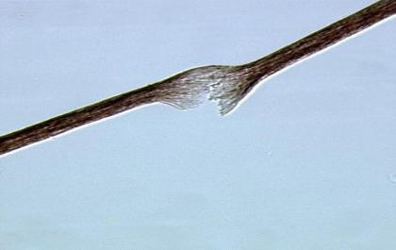
Argininosuccinate lyase deficiency leads to argininosuccinic acidemia and therefore metabolic acidosis.
Hyperammonemia is less severe and argininosuccinate is elevated in CSF and excreted in urine.
A typical clinical feature is friable tufted hair (trichorrhexis nodosa).

Slide 46
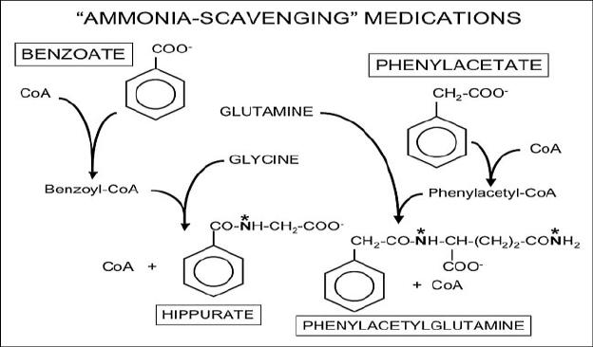
Phenylbutyrate and benzoate are used to scavenge Ammonia.

