Slide 1
ARE YOU SENDING A PROPER SAMPLE FOR MICROBIOLOGICAL TESTS: PART II Dr Gitali Bhagawati Department of Microbiology

Slide 2
Objectives
To emphasize that obtaining a relevant microbiology report begins with the patient and not at the door of the microbiology laboratory.
To accentuate the importance of proper collection and transport of specimens.
To give stress on importance of timely communication between the Microbiology laboratory and those collecting specimens.
To describe common pitfalls in specimen collection and transport.

Slide 3
PROVISIONAL DIAGNOSIS: organism suspected
Communication with microbiologist
SAMPLE COLLECTION
At appropriate time -from app. Site, in appropriate container, -using proper technique
TEST SELECTION:
select test/tests to confirm/rule out infection
Labelling and Filling Requisition form
Transport and Storage

Slide 4
COLLECTION OF PUS SAMPLE

Slide 5
Pus
Container for collection: small screw-capped sterile universal containers, firmly stoppered tube or sealed capillary tube.
In burns wound, diabetic foot, necrotic material after wound debridement.
Before collection of sample, thoroughly remove surface commensals and any local antiseptic.

Slide 6
Pus or exudate should be avoided on a swab because:
Swab desiccates the specimen and traps the bacteria.
On delay, exudate may dry into the cotton wool.
Inhibitory substances may be present in cotton which decrease chances of recovery of delicate organisms like H. influenzae. Neisseria & Pneumococcus.
Swabs may get contaminated with surface colonizers and commensal flora.

Slide 7
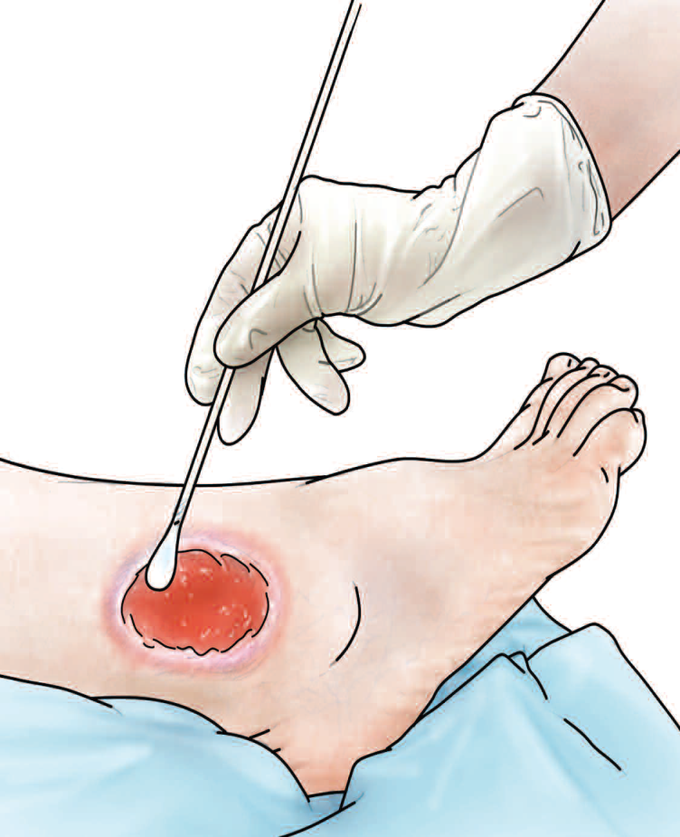
PUS
If it is decided to compromise and send a swab,
Thoroughly wash the wound
Keep the swab in wound for 1-2 min & rotate gently at 360 º so that swab soaks completely.
load the swab well with the material
two swabs should be taken from the depth of the lesion, one for microscopy , another for culture
When collecting pus specimens obtain as much material as possible to increase the rate of isolation.

Slide 9
Wound Swab: Surface contaminants
Culture report will suggest ONLY SURFACE CONTAMINATION if wound swab sample is taken
prior to wound cleansing and
before removal of devitalized superficial debris

Slide 10
COLLECTION OF CEREBROSPINAL FLUID and Other body fluids

Slide 11
CSF for culture
Amount: 3-5 ml
For isolation of Mycobacteria CSF amount required is about 10 ml
Processing with too less specimen: FALSE NEGATIVE RESULT
Container: NEW DISPOSIBLE STERILE SCREW CAP CONAINER
(STERILIZED CONTAINERS kept in the Lumbar puncture kit ARE NOT ACCEPTABLE)

Slide 12
CSF transportation
CSF transportation to lab. Should not be delayed. Delay may result in death of delicate organisms, such as meningococci and disintegration of leucocytes.
It should not be kept in refrigerator, which tends to kill H. influenzae.
If delay for hours, keep the specimen in incubator at 37° C

Slide 13
Specimen: Body Fluids other than CSF (ascitic fluid, pleural fluid, synovial fluid etc.)
Sample must be acquired using aseptic technique.
Device and/or minimal volume
Sterile screw capped transport container. Volume as follows:
Bacterial Culture ≥ 1 mL
Fungal Culture ≥ 10 mL
AFB Culture ≥ 10 mL
Storage/Transport
Local: Transport as soon as possible, hold at room temperature
Local storage: ≤ 24 hrs at room temperature
Comments: Always submit as much fluid as possible, do not submit a swab dipped in fluid.

Slide 14
Specimen: Tissue
Sample must be acquired using aseptic technique.
Device
Wide mouthed , sterile screw capped plastic container.
Small amount of sterile saline may be added to keep the specimen moist.
Storage/Transport
Local: Transport as soon as possible, hold at room temperature
Rejection Criteria:
Tissue in formalin is not used for culture

Slide 15
COLLECTION OF
GENITAL TRACT SPECIMENS

Slide 16
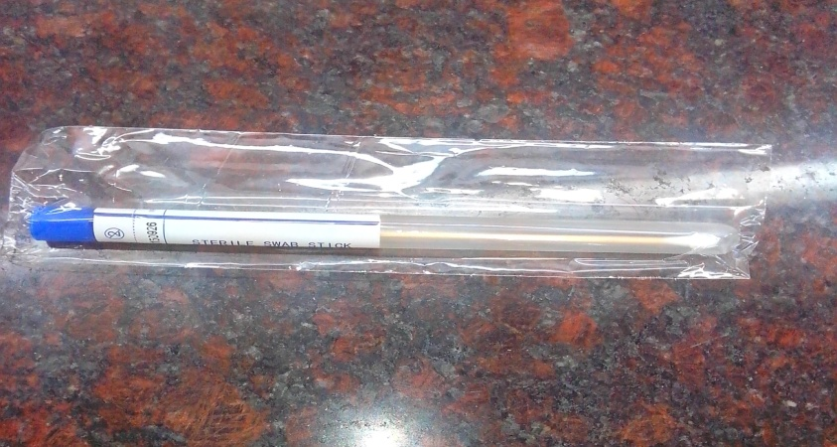
High vaginal swab
Swab: Plain cotton swab
Two swabs should be
collected- one for making film,
other for seeding cultures.
Indication: in suspected cases of
Vaginitis, Vaginosis
Insrtuctions for collection:
The swab is inserted into the upper part of vagina and rotated there to collect exudate from upper as well as lower vaginal wall.
Comment: HVS is unsuitable in suspected cases of gonorrhea, because gonococci tend to die off in acidic vaginal secretion.

Slide 17
Endocervical swab
Indication: in suspected cases of cervical and uterine infections (e.g. gonorrhoea)
Insrtuctions for collection:
Vaginal speculum is used to provide a clear sight of the cervix
A swab is rubbed in and around the introitus of the cervix
Withdraw the swab without contaminating with the commensals of vagina
Send the swab as soon as possible

Slide 18
Will be continued ….

