Slide 1
Introduction to Procalcitonin (PCT)
Dr. Amit Samadhiya
Junior Consultant
Department of Biochemistry
Dharamshila Narayana Superspeciality Hospital

Slide 2
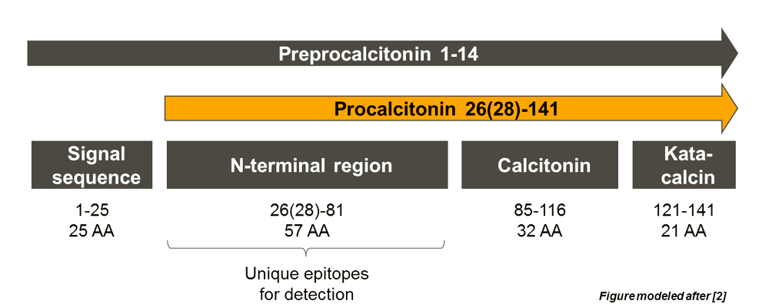
Nature and Synthesis
116 AA Long peptide, Precursor of calcitonin.
Parafollicular cells, Neuroendocrine cells of lungs and Intestine.
Induced by IL-6, TNF-alfa and IL-1β.

Slide 3
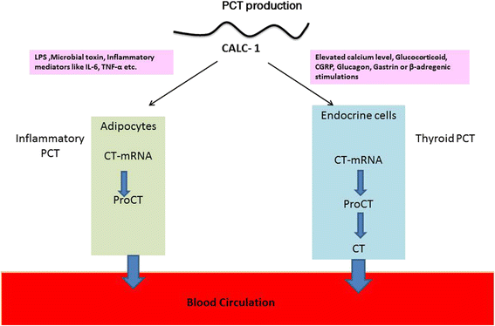
Why procalcitonin is raised with normal calcitonin ?
Notes:
However, the other tissues including the adipocytes, brain, kidney, lungs, spleen, pancreas, and colon cannot convert PCT to calcitonin. This eventually leads to rising of PCT serum levels. On the other hand, viral infections mainly characterized by IFN-γ activation, attenuate PCT production.
. The elevation of PCT in the absence of bacterial infection can be associated with severe trauma, severe burns, abdominal or cardiothoracic surgery, thyroid medullary carcinoma, small cell lung cancer, acute pancreatitis, prolonged or severe cardiogenic shock, cardiac arrest resuscitation, and OKT3 antibodies and antithymocyte globulin treatments.

Slide 4
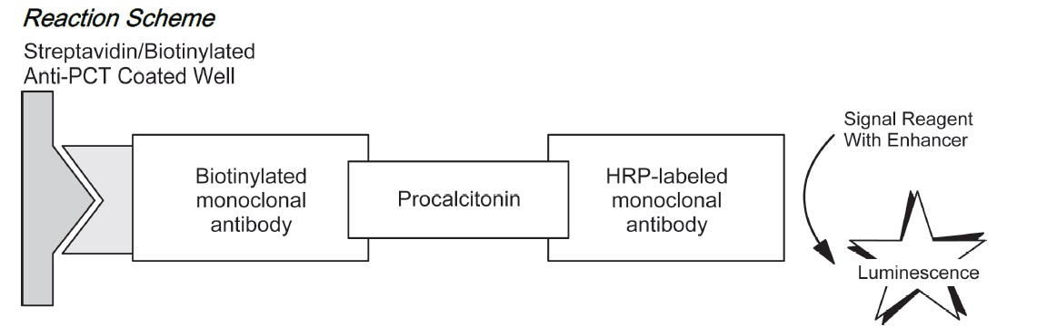
Diagnostic accuracy of PCT
A rapid semi-quantitative solid-phase immunoassay (BRAHMS PCT-Q) and a POC assay (BRAHMS PCT™ direct) are commercially available (www.procalcitonin.com)
System Measuring Range 0.030–100 ng/mL or microg/L
95th Percentile URL - 0.077 ng/mL
SD - O.O27 ng/mg CV – 4.6%
Notes:
Physiologic elevations of PCT levels in 3-day-old newborns have demonstrated.

Slide 5
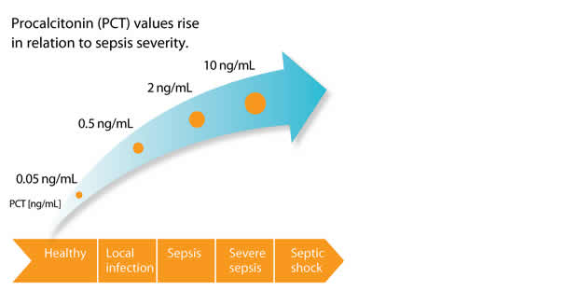
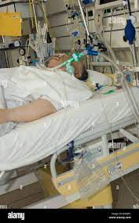
Reference Interval

Slide 6
Antibiotic guidance in sepsis and LRTI
Antibiotic therapy may be discontinued if the ΔPCT >80%
or if the PCT Current is
• ≤0.250 ng/mL for LRTI patients.
• ≤0.500 ng/mL for suspected or confirmed septic patients.
Antibiotic therapy may be continued if :
• Apparent progression on chest x-ray.
• Ongoing physiologic instability for patients with suspected or confirmed sepsis.

Slide 7
prediction of mortality in patients with severe sepsis and septic shock

Slide 8
PCT Vs CRP
.
 | PCT | CRP
Onset | 4 h | 12-24 hrs
Peak | 6h | 1-2 days
Plateau | 8-24h | 2-3 days
Baseline | 2-3 days | 3-7 days
The advantages of PCT over CRP are a more rapid increase and earlier peak at 24 h following infection and a faster decrease following resolution of infection. T1/2 – 25-30h.

Slide 9
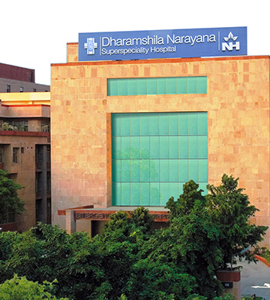
Thank You

