Slide 1
Biological Oxidation
Dr. Saba Amin Khan
Assistant Prof.
Biochemistry dept.

Slide 2
Competency BI 6.6
Describe the biochemical process involved in generation of energy in a cell.

Slide 3
Specific Learning Objectives
To discuss the concept of Bioenergetics
To define different terms used in bioenergetics
To revise laws of thermodynamics .
To explain the process of biological oxidation
Enzymes involved and intermediary energy-rich compounds.

Slide 4
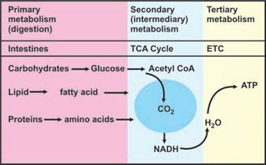

Slide 5
Bioenergetics/ Biochemical thermodynamics
Study of the energy changes accompanying biochemical reactions.
Biologic systems are essentially isothermic
Use chemical energy to power living processes.
Death from starvation occurs when available energy reserves are depleted.
Excess storage of surplus energy causes obesity.

Slide 6
Biologic Systems Conform to the Laws of Thermodynamics
The first law of thermodynamics states that the total energy of a system, including its surroundings, remains constant.
The second law of thermodynamics states that the total entropy of a system must increase if a process is to occur spontaneously.
Notes:
implies that within the total system, energy is neither lost nor gained during any change. However, energy may be transferred from one part of the system to another or may be transformed into another form of energy.
Entropy is the extent of disorder or randomness of the system

Slide 7
Free energy (G):
  An amount of energy available to do work (utilizable) is known as free energy
  Changes in the free energy (ΔG) are valuable in predicting the feasibility of chemical reactions.
Enthalpy (H):
  Represents the heat content of the reacting systems.
  When there is release of heat during a reaction it is referred to as exothermic reaction and the ΔH is negative.
  Opposite is endothermic reaction with ΔH positive.
Entropy (S):
  Quantitative expression for the randomness or disorder in the system.
  Reactions of biological systems involve a temporary decrease in entropy.
Notes:
When a reaction proceeds with the release of free energy, the free energy change ΔG has a negative value, and the reaction is called exergonic.
Opposite is an endergonic reaction in which there is a gain of free energy

Slide 8
Bioenergetics of a Biological System
Under constant temperature and pressure, the relationship between the free-energy change (ΔG) of a reacting system and the change in entropy (ΔS) is expressed
Δ G=ΔH − TΔS
where ΔH is the change in enthalpy and T is the absolute temperature.
If ΔG is negative, the reaction proceeds spontaneously with loss of free energy; it is exergonic.
If ΔG is positive, the reaction proceeds only if free energy can be gained; it is endergonic.
If ΔG is zero, the system is at equilibrium and no net change takes place.
Notes:
by the following equation, which combines the two laws of thermodynamics: . If, in addition, ΔG is of great magnitude, the reaction goes virtually to completion and is essentially irreversible.

Slide 9
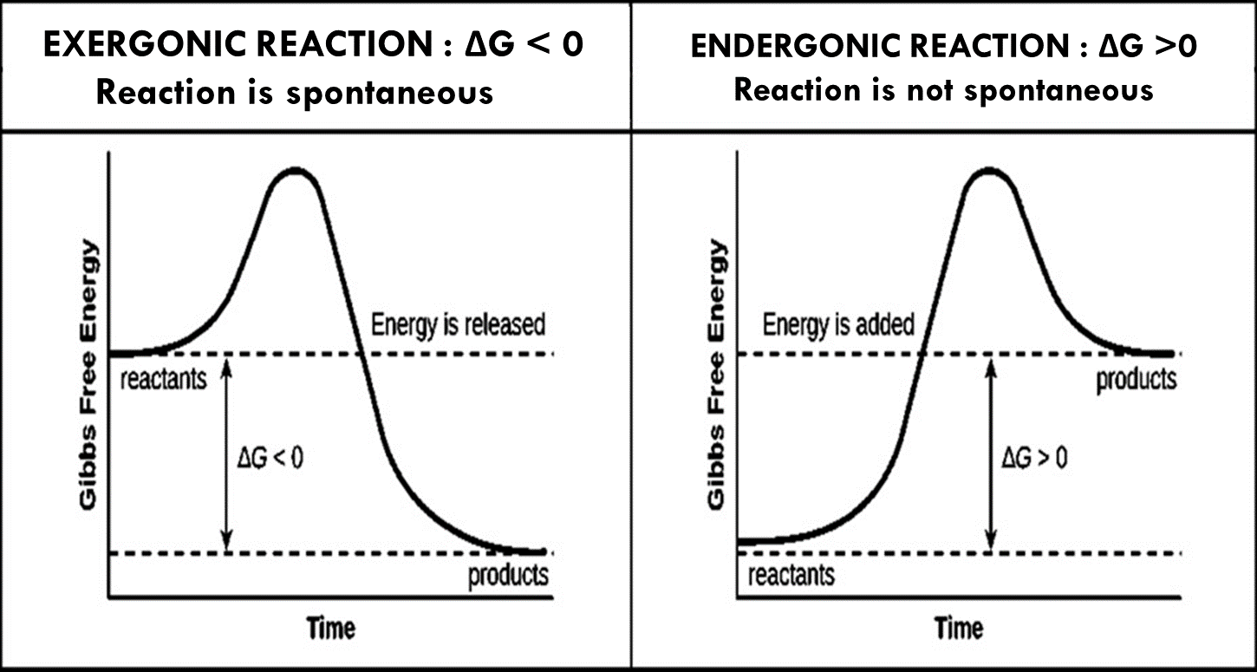

Slide 10
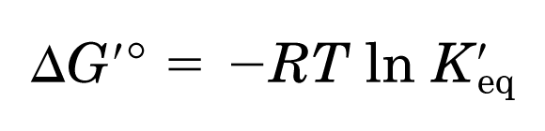
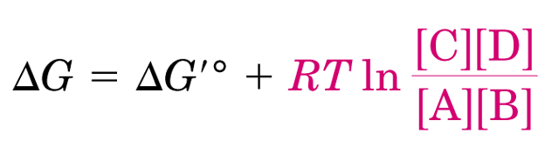
Standard free energy change
Free energy change of a reaction at standard conditions (at 298 K and 1 atm pressure, pH of 7.0 and, when the initial concentrations of reactants and products are at 1M each).
aA + bB → cC + dD
(Equilibrium constant) K_{eq} = [C]^{c}[D]^{d}/[A]ª[B]^{b}
Actual free energy change depends on reactants and product concentration

Slide 11
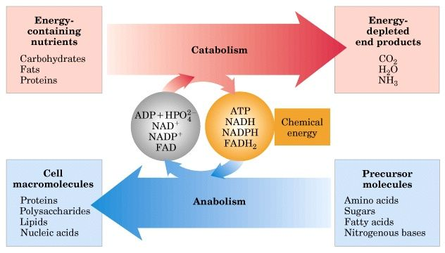

Slide 12
Oxidation-Reduction reactions in biological systems
Transfer free energy in biological systems through flow of electron in oxidation reduction reactions.
Flow of electrons can be used to do useful work.
In living systems, electron flow from various electron carrier to oxygen and the EMF (electro-motive force) generated is utilized for various energy transduction reactions.

Slide 13
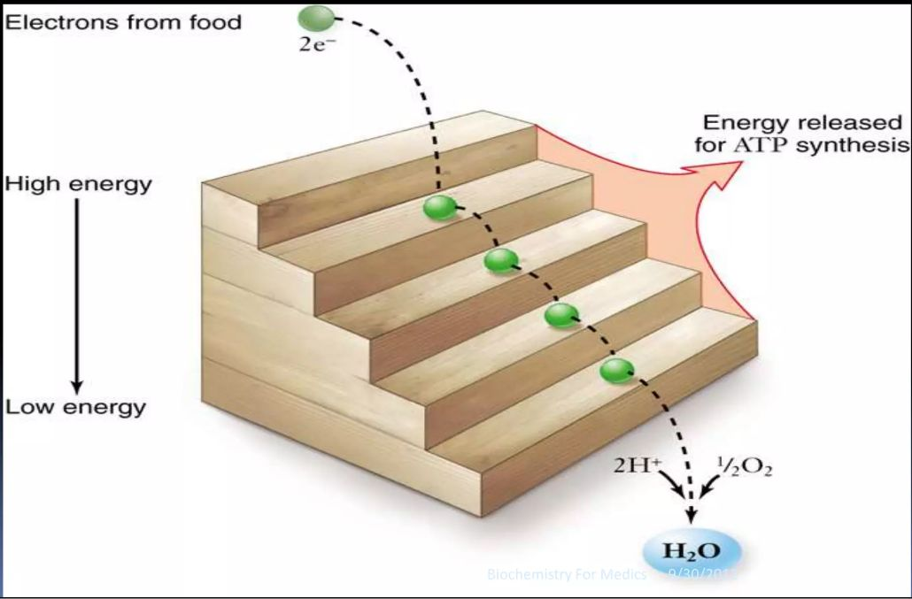

Slide 14
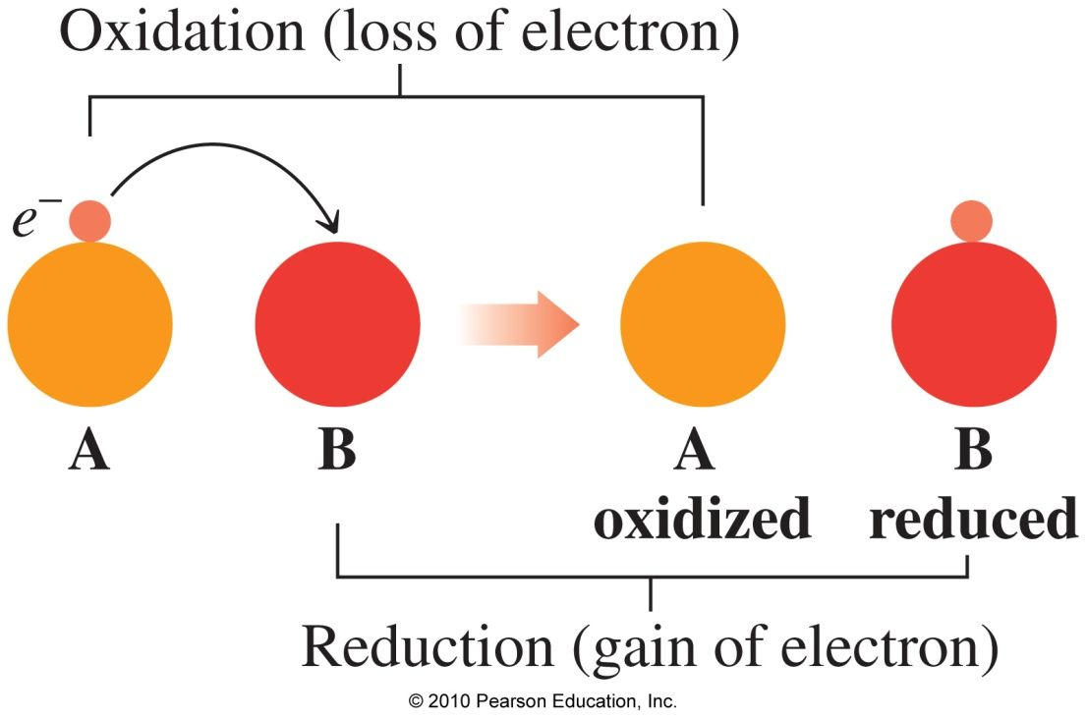
Oxidation and Reduction

Slide 15
Oxidation–Reduction in Biological Systems
In biological systems, oxidation may involve
the loss of H
the gain of O
In biological systems, reduction may involve
the gain of H
the loss of O

Slide 16
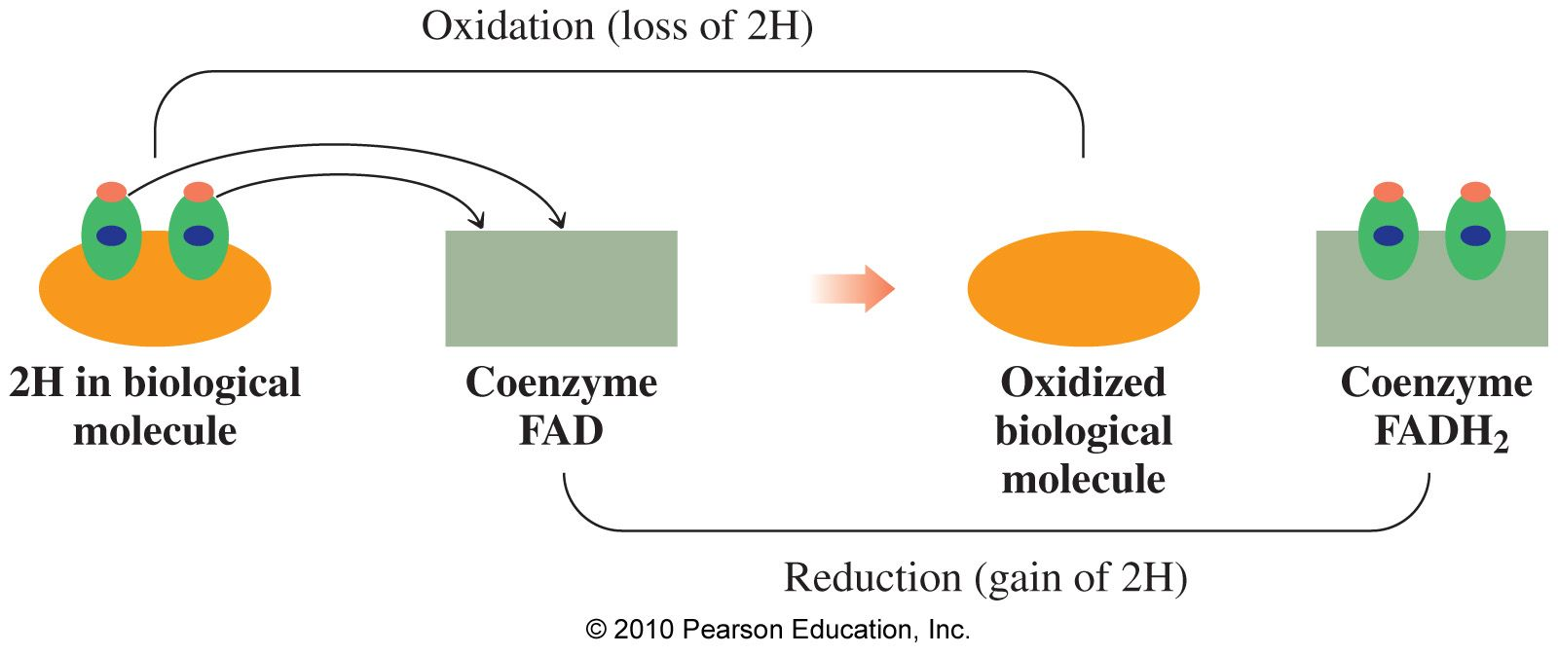
Oxidation–Reduction in Biological Systems

Slide 17
Redox potential (E⁰)
Is a quantitative measure of the tendency of a redox pair to lose or gain electrons.
A specific standard redox potential (E⁰ volts) is assigned to each redox pair at pH- 7.0 and 25°C.
More negative redox potential represents a greater tendency to lose electrons.
More positive redox potential indicates a greater tendency to accept electrons.
Electrons flow from a redox pair with more negative E⁰ to more positive E⁰.

Slide 18
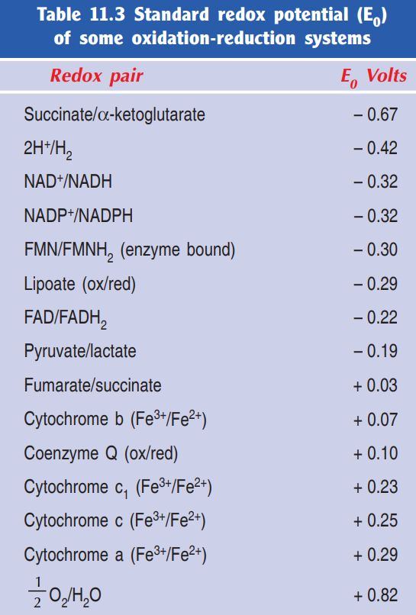

Slide 19
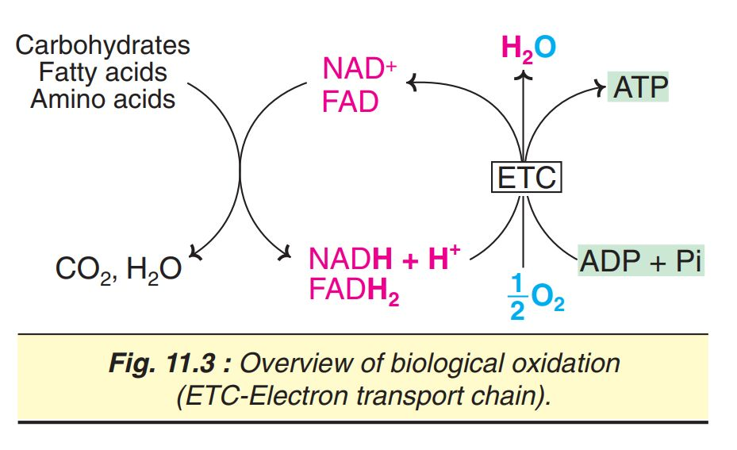

Slide 20
Enzymes involved in biological oxidation
Class: Oxidoreductases.
Further grouped into 4 categories.
Oxidases
Dehydrogenases
Hydro peroxidases
Oxygenases.

Slide 21
Oxidases
Catalyse the elimination of hydrogen from the substrates which is accepted by oxygen to form mostly water
E.g. Cytochrome Oxidase, Tyrosinase, Monoamine Oxidase
Some flavoproteins containing FAD or FMN also belong to the category of oxidases.
E.g. L-amino acid oxidase (FMN), xanthine oxidase (FAD).

Slide 22
Dehydrogenases
Catalyze the reversible transfer of hydrogen from one substrate to another.
  NAD⁺ dependent dehydrogenases: Alcohol dehydrogenase, Glycerol 3-phosphate dehydrogenase etc.
  NADP⁺ dependent dehydrogenases: HMG CoA reductase, Enoyl reductase etc.
  FMN dependent dehydrogenases: NADH dehydrogenase.
  FAD dependent dehydrogenases: Succinate dehydrogenase, Acyl coa dehydrogenase etc.
  Cytochromes: All the cytochromes of E.T.C. (b, c1 and c) except the terminal cytochrome oxidase (a+a3).
Notes:
Thus, bring about oxidation-reduction reactions

Slide 23
Hydroperoxidases
Hydrogen peroxide is the substrate for these enzymes.
H₂O₂ is produced in the reactions catalysed by the aerobic dehydrogenases.
Harmful effects of H₂O₂ are prevented by hydroperoxidases,
E.G. Peroxidase and Catalase.
H₂O₂ → H₂O + O₂

Slide 24
Oxygenases
catalyses the direct incorporation of oxygen into the substrate molecules.
    Dioxygenases (true oxygenases):
    responsible for the incorporation of both atoms of oxygen (O2) into the substrate, e.g. Homogentisate Oxidase, L-tryptophan pyrrolase.
    Monooxygenases (mixed function oxidases):
    Catalyse the incorporation of one atom of oxygen ( 1/2 O₂) while the other oxygen atom is reduced to H₂O.
    NADPH usually provides the reducing equivalents.
    E.g. Cytochrome P₄₅₀ monooxygenase system of microsomes of microsomes.

Slide 25
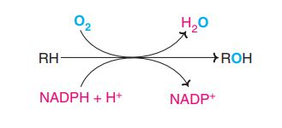
Monooxygenases (mixed function oxidases)

Slide 26
High-energy compounds
Certain compounds are in the biological system on hydrolysis, yield energy.
High-energy compounds or energy-rich compounds are applied to substances that possess sufficient free energy to liberate (at least 7 Cal/mol at pH 7.0).
All the high-energy compounds, when hydrolyzed—liberate more energy than that of ATP.
Notes:
These include phosphoenol pyruvate, 1,3- bisphosphoglycerate, phosphocreatine etc.

Slide 27
Standard free energy of hydrolysis of some important compounds
High-energy phosphates | 'G° (Cal/mol)
Phosphoenol pyruvate | –14.8
Carbamoyl phosphate | –12.3
Cyclic AMP | –12.0
1,3-Bisphosphoglycerate | –11.8
Phosphocreatine –10.3 | –10.3
Acetyl phosphate | –10.3
S-Adenosylmethionine* | –10.0
Pyrophosphate | –8.0
Acetyl CoA** | –7.7
ATP →ADP + Pi | –7.

Slide 28
Classification of high-energy compounds
Pyrophosphates e.g. ATP.
Acyl phosphates e.g. 1,3-bisphosphoglycerate.
Enol phosphates e.g. phosphoenolpyruvate.
Thioesters e.g. acetyl CoA.
Phosphagens e.g. phosphocreatine.
Notes:
Most of the high-energy compounds contain phosphate group (except acetyl CoA) hence they are called high-energy phosphate compounds.
high-energy compounds possess acid anhydride bonds (mostly phosphoanhydride bonds) which are formed by the condensation of two acidic groups or related compound

Slide 29
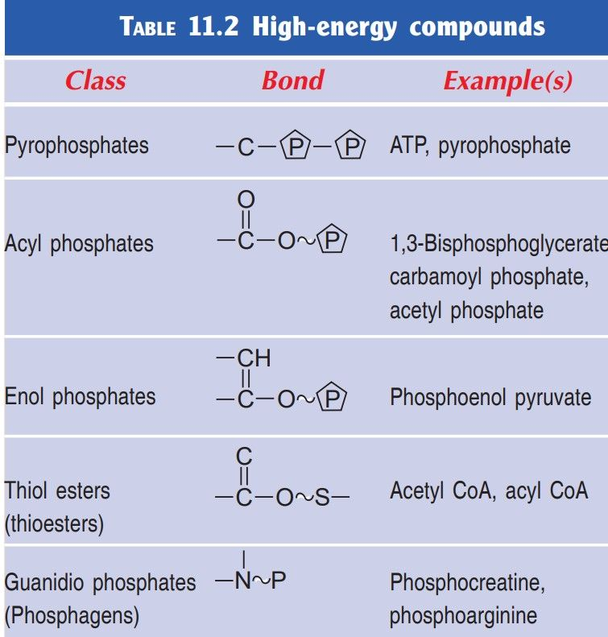

Slide 30
ATP as currency of free energy
It consists of an adenine, a ribose, and a triphosphate moiety
ATP is a high-energy compound due to the presence of two phosphoanhydride bonds in the triphosphate unit.
ATP serves as the energy currency of the cell as is evident from the ATP-ADP cycle.
ATP acts as an energy link between the catabolism and anabolism in the biological system
Notes:
Adenosine triphosphate (ATP) is a unique and the most important high-energy molecule in living cells.
ATP acts as an energy link between the catabolism (degradation of molecules) and anabolism (synthesis) in the biological system

Slide 31
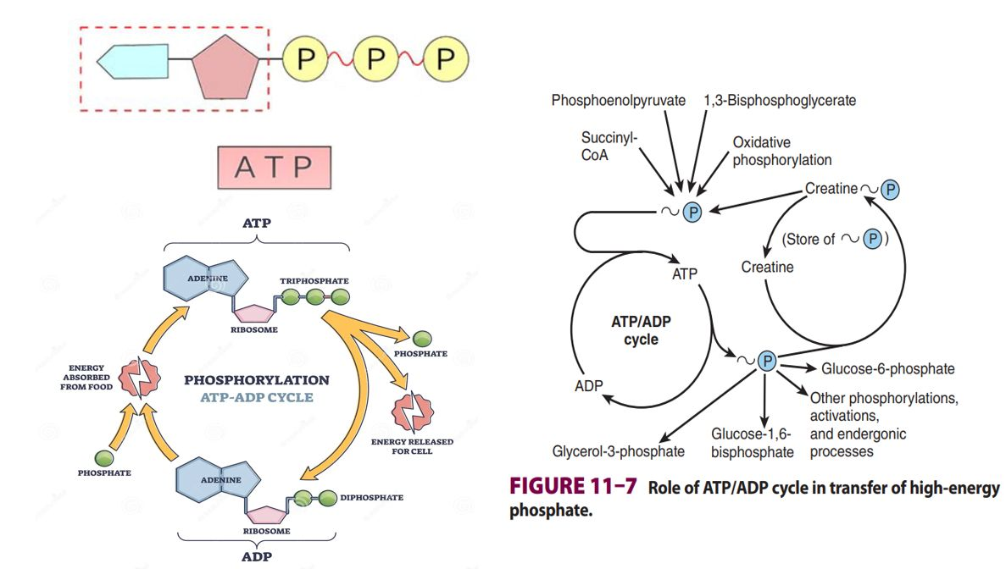

Slide 32
Basis of high energy of hydrolysis of ATP
Resonance stabilization of products
Electrostatic repulsion between negatively charged oxygen atoms in ATP
High solvation energy of products

Slide 33
Synthesis of ATP
ATP can be synthesized in two ways:
Oxidative phosphorylation:
  Major source of ATP in aerobic organisms.
  Linked with the mitochondrial electron transport chain
Substrate level phosphorylation:
  ATP may be directly synthesized during substrate oxidation in the metabolism.

Slide 34
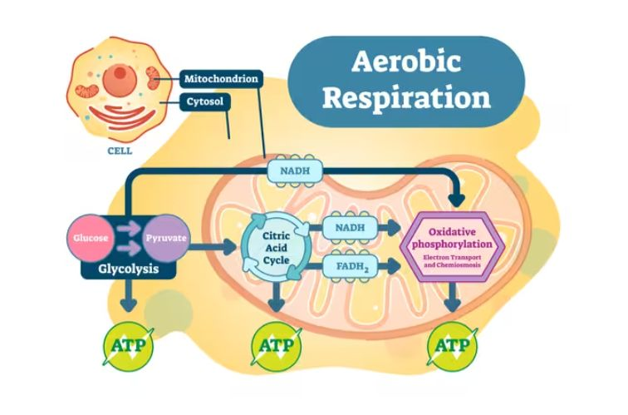
Substrate level phosphorylation

Slide 35
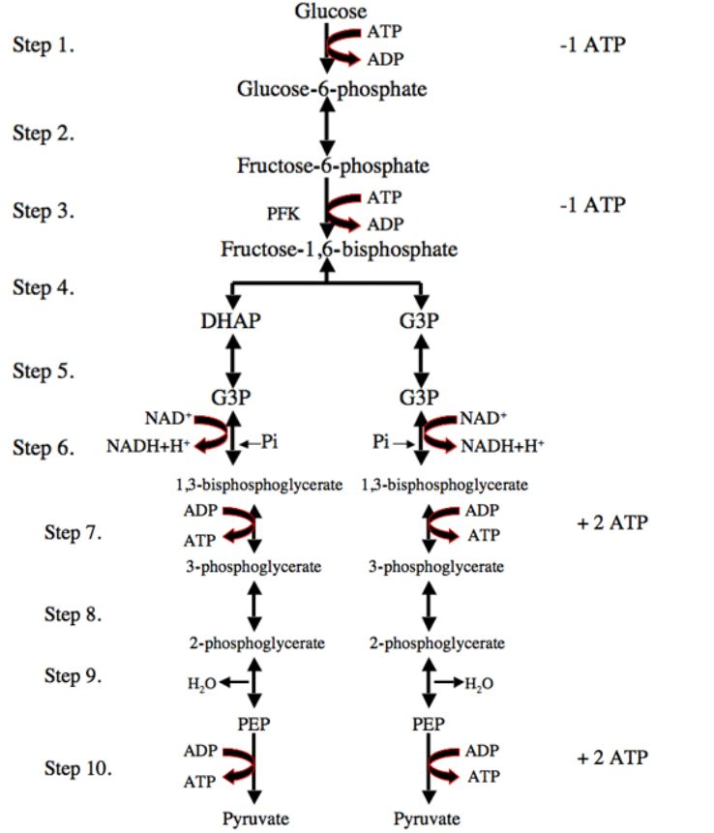
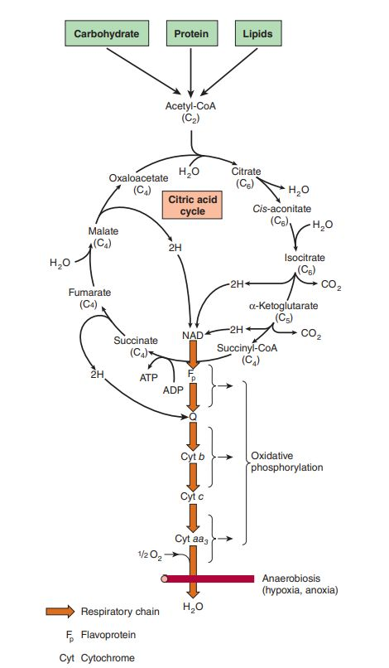
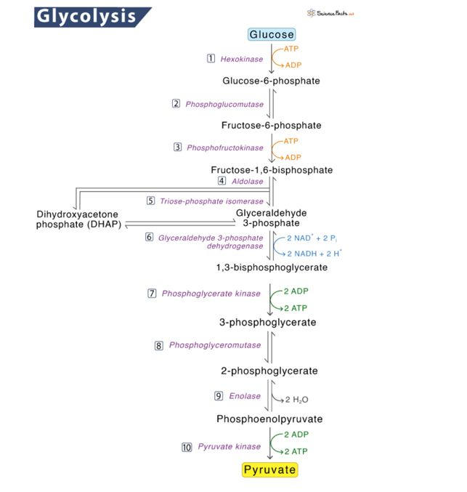

Slide 36
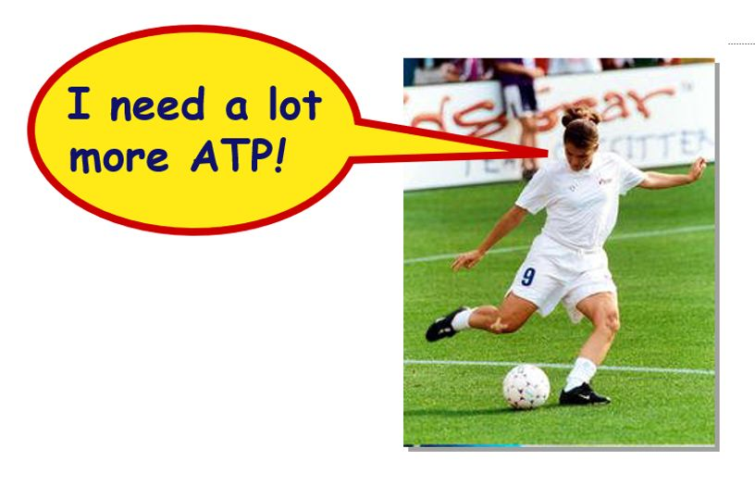
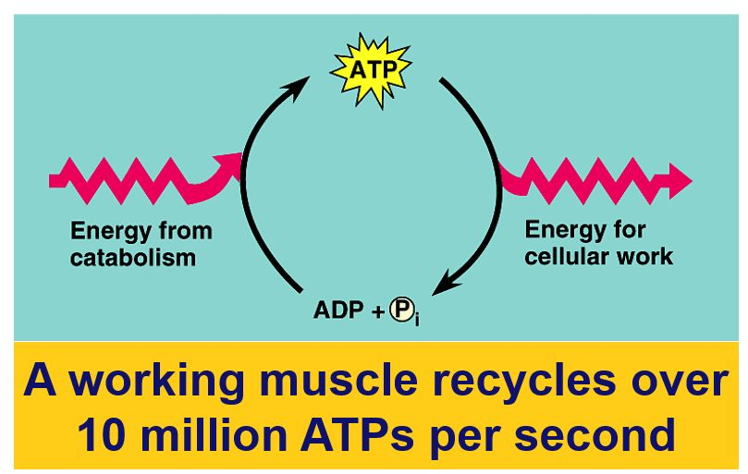
Life takes a lot of energy to run, need to extract more energy than 4 ATP!

Slide 37
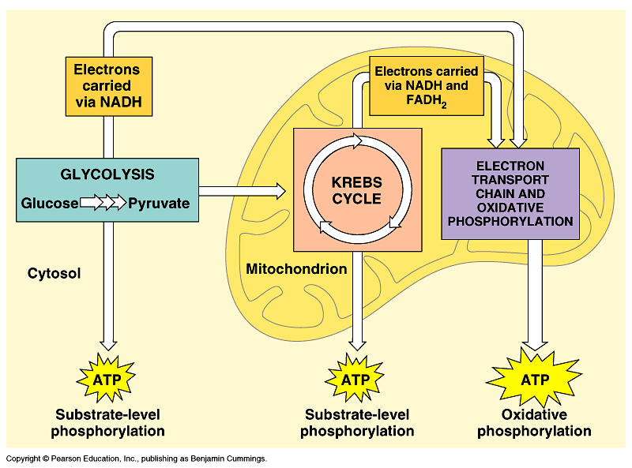
Oxidative phosphorylation

Slide 38
Electron Transport Chain

Slide 39
Electron Transport Chain
Also known as cellular respiration
Highly exergonic, producing energy gradually.
Process is stepwise, efficient, and controlled.
Electron pass on from electronegative NADH/ FADH₂ to electropositive O₂
95% O₂ of consumed by humans is reduced to H₂O by cytochrome oxidase (300 ml H₂O/day) and called metabolic water.
Transport of electrons down ETC linked to pumping of H⁺ to create proton gradient that yields ATP
Notes:
yields ~36 ATP from 1 glucose!
only in presence of O₂ (aerobic respiration)
Oxidative Phosphorylation: The proton gradient runs downhill to drive the synthesis of ATP.
This During hydrogen (H+ and electron) transfer through different components of the redox chain, energy is released gradually in small utilizable amounts instead of a massive energy production in the form of heat, which if happens may destroy the living cells

Slide 40
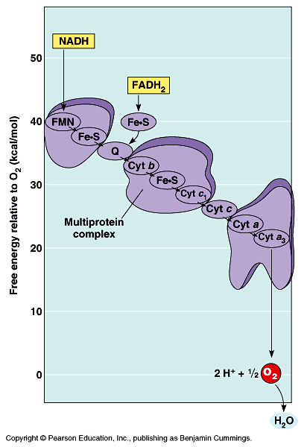
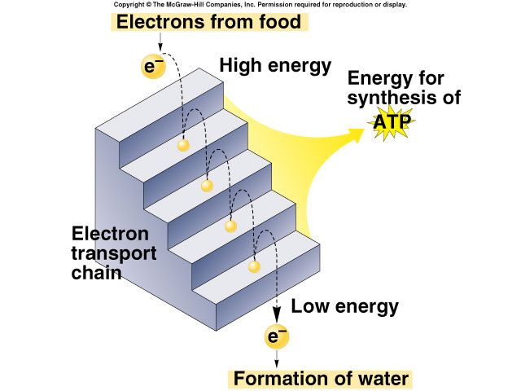

Slide 41
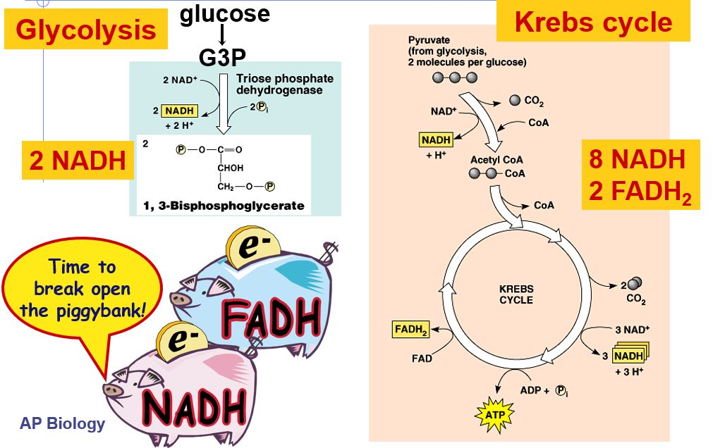

Slide 42
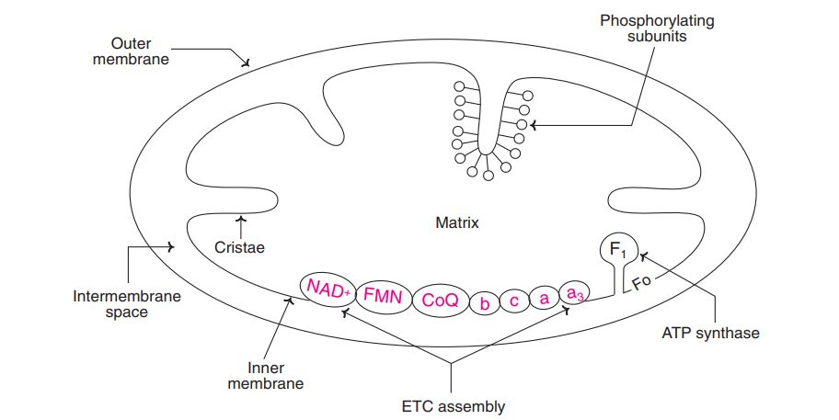
Site for E T C
Inner mitochondrial membrane
Notes:
Electrons carried by reduced coenzymes are passed through a chain of proteins and coenzymes to drive the generation of a proton gradient across the inner mitochondrial membrane

Slide 43
Components of ETC
Four protein complexes (I-V) in the inner mitochondrial membrane.
Complex V is responsible for ATP synthesis.
A lipid-soluble coenzyme (UQ, Co-Q) and
A water-soluble protein (Cyt-c) shuttle between protein complexes.
Flow of electrons through Complexes I, III, and IV results in the pumping of protons from the matrix across the inner mitochondrial membrane into the intermembrane space.
Notes:
Components of ETC are arranged in order of increasing redox potential.
Electrons generally fall or flow in energy through the chain - from complexes I and II to complex III -> IV

Slide 44
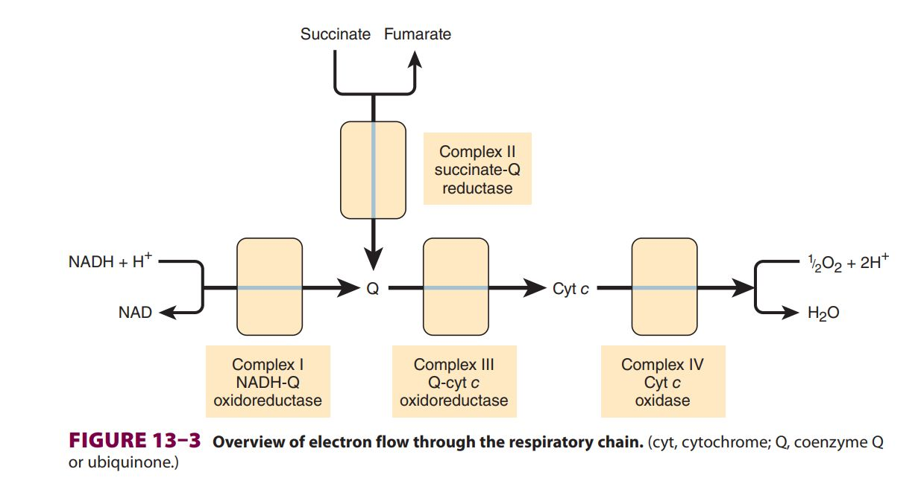

Slide 45

Complex I
NADH-Co-Q reductase
Catalyzes electron transfer from NADH to Q, coupled with the transfer of 4H⁺ (protons) across the membrane.
Electrons are transferred from NADH to FMN initially, then to a series of Fe-S centers, and finally to Q
Notes:
4H⁺ pumped

Slide 46
Complex II
Succinate dehydrogenase (Succinate Co-Q reductase)
FADH₂ is formed during the conversion of succinate to fumarate in the citric acid cycle.
Electrons are then passed via several Fe-S centers to Q

Slide 47
Iron–sulfur proteins (Fe–S)
Iron sulfur proteins (non-heme iron proteins, Fe-S center).
Found in complexes I, II, and III.
These may contain 1, 2, or 4- Fe atoms linked to inorganic sulfur atoms and/or via cysteine SH groups to the protein.
Fe-S takes part in single electron transfer reactions.
1 Fe atom undergoes oxidoreduction between Fe²⁺ and Fe³⁺.

Slide 48
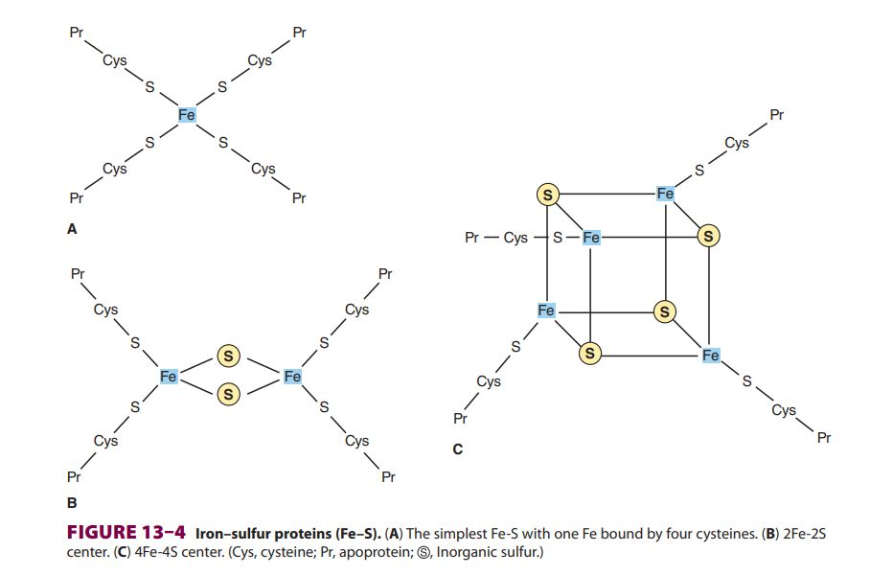

Slide 49
Coenzyme Q
Mobile electron carrier
Lipid soluble Ubiquinone called Coenzyme Q that accept electrons from complex I and II to transfer them into complex III
Q may exist in three forms: oxidized quinone, reduced quinol, or semiquinone.
Oxidation of 1 QH₂ (reduced quinol) is coupled to the reduction of two molecules of cytochrome c via the Q cycle.
Notes:
Semiquinone is formed transiently during the cycle, one turn of which results in the oxidation of 2QH2 to Q, releasing 4H+ into the intermembrane space,
Reduction of one Q to QH2 , causing 2H+ to be taken up from the matrix
Q carries two electrons, but the cytochromes carry only one.

Slide 50
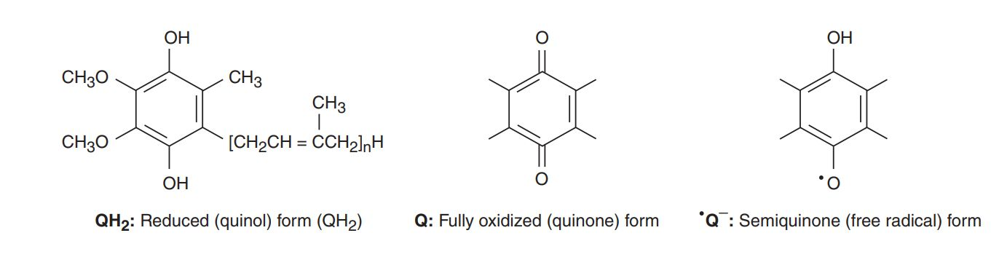
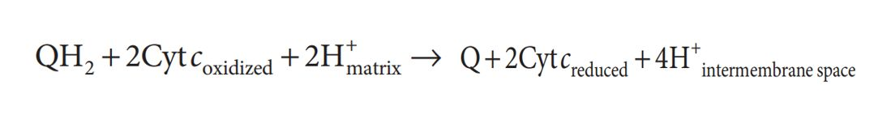

Slide 51
Q cycle

Slide 52
Complex III
Co-Q-Cytochrome c reductase
Contains cytochromes, b, c₁ and c
Cyt c: is a water-soluble / mobile electron carrier,
Transfers electrons from complex III to complex IV.
4H⁺ pumped
Notes:
4H+ pumped.
passes electrons to Cyt c (and pumps H+ ) in a unique redox cycle known as the Q cycle

Slide 53
Complex IV
Cytochrome oxidases - a+a₃ (Heme and Copper center).
Electrons from Cyt c are used in a 4-electron reduction of O₂ to produce 2H₂O.
O₂ is the final electron acceptor.
2H+ pumped

Slide 54
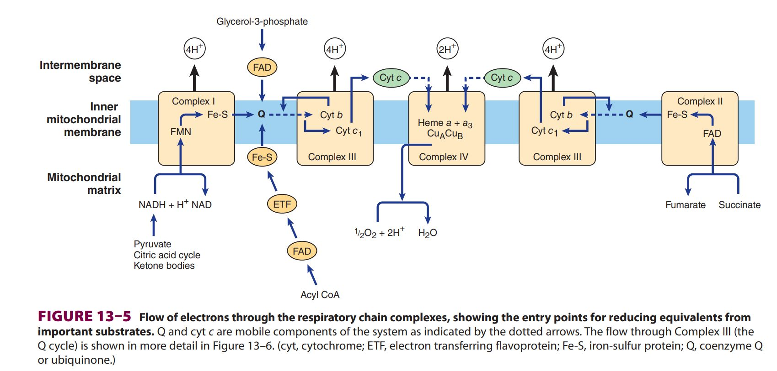

Slide 55
Complex V
ATP Synthase
ATP synthase is embedded in the inner membrane, together with the respiratory chain complexes.
Proton motive force drives ATP synthase to forms ATP in the presence of pi + ADP
Notes:
Enzyme uses the proton gradient across the inner membrane to drive the synthesis of ATP

Slide 56
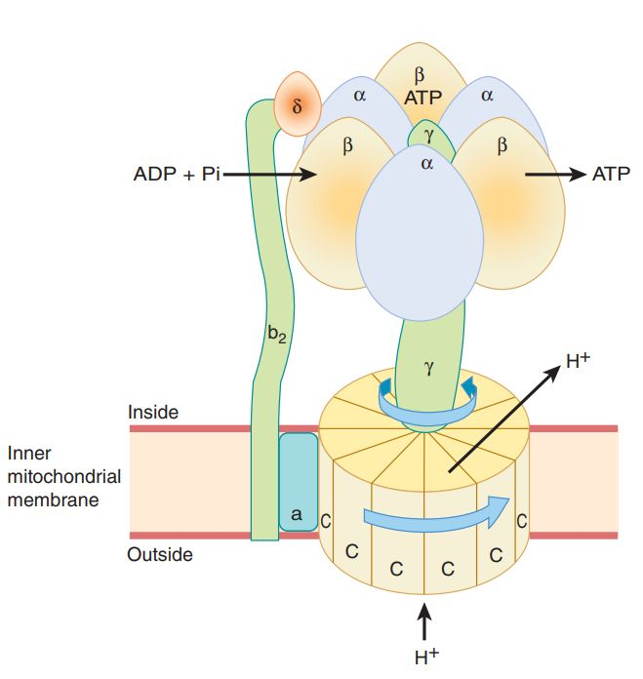
ATP synthase
ATP synthase is F₀-F₁ complex (of complex V).
F₀ subcomplex is composed of channel protein ‘C’ that spans IMM.
F₁-consists of a central γ subunit surrounded by alternating α and β subunits (α3 and β3)
Matrix
Inner
Mitochondrial
Membrane

Slide 57
Oxidative Phosphorylation
flow of electrons through the respiratory chain (ETC) generates ATP by the process of oxidative phosphorylation
Coupling of ETC with the formation of ATP from ADP and Pi.
Notes:
process of synthesizing ATP from ADP and Pi coupled with the electron transport chain/ flow of electrons through the respiratory chain generates ATP by the process of oxidative phosphorylation. T

Slide 58
Sites of oxidative phosphorylation in ETC
Oxidation of FMNH2 by coenzyme Q. (Complex I)
Oxidation of cytochrome b by cytochrome c. (Complex III)
Cytochrome oxidase reaction. (Complex IV)
Notes:
Each one of the above reactions represents a coupling site for ATP production. Complexes I, III, and IV act as proton pumps.

Slide 59
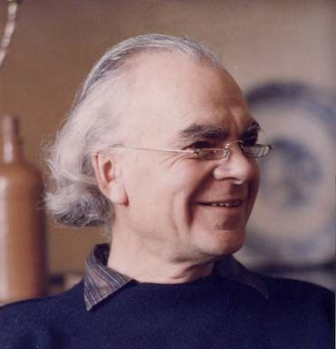
Chemiosmotic hypothesis
Peter Mitchell (1961) proposed the Chemiosmotic hypothesis
Flow of electrons through ETC is coupled with the translocation of protons (H+) across the inner mitochondrial membrane which generates Proton motive force.
That drives the mechanism of ATP synthesis.
Peter Mitchell
Notes:
revolutionary idea at the time,
: caused by the electrochemical potential difference (negative on the matrix side).
Energy obtained from electron transport is coupled to the proton motive force in what’s called chemiosmosis.

Slide 60
Mitchell’s hypothesis (chemiosmosis model)
Complex I, III, and IV act as proton pumps.
Protons that accumulate on the intermembrane space re-enter the mitochondrial matrix Complex V.
Energy released by a flow of H⁺ down its gradient is used for ATP synthesis
Notes:
The translocation of protons H⁺ from the mitochondrial matrix into the inter-mitochondrial space is called proton pumping.
More +ve on the outside of the membrane than on the inside
H⁺ pumping and electron transport result in an electrochemical gradient.

Slide 61
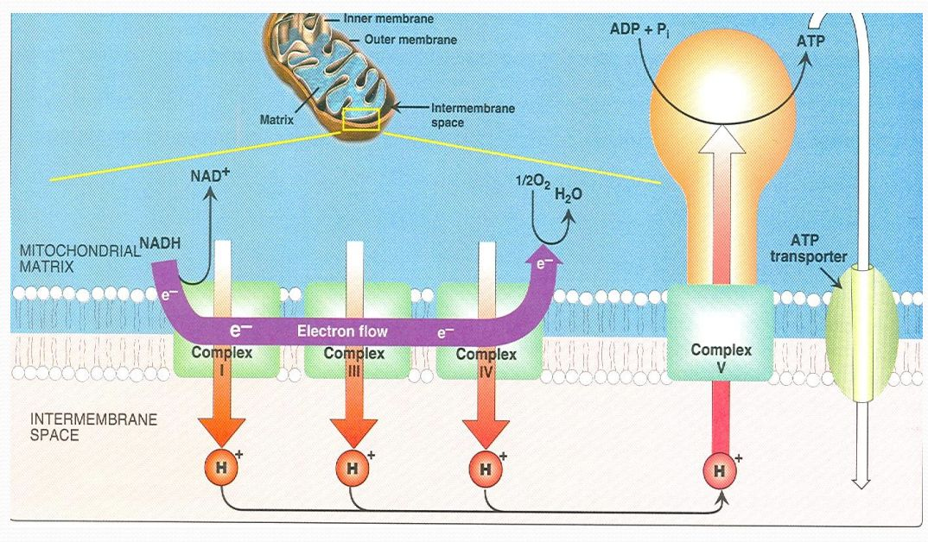

Slide 62
Findings to support the chemiosmosis model
Addition of protons (acid) to the external medium of the mitochondria stimulates ATP production.
Oxidative phosphorylation does not occur in the case of solubilising mitochondrial membranes.
Uncouplers

Slide 63
Rotary motor model for ATP generation
Binding change model
Paul Boyer in 1964 proposed that a conformational change in the enzyme ATP synthase leads to the synthesis of ATP.
In response to the proton flux through the F₀ unit of ATP synthase,
the γ subunit physically rotates.
This induces conformational changes in the β₃ subunits that finally lead to the release of ATP
Notes:
Nobel Prize, 1997

Slide 64
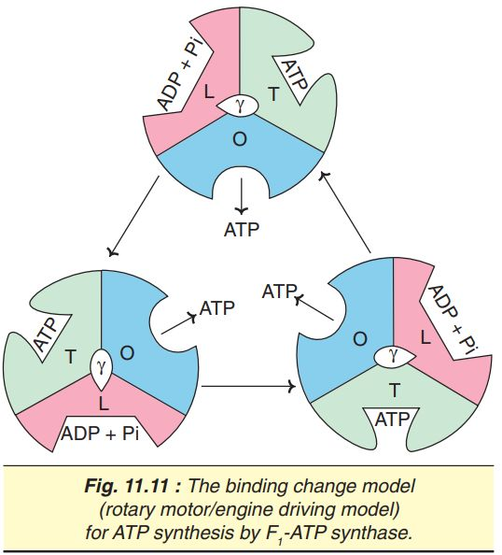
Binding change model
3β subunits of F₁-ATP synthase has different conformations.
One subunit has open (O) conformation,
Second has loose (L) conformation,
Third has tight (T) conformation
Notes:
The substrates ADP and Pi bind to E subunit in

Slide 65
Conformation changes
ADP and Pi bind to the β subunit in L-conformation.
L changes to T conformation, and this leads to the synthesis of ATP.
T changes to O conformation and releases ATP.
Cycle of conformation changes is repeated
3 ATP are generated for each revolution
Notes:
O changes to L conformation which binds to ADP and Pi.

Slide 66
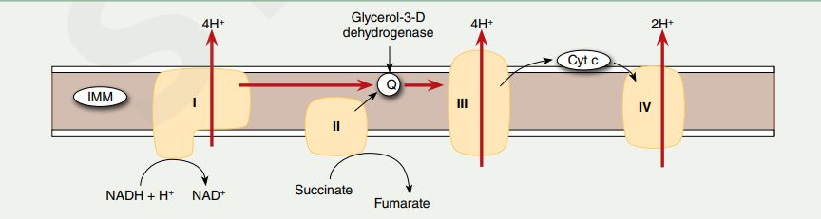
P:O Ratio
Refers to the number of inorganic phosphates utilized to synthesize ATP for every atom of oxygen consumed.
Synthesis of one ATP requires four protons.
P:O ratio of 2.5 for NADH, and 1.5 for FADH₂,

Slide 67
Regulation of ETC
No storage form for ATP.
ATP formed is only sufficient to cover the needs of cell at the moment.
So, there should be a controlled way for the production of ATP in ETC.
  1. Availability of ADP (ADP/ATP transporter is a rate-limiting step in ETC).
  2. Availability of electrons: NADH/NAD ratio or FADH2/FAD ratio.
  3. Availability of O₂

Slide 68
Inhibitors of electron transport chain (ETC)
Inhibitors bind to one of the components of ETC and block the transport of electrons.
Causes the accumulation of reduced components before the inhibitor blockade step and oxidized components after that step.
All the site-specific inhibitors of ETC also inhibit ATP formation.

Slide 69
Inhibitors of Complex I
Blocks the transfer from Fe-S to Q.
Examples:
  Barbiturates (antidepressant drugs- Amytal)
  Rotenone (Fish poison)
  Piercidin A (antibiotic)
  Guanithidine.

Slide 70
Inhibitors of Complex II
Malonate is a competitive inhibitor of succinate dehydrogenase (Complex II).
TTFA (Trienoyl tri fluoro acetone)- iron chelating agent .
Carboxin

Slide 71
Inhibitors of Complex III
Inhibitors of the site between cytochrome b and c1.
Examples:
  Antimycin A — an antibiotic,
  British antilewisite (BAL)— an antidote used against war-gas.
  Dimercaprol
  Phenformin

Slide 72
Inhibitors of Complex IV
Inhibit cytochrome oxidase.
Examples:
  Carbon Monoxide
  Cyanide
  Hydrogen Sulfide
  Azide

Slide 73
Inhibitors of Oxidative Phosphorylation
Oligomycin: This antibiotic prevents mitochondrial oxidation as well as phosphorylation.
It binds with the enzyme ATP synthase and blocks the flow of the proton (H+).
Atractyloside: This toxin inhibits oxidative phosphorylation by inhibiting the transporter of ADP into and ATP out of the mitochondria.
Thus, blocks the adequate supply of ADP, for ATP synthesis.
Notes:
It thus prevents the translocation (re-entry) of protons into the mitochondrial matrix.
by inhibiting the transporter of ADP into and ATP

Slide 74
Uncouplers
Dissociate/ delink oxidation in the ETC from phosphorylation.
Act by increasing the permeability of the inner mitochondrial membrane to protons (H⁺).
leads to failure of the electrochemical gradient formation.
ATP formation stops while oxidation proceeds.
Energy is released as heat rather than ATP.

Slide 75
Physiological Uncouplers
Thermogenin (or uncoupling protein, UCPI) is a physiological uncoupler.
Located in the inner mitochondrial membrane of brown adipose tissue.
It blocks the formation of ATP and generates heat.
Significant in the newborn, and during hibernation in animals.
Other examples of physiological uncoupler include:
  Thyroxine
  Long chain free fatty acids.
  Unconjugated bilirubin

Slide 76
Chemical /Toxic Uncouplers
2,4-dinitrophenol (DNP), is a classic chemical uncoupler.
DNP is a proton carrier and can easily diffuse through the inner mitochondrial membrane
DNP is a banned drug for weight loss due to side effects.
Other uncouplers include:
  Dinitrocresol
  Pentachlorophenol,
  Trifluorocarbonylcyanide Phenylhydrazone (FCCP)
  In high doses, the drug aspirin acts as an uncoupler.
Notes:
In the people seeking to lose, was used as a

Slide 77
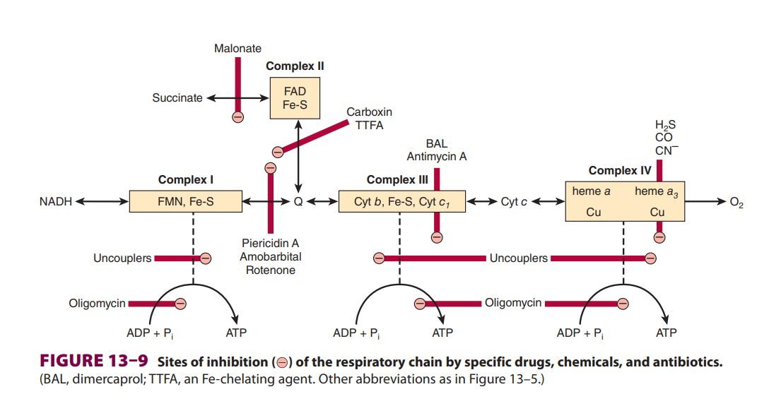

Slide 78
Ionophores
Term ‘ionophores’ represents the lipophilic substances that transport ions across biological membranes.
Antibiotics: Valinomycin, Gramicidin A, and Nigercin act as ionophores for K+ ions.
These compounds are capable of dissipating proton gradient across the inner mitochondrial membrane.
Thus, inhibit oxidative phosphorylation.
Notes:
All the uncouplers are, in fact, proton ionophores.

Slide 79
Oxidation of extra-mitochondrial NADH
Some NADH molecules are formed in the cytosol.
NADH cannot penetrate the mitochondrial membrane
They must be transported into the mitochondria for electrons to enter the ETC.
Two different “shuttles” are commonly encountered:
  Malate-aspartate shuttle (transfers electrons to NADH)
  Glycerol 3-phosphate shuttle (transfers electrons to FADH₂ ).

Slide 80
Malate- Aspartate shuttle: (NADH-> NADH)
In the cytosol, oxaloacetate accepts the reducing equivalents (NADH) and becomes malate.
Malate then enters mitochondria where it is oxidized by mitochondrial malate dehydrogenase.
In this reaction, NADH and oxaloacetate are regenerated.
NADH gets oxidized via the electron transport chain and 2.5 ATP are produced.
Liver and heart utilize the malate-aspartate shuttle

Slide 81
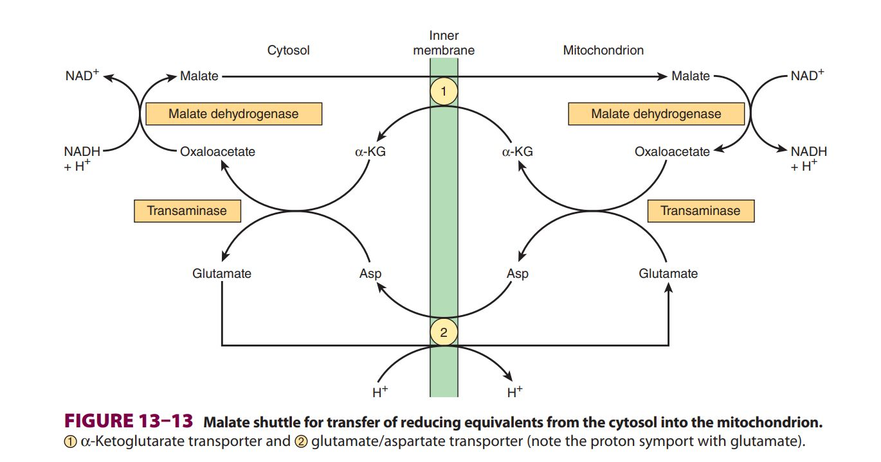

Slide 82
Glycerol 3-phosphate shuttle:(NADH->FADH₂)
Cytosolic glycerol 3-phosphate dehydrogenase oxidizes NADH to NAD+.
Reducing equivalents are transported through glycerol 3-phosphate into the mitochondria.
Glycerol 3-phosphate dehydrogenase—present on the inner mitochondrial membrane— reduces FAD to FADH₂.
Dihydroxyacetone phosphate escapes into the cytosol and the shuttling continues.
FADH₂ gets oxidized via ETC to generate 1.5 ATP.

Slide 83
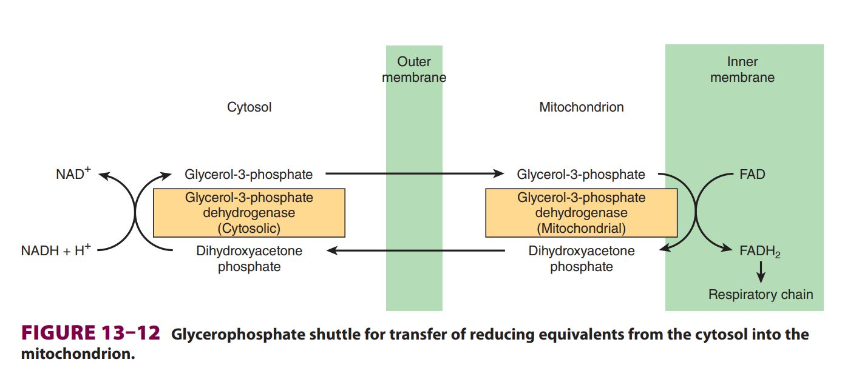

Slide 84
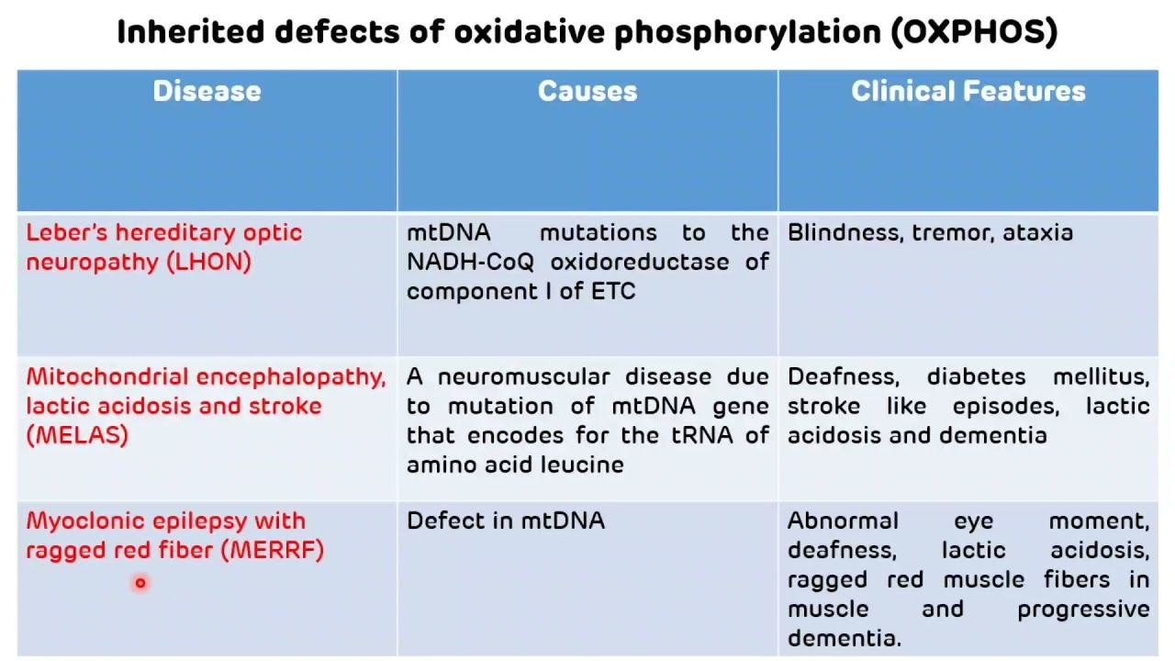
Inherited disorders of oxidative phosphorylation
Notes:
mtDNA is maternally inherited since mitochondria from the sperm do not enter the fertilized ovum

Slide 85
THANK YOU

