Slide 2
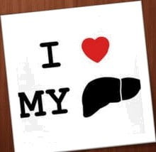
The l‹ e has a wade ange of funct ons ‹n ludo g
dc i a io of va ious metabolites
D di s he i and p oduction of biochemicals
compensa e o the absence o live func ion in the

Slide 29
