Slide 1
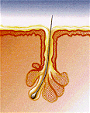
Acne Treatment and Therapeutic Strategies
The Aga Khan University Hospital, Karachi
Dr. Marie Andrades
Senior Instructor
Family Medicine

Slide 2
Acne Treatment and Therapeutic Strategies
The Aga Khan University Hospital, Karachi
One of the most common skin diseases presenting to family physicians
Considerable psychological impact on the quality of life
No cure, but the disease can be controlled through medications

Slide 3
Acne Treatment and Therapeutic Strategies
The Aga Khan University Hospital, Karachi
Pathophysiology
Four important factors
plugging of the hair follicle
hyperactivity of the sebaceous gland
proliferation of Propionobacterium Acnes
inflammation

Slide 4
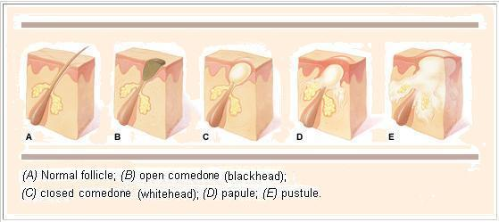
Acne Treatment and Therapeutic Strategies
The Aga Khan University Hospital, Karachi
Stages of Development

Slide 5
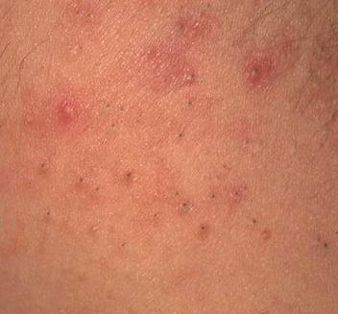
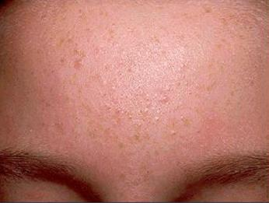
Acne Treatment and Therapeutic Strategies
The Aga Khan University Hospital, Karachi
Comedonal Lesions

Slide 6
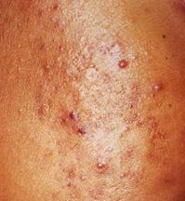
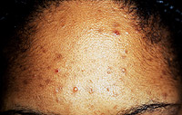
Acne Treatment and Therapeutic Strategies
The Aga Khan University Hospital, Karachi
Inflammatory Lesions

Slide 7
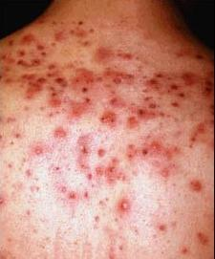
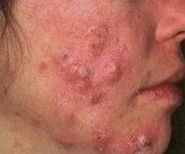
Acne Treatment and Therapeutic Strategies
The Aga Khan University Hospital, Karachi
Nodulocystic Lesions

Slide 8
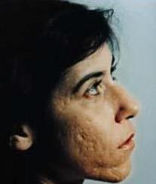
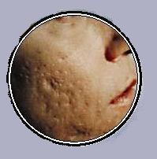
Acne Treatment and Therapeutic Strategies
The Aga Khan University Hospital, Karachi
Scarring

Slide 9
Acne Treatment and Therapeutic Strategies
The Aga Khan University Hospital, Karachi
Patient Evaluation
Key Elements in History
previous medications used
current products being used for acne
medical problems
other medications
use of cosmetics or hair pomades
recreational activities and occupation

Slide 10
Acne Treatment and Therapeutic Strategies
The Aga Khan University Hospital, Karachi
Patient Evaluation
For Female Patients
menstrual history
hirsutism
use of hormonal contraceptives

Slide 11
Acne Treatment and Therapeutic Strategies
The Aga Khan University Hospital, Karachi
Management
Patient Education (Dispelling Myths)
hygiene
diet
cosmetics
hair styles

Slide 12
Acne Treatment and Therapeutic Strategies
The Aga Khan University Hospital, Karachi
Management
Patient Education
washing of lesions
picking lesions
premenstrual flare
hair care products

Slide 13
Acne Treatment and Therapeutic Strategies
The Aga Khan University Hospital, Karachi
Management
Patient Education
improvement is not overnight
treatment must be used regularly
treatment is long term

Slide 14
Acne Treatment and Therapeutic Strategies
The Aga Khan University Hospital, Karachi
Management
Topical Therapy (Indications)
comedonal acne
mild to moderate inflammatory acne

Slide 15
Acne Treatment and Therapeutic Strategies
The Aga Khan University Hospital, Karachi
Management
Topical Therapy (Basic Rules)
avoid applying medication right after
washing face
avoid over use of medication
apply on all acne prone areas
if face gets dry apply oil free moisturizer

Slide 16
Acne Treatment and Therapeutic Strategies
The Aga Khan University Hospital, Karachi
Management
Topical Therapy (Treatment Vehicle)
cream → sensitive or dry skin
lotion → any skin type
gel → oily skin
solution → oily skin

Slide 17
Acne Treatment and Therapeutic Strategies
The Aga Khan University Hospital, Karachi
Management
Topical Therapy (Anti Comedonal Agents)
Topical Retinoids
Azelaic acid
Salicylic acid

Slide 18
Acne Treatment and Therapeutic Strategies
The Aga Khan University Hospital, Karachi
Management
Topical Retinoids 0.025% - 0.5% (application)
apply at night
always apply test dose
start at low concentrations
avoid in pregnancy

Slide 19
Acne Treatment and Therapeutic Strategies
The Aga Khan University Hospital, Karachi
Management
Topical Retinoids 0.025% - 0.1% (side effects)
pustular flare
photosensitivity
skin irritation and erythema
dryness and peeling

Slide 20
Acne Treatment and Therapeutic Strategies
The Aga Khan University Hospital, Karachi
Management
Azelaic Acid 20%
(application and side effects)
applied twice daily
erythema and irritation
decrease in pigmentation

Slide 21
Acne Treatment and Therapeutic Strategies
The Aga Khan University Hospital, Karachi
Management
Salicylic Acid 0.5 - 2%
(application and side effects)
applied twice daily
skin dryness and irritation

Slide 22
Acne Treatment and Therapeutic Strategies
The Aga Khan University Hospital, Karachi
Management
Topical Therapy (Anti Inflammatory Agents)
Benzoyl Peroxide
Topical antibiotics

Slide 23
Acne Treatment and Therapeutic Strategies
The Aga Khan University Hospital, Karachi
Management
Benzoyl Peroxide 2.5 - 10%
(application and side effects)
apply once to twice daily
always apply test dose
avoid use at night
dryness of skin

Slide 24
Acne Treatment and Therapeutic Strategies
The Aga Khan University Hospital, Karachi
Management
Topical Antibiotics, Clindamycin and Erythromycin (application and side effects)
apply twice daily
skin dryness

Slide 25
Acne Treatment and Therapeutic Strategies
The Aga Khan University Hospital, Karachi
Management
Combination therapy
5% Benzoyl Peroxide and 3% Erythromycin
5% Benzoyl Peroxide and 1% Clindamycin
Topical antibiotics and Azelaic acid or Tretinion

Slide 26
Acne Treatment and Therapeutic Strategies
The Aga Khan University Hospital, Karachi
Management
Systemic therapy (Indications)
moderate inflammatory acne non responsive to topical therapy
nodulocystic acne

Slide 27
Acne Treatment and Therapeutic Strategies
The Aga Khan University Hospital, Karachi
Management
Systemic therapy
Oral Antibiotics
Isotretinoin
Hormonal Therapy

Slide 28
Acne Treatment and Therapeutic Strategies
The Aga Khan University Hospital, Karachi
Management
Oral Antibiotics (used for 3-6 months)
Tetracycline 500mg X BD
Doxycycline 100mg X BD
Minocycline 100mg X OD
Eythromycin 500mg X BD
combined with topical therapy

Slide 29
Acne Treatment and Therapeutic Strategies
The Aga Khan University Hospital, Karachi
Management
Isotretinoin (Accutane) indicated in
severe nodulocystic acne
non responsive acne
severe psychological distress
Only to be used by physicians with experience in the therapy of severe dermatological disorders

Slide 30
Acne Treatment and Therapeutic Strategies
The Aga Khan University Hospital, Karachi
Management
Isotretnoin (RoAccutane) side effects
teratogenic
mucosal dryness
photosensitivity
arthralgias
alteration of liver enzymes
hypertriglyceridemia and hypercholesterolemia

Slide 31
Acne Treatment and Therapeutic Strategies
The Aga Khan University Hospital, Karachi
Management
Hormonal Therapy indicated in
acne associated with hirsutism, menstrual irregularity and alopecia
women desiring contraception

Slide 32
Acne Treatment and Therapeutic Strategies
The Aga Khan University Hospital, Karachi
Management
Hormonal Therapy
Oral contraceptives containing low androgenic progesterone
Cyproterone Acetate
Spironolactone

Slide 33
Acne Treatment and Therapeutic Strategies
The Aga Khan University Hospital, Karachi
Comedonal lesions | Lesion | Type(s)

Slide 34
Acne Treatment and Therapeutic Strategies
The Aga Khan University Hospital, Karachi
Comedonal lesions
Topical retinoid
Azelaic acid
Salicylic acid
Lesion
Type(s)

Slide 35
Acne Treatment and Therapeutic Strategies
The Aga Khan University Hospital, Karachi
Comedonal lesions
Topical retinoid
Azelaic acid
Salicylic acid
If results unsatisfactory
Increase strength or change medications
Lesion
Type(s)

Slide 36
Acne Treatment and Therapeutic Strategies
The Aga Khan University Hospital, Karachi
Comedonal lesions
Topical retinoid
Azelaic acid
Salicylic acid
If results unsatisfactory
Increase strength or change medications
Lesion
Mixed comedonal lesions and papulopustules
Type(s)

Slide 37
Acne Treatment and Therapeutic Strategies
The Aga Khan University Hospital, Karachi
Comedonal lesions
Topical retinoid
Azelaic acid
Salicylic acid
If results unsatisfactory
Increase strength or change medications
Type(s)
Lesion Types
Mixed comedonal lesions and papulopustules
Retinoid+topical antibiotics
Retinoid+benzoyl peroxide
Retinoid+benzoyl peroxide+topical antibiotics
Azelaic acid+benzoyl peroxide
Azelaic acid+topical antibiotics

Slide 38
Acne Treatment and Therapeutic Strategies
The Aga Khan University Hospital, Karachi
Comedonal lesions
Topical retinoid
Azelaic acid
Salicylic acid
If results unsatisfactory
Increase strength or change medications
Lesion Types
Mixed comedonal lesions and papulopustules
Retinoid+topical antibiotics
Retinoid+benzoyl peroxide
Retinoid+benzoyl peroxide+topical antibiotics
Azelaic acid+benzoyl peroxide
Azelaic acid+topical antibiotics
If results unsatisfactory prescribe topical retinoid+course of oral antibiotics
Type(s)

Slide 39
Acne Treatment and Therapeutic Strategies
The Aga Khan University Hospital, Karachi
Comedonal lesions
Topical retinoid
Azelaic acid
Salicylic acid
If results unsatisfactory
Increase strength or change medications
Lesion
Mixed comedonal lesions and papulopustules
Retinoid+topical antibiotics
Retinoid+benzoyl peroxide
Retinoid+benzoyl peroxide+topical antibiotics
Azelaic acid+benzoyl peroxide
Azelaic acid+topical antibiotics
If results unsatisfactory prescribe topical retinoid+course of oral antibiotics
Type(s)
Papules and pustules

Slide 40
Acne Treatment and Therapeutic Strategies
The Aga Khan University Hospital, Karachi
Comedonal lesions
Topical retinoid
Azelaic acid
Salicylic acid
If results unsatisfactory
Increase strength or change medications
Lesion
Mixed comedonal lesions and papulopustules
Retinoid+topical antibiotics
Retinoid+benzoyl peroxide
Retinoid+benzoyl peroxide+topical antibiotics
Azelaic acid+benzoyl peroxide
Azelaic acid+topical antibiotics
If results unsatisfactory prescribe topical retinoid+course of oral antibiotics
Type(s)
Papules and pustules
Benzoyl peroxide
If results unsatisfactory switch to or add topical antibiotics

Slide 41
Acne Treatment and Therapeutic Strategies
The Aga Khan University Hospital, Karachi
Comedonal lesions
Topical retinoid
Azelaic acid
Salicylic acid
If results unsatisfactory
Increase strength or change medications
Lesion
Mixed comedonal lesions and papulopustules
Retinoid+topical antibiotics
Retinoid+benzoyl peroxide
Retinoid+benzoyl peroxide+topical antibiotics
Azelaic acid+benzoyl peroxide
Azelaic acid+topical antibiotics
If results unsatisfactory prescribe topical retinoid+course of oral antibiotics
Type(s)
Papules and pustules
Benzoyl peroxide
If results unsatisfactory switch to or add topical antibiotics
If results unsatisfactory add course of oral antibiotics

Slide 42
Acne Treatment and Therapeutic Strategies
The Aga Khan University Hospital, Karachi
Comedonal lesions
Topical retinoid
Azelaic acid
Salicylic acid
If results unsatisfactory
Increase strength or change medications
Lesion
Mixed comedonal lesions and papulopustules
Retinoid+topical antibiotics
Retinoid+benzoyl peroxide
Retinoid+benzoyl peroxide+topical antibiotics
Azelaic acid+benzoyl peroxide
Azelaic acid+topical antibiotics
If results unsatisfactory prescribe topical retinoid+course of oral antibiotics
Type(s)
Papules and pustules
Benzoyl peroxide
If results unsatisfactory switch to or add topical antibiotics
If results unsatisfactory add course of oral antibiotics
Cystic lesions

Slide 43
Acne Treatment and Therapeutic Strategies
The Aga Khan University Hospital, Karachi
Comedonal lesions
Topical retinoid
Azelaic acid
Salicylic acid
If results unsatisfactory
Increase strength or change medications
Lesion
Mixed comedonal lesions and papulopustules
Retinoid+topical antibiotics
Retinoid+benzoyl peroxide
Retinoid+benzoyl peroxide+topical antibiotics
Azelaic acid+benzoyl peroxide
Azelaic acid+topical antibiotics
If results unsatisfactory prescribe topical retinoid+course of oral antibiotics
Type(s)
Papules and pustules
Benzoyl peroxide
If results unsatisfactory switch to or add topical antibiotics
If results unsatisfactory add course of oral antibiotics
Cystic lesions
Prescribe course of oral antibiotics + mixed comedonal- papulopustular topical therapy

Slide 44
Acne Treatment and Therapeutic Strategies
The Aga Khan University Hospital, Karachi
Comedonal lesions
Topical retinoid
Azelaic acid
Salicylic acid
If results unsatisfactory
Increase strength or change medications
Mixed comedonal lesions and papulopustules
Retinoid+topical antibiotics
Retinoid+benzoyl peroxide
Retinoid+benzoyl peroxide+topical antibiotics
Azelaic acid+benzoyl peroxide
Azelaic acid+topical antibiotics
If results unsatisfactory prescribe topical retinoid+course of oral antibiotics
Papules and pustules
Benzoyl peroxide
If results unsatisfactory switch to or add topical antibiotics
If results unsatisfactory add course of oral antibiotics
Cystic lesions
Prescribe course of oral antibiotics + mixed comedonal- papulopustular topical therapy
If results unsatisfactory consider referral to dermatologist for oral isotretinoin therapy

