Slide 1
Orthopedic History Taking

Slide 2
Orthopedic History Taking
Importance
Structure
Orthopedic C/O…
History of treatment
Special H/O:
Pediatric
Spine
Shoulder
Knee

Slide 3
IMPORTANCE
History taking is the most important step in making a diagnosis.
A clinician is:
60% closer to a diagnosis with a thorough history.
40% by (examination & investigations).
History taking can either:
Traumatic,
Non-traumatic injury.

Slide 4
Structure Of History
Demographic features
Chief complaint
History of presenting illness
Past history
Personal history
Family History
Drug History
History of allergy.
History of immunisation

Slide 5
Particulars of patient
Name
Age
Sex
Religion
Social status
Occupation
Residence

Slide 6
History of present illness
Mode of onset
Progression with evolution of symptoms
Treatment the patient has received

Slide 7
Common complaints
Pain
Stiffness.
Swelling
Instability
Deformity
Limp
Loss of function
Altered Sensation.
Weakness.

Slide 8
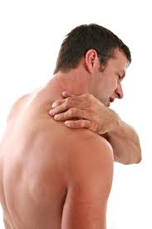
1) Pain
Location
Point with a finger to where it is
Movement-
Radiation
Referral
Shifting
Nature
Duration
Mode of onset—
Insideous-Chronic ,
Recent-Acute

Slide 9
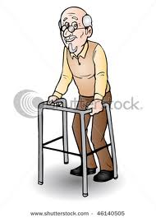
1) Pain
Progression
Is it better, worse or the same
Periodicity
Mechanical / Walking
Rest
Night
Constant

Slide 10
Aggravating factors
Stairs
Start up, mechanical
Pain with twisting & turning
Up & down hills
Kneeling
Squatting
Releiving factors

Slide 11
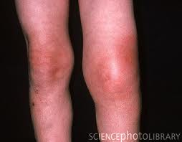
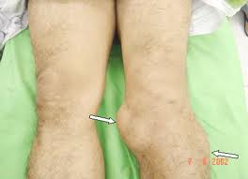
2) Swelling
Onset
Duration
Painful or not
Local vs. generalized
Constant vs. comes and goes
Size progression: same or ↑
Rapidly or slowly
Aggravated & relived factors
Associated with injury or reactive
From: soft tissue, joint, or bone

Slide 12
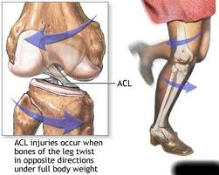
3) Instability
Onset
How dose it start?
Any Hx of trauma?
Frequency
Trigger/aggravated factors
Giving way
Locking
I can not trust my leg!
Associated symptoms
Swelling
Pain

Slide 13
Mechanical symptoms
Locking / clicking
Due:
Loose body,
Meniscal tear
Locking vs. pseudo-locking
Giving way
Due:
ACL
Patella

Slide 14
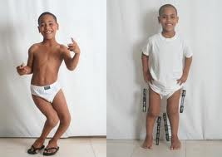
4) Deformity
When did you notice it?
Progressive or not?
Associated with symptoms → pain, stiffness, …
Impaired function or not?
Past Hx of trauma or surgery
PMHx (neuromuscular, polio)

Slide 15
5) Limping
Onset (acute or chronic)
Traumatic or non-traumatic ?
Painful vs. painless
Progressive or not ?
Use walking aid ?
Functional disability ?
Associated → swelling, deformity, or fever.

Slide 16
6) Loss of function
How has this affected the patient’s life
Home (daily living activities DLA)
Prayer
Squat or kneel for gardening
Using toilet
Getting out of chairs / bed
Socks
Stairs
Walking distance
Go in & out of car
Work
Sport
Type & intensity
Run, jump

Slide 17
Red flags
Weight loss
Fever
Loss of sensation
Loss of motor function
Sudden difficulties with urination or defecation

Slide 18
Risk factors
Age (the extremes)
Gender
Obesity
Lack of physical activity
Inadequate dietary calcium and vitamin D
Smoking
Occupation and Sport
Family History (as: SCA)
Infections
Medication (as: steroid)
Alcohol
PHx MSK injury/condition
PHx Cancer

Slide 19
Current and Previous History of Treatment
Non-operative:
Medications:
Analgesia
Antibiotic
Patient's own
Physiotherapy
Orthotics:
Walking aid
Splints
Operative:
What, where, and when ?
Peri-operative complications

Slide 20
Pediatric
Product of → Full term or premature
Pregnancy → normal or not
Delivery → Normal / CS
Family → parents relatives, patient sequence, F/H of same D.
Any → NICU, jaundice, blood transfusion
Vaccination
Milestones → neck, flip, sit, stand, walk
Who noticed the C/O

Slide 21
Spine
Pain radiation → as L4, exact dermatome or myotome
Coughing, straining
Sphincter control (urine & stool)
Shopping trolleys (forward flexion)
Neuropathic:
Increase → back extension & walking downhill
Improves → walking uphill & sitting
Vascular:
Increase → walking uphill (generates more work)
Improves → stop walking (stand) is better than sitting due to pressure gradient

Slide 22
Spine
Cervical myelopathy:
Hand assessment
Coughing, straining
Red Flags
Constitutional symptoms → fevers, sweat, weight loss
Pain → night or rest
Immunosuppression

Slide 23
Shoulder
Age of the patient
Younger patients more:
shoulder instability,
acromioclavicular joint injuries
Older patients more:
rotator cuff injuries,
degenerative joint problems
Mechanism of injury
Abduction & external rotation ➔ dislocation of the shoulder
Chronic pain upon overhead activity or at night time ➔ rotator cuff problem.

Slide 24
Shoulder
Pain where:
Rotator Cuff → anterolateral & superior
Bicipital tendonitis → referred to elbow
Stiffness, Instability, Clicking, Catching, Grinding:
Initial trauma
What position
How often
Weakness → if large tear in the R.C, not as neuro

Slide 25
Shoulder
Loss of function:
Home:
Dressing → coat, bra
Grooming → toilet, brushing hair
Lift objects
Arm above shoulder → top shelves, hanging
Work
Sport
Referred pain → mediastinal disorders, cardiac ischaemia

Slide 26
Knee
Injury → as: ACL
Mechanism → position of leg at time of injury
Direct / indirect
Audible POP
Did it swell up:
Immediately (haemathrosis)
Delayed (traumatic synovitis)
What first aid was done / treated
Could continue football match or had to leave

Slide 27
Knee
Insidious → as O.A
Walking distance
Walking aid
How pray → regular or chair
Cross legs on ground
Squat (traditional toilet)
Swelling on & off
Old injury intra-articular

Slide 28
THANK YOU

