Slide 1
CHANGES IN THE LYMPHOID NEOPLASMS : who 5th edition
Presenter- DR swastika Padmapati
Moderater- dr bhavna jha

Slide 2
INTRODUCTION
The WHO-HAEM5 applies a hierarchical system for classification.
It organises diseases in increasing order of specification.
Category;(mature B cell)
Family/class(large B cell lymphoma)
Entity /type(diffuse large B cell lymphoma ,not otherwise specified)
Subtype( Diffuse Large B cell Lymphoma, not other wise specified , germinal centre B cell like)

Slide 3
WHO defines ESSENTIAL criteria and DESIRABLE criteria
Essential criteria are minimal criteria to allow the diagnosis of thr entity as universally as possible
Desirable criteria are those that aid in confirmation and refinement of the diagnosis and usually require the application of advanced techniques.

Slide 4
B CELL LYMPHOID PROLIFERATIONS AND LYMPHOMAS
NEW ADDITIONS-Tumour like lesions with B cell predominance( covers non neoplastic B cell predominant lymphoid neoplasms involving lymph node or extranodal sites).
CASTLEMAN’s DISEASE- Unicentric Castleman’s disease,
Idiopathic multicentric Castleman’s disease,
HHV8 associated multicentric Castlemans disease.
IgG4 related disease.
Infectious mononucleosis
Florid reactive lymphoid hyperplasia
SLE

Slide 5
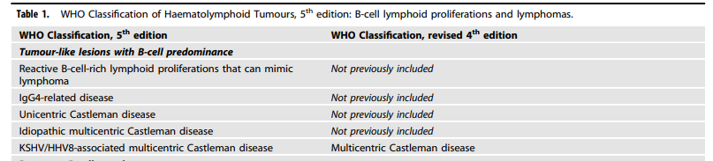

Slide 6
B LYMPHOBLASTIC LEUKEMIA /LYMPHOMA(B-ALL);NEW GENETICALLY DEFINED ENTITIES AND SUBTYPES
The rare B-ALL with TCFB3::HLF fusion has been added.(aggressive disease course)
B- ALL with BCR::ABL-1 like features is now an entity( previously a provisional entity)
B- ALL with other defined genetic abnormalities- includes
B ALL with DUX4, MEF2D, ZNF384 or NUTM1 rearrangements, with IG::MYC fusion and with PAXalt or PAX5 p.P80R abnormalities.

Slide 7
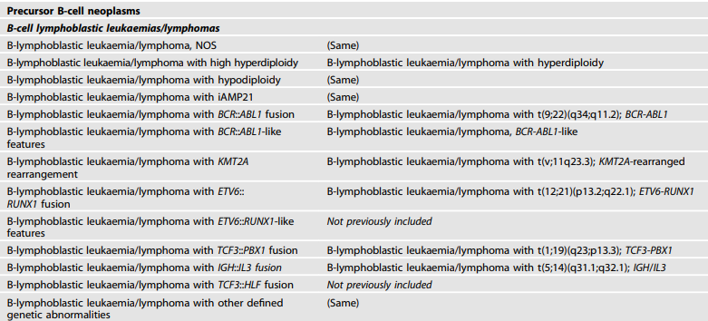

Slide 8
MATURE B CELL NEOPLASMS
Pre neoplastic and neoplastic small lymphocytic proliferations:
MBL and CLL/SLL remain, B-PLL is no longer recognized as an entity.
WHO- HAEM5 recognizes three subtypes of monoclonal B cell lymphocytosis( MBL):
Low count MBL or clonal B cell expansion- below 0.5X10⁹ /L
CLL/ SLL type MBL-monoclonal CLL/SLL phenotype ,B-cell count> or = 0.5X10⁹/ L with no features diagnostic of CLL/SLL and total B cell countless than 5X10⁹/L.
Non CLL/SLL type MBL-Any monoclonal non CLL/SLL phenotype Bcell expansion with no symptoms or features diagnostic of another mature Bcell neoplasm.

Slide 9
The International Prognostic score for early stage CLL/SLL includes- IGHV mutation status, absolute lymphocyte count >15X10⁹/ L , and presence of palpable lymph node.
In the setting of transformation, RICHTER transformation is prefered over RICHTER SYNDROME.
B-PLL no longer recognized.-reclassified into
→A variant of mantle zone lymphoma with IGH:: CCND1
Prolymphocytic progression of CLL/SLL( CD5 positive non mantle neoplasm with > 15% prolymphocytes in peripheral blood or bone marrow.
→splenic B cell lymphoma/ leukemia with prominent nucleoli.

Slide 10
The term “Splenic B cell lymphoma/ leukemia with prominent nucleoli” now replaces “hairy cell leukemia variant” and “ CD5 negative B cell prolymphocytic leukemia.”
negative for HCL markers- CD25, AnnexinA1, TRAP and CD123.

Slide 11
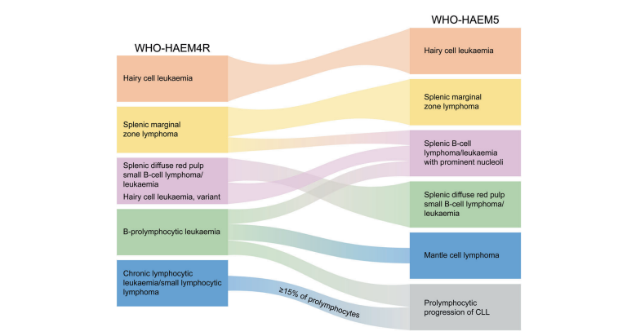

Slide 12
MARGINAL ZONE LYMPHOMAS
Paediatric nodal marginal zone lymphoma gets upgraded to a separate entity.
Primary cutaneous marginal zone lymphoma – a separate entity.
More emphasis on cytogenetic and mutational profiles and on anatomic sites.

Slide 13
FOLLICULAR LYMPHOMA
CLASSIC FOLLICULAR LYMPHOMA- composed of centrocytes and centroblasts and harbour t (14:18) associated with IGH::BCL2 fusion.
FOLLICULAR LARGE B CELL LYMPHOMA
FOLLICULAR LYMPHOMA WITH UNCOMMON FEATURES.
Grading of follicular lymphoma , which is only pertinent to classic follicular lymphoma is no longer mandatory.

Slide 14
The newly introduced subtype – uFL includes two subsets.
1) blastoid or large centrocyte variant→ inferior survival
2)FL with a predominant diffuse growth pattern→large inguinal tumour;
IGH::BCL2- ABSENT
CD23+
STAT6 mutation+

Slide 15
MANTLE CELL LYMPHOMA-improved risk stratification.
IN SITU MANTLE CELL NEOPLASM- rare , represents colonization of mantle zones of lymphoid follicles by B cells carrying an IG::CCND1 fusion.
Occasional cases→cryptic reaarangements of IGK or IGL enhancers with CCND1
Non nodal MCL- Lack of SOX11 expression,
low Ki67
higher somatic hypermutation
lack of CD5 expression.

Slide 16
LARGE B CELL LYMPHOMAS
DIFFUSE LARGE B CELL LYMPHOMA, NOS- Two main subtypes
1)Germinal centre B cell like(GCB) subtype: enriched for IGH::BCL2
2) Activated B cell Like(ABC) subtype:IRF4/MUM1,MYD88
WHO HAEM5 recognises 17 specific entities as large B cell lymphomas.

Slide 17
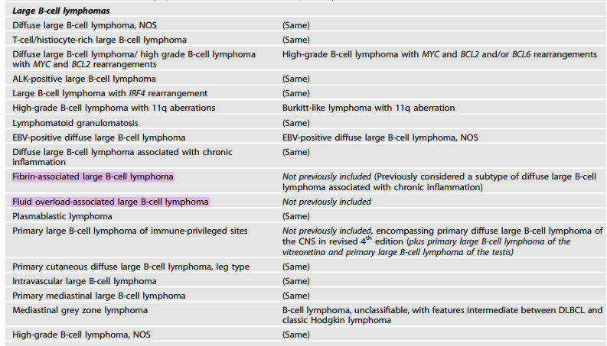

Slide 18
LARGE B CELL LYMPHOMAS OF IMMUNOPRIVELEGED SITES.
A new umbrella term introduced for aggressive B cell lymphomas that arise as primary tumors in the CNS, the vitreoretinal compartment and the testes of the immunocompetent patients.
They arise in immune sanctuaries created by their respective anatomical structures( the blood brain, blood retinal and blood testicular barriers), and immune regulation system within their respective primary sites.

Slide 19
FLUID ASSOCIATED LARGE B CELL LYMPHOMAS
Distinct from Primary Effusion lymphomas.
Adults, predominantly elderly without underlying immunodeficiency, who present with exclusive involvement of body cavities, most commonly the pleural cavity.
Frequently have an underlying condition- Chronic heart failure, renal failure ,protein losing enteropathy or liver failure.
KSHV/HHV – negative: EBV – positive in 13-30% cases.

Slide 20
MEDIASTINAL GREY ZONE LYMPHOMA
B cell lymphoma with overlapping features between primary mediastinal B cell lymphoma and classic Hodgkin’s lymphoma.
BURKITT LYMPHOMA-
From endemic, sporadic and immunodeficiency associated to
EBV positive and EBV negative Burkitt lymphoma.

Slide 21
LYMPHOID PROLIFERATION AND LYMPHOMAS ASSOCIATED WITH IMMUNE DEFICIENCY AND DYSREGULATION
The new standardised nomenclature builds on an integrated approach to diagnosis that combines all relevant data into a reporting system as follows-
Histological diagnosis according to accepted criteria and terminology.
The clinical setting/ immunodeficiency background.
Presence or absence of one or more oncogenic virus(es).
Primary immunodeficiencies , associated with germline mutations have been renamed as “ INBORN ERRORS OF IMMUNITY”

Slide 22
HODGKINS LYMPHOMA
WHO HAEM5 continues to list nodular lymphocyte predominant Hodgkin’s lymphoma under the family of Hodgkin’s lymphoma.
Caution to be excercised in immunodeficiency setting- mimickers to be considered-nodal T follicular helper cell lymphomas and lymphoproliferative disorders arising in immunodeficiency/dysregulation settings that may contain EBV positive HRS like cells.
However NLPHL is more accurately called “NODULAR LYMPHOCYTE PREDOMINANT B CELL LYMPHOMA”, since the neoplastic cells have a functional B cell program.

Slide 23
PLASMA CELL NEOPLASMS AND OTHER DISEASES WITH PARAPROTEINS
NEW ENTITIES
MGRS: Monoclonal gammopathy of renal significance
CAD: cold agglutinin disease
TEMPI SYNDROME:characterised by telangiectasias, elevated erythropoietin and erythrocytosis, monoclonal gammopathy, perinephric fluid collection and intrapulmonary shunting.
AESOP SYNDROME- ( Adenopathy and extensive skin patch overlying a plasmacytoma)
The skin biopsies show diffuse hyperplasia of dermal vessels with surrounding mucin.

Slide 24
COLD AGGLUTININ DISEASE
Autoimmune haemolytic anaemia mediated by monoclonal cold agglutinins and driven by an underlying clonlal B cell lymphoid proliferation not fulfilling criteria for a B cell lymphoma.
The risk stratification model for IgM MGUS and non- IgM MGUS has been updated.
An abnormal free light chain ratio
IgA or IgM type MGUS
Serum M protein value>1.5g/dL.

Slide 25
T- CELL and NK cell LYMPHOID PROLIFERATIONS AND LYMPHOMAS
TUMOUR LIKE LESIONS WITH T CELL PREDOMINANCE : A new class of tumour like lesions; includes-
1) indolent T lymphoblastic proliferation(ITLP)
2)Kikuchi Fujimoto disease
3) Autoimmune lymphoproliferative syndrome.
NK- LYMPHOBLASTIC LEUKEMIA/LYMPHOMA is considered a provisional entity in WHO-HAEM4R , is not separately listed in WHO- HAEM5, due to lack of clear cut and reliable diagnostic criteria, and lack of published information on NK cell associated antigens.

Slide 26
PRIMARY CUTANEOUS T CELL LYMPHOID PROLIFERATIONS AND LYMPHOMAS
CUTANEOUS PERIPHERAL T CELL LYMPHOMA
NEW ENTITIES-
Primary cutaneous gamma/delta T cell lymphoma
CD8 positive T cell lymphoproliferative disorder
Acral CD8 positive T cell lymphoproliferative disorder
CD4 positive small to medium Tcell lymphoproliferative disorder.

Slide 27
INTESTINAL T CELL AND NK CELL LYMPHOID PROLIFERATIONS AND LYMPHOMAS
INDOLENT T CELL LYMPHOPROLIFERATIVE DISORDER OF GI TRACT
LYMPHOMATOID GASYROPATHY OF GI TRACT
INDOLENT T CELL LYMPHOMA OF GI TRACT
INDOLENT NK CELL LYMPHOPROLIFERATIVE DISORDER OF GI TRACT.

Slide 28
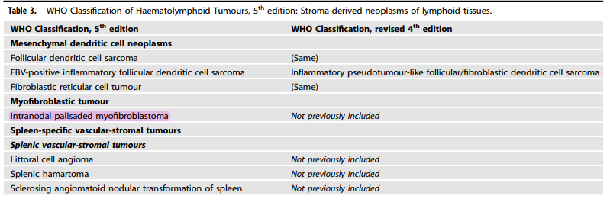
STROMA DERIVED NEOPLASMS OF LYMPHOID TISSUES

Slide 29
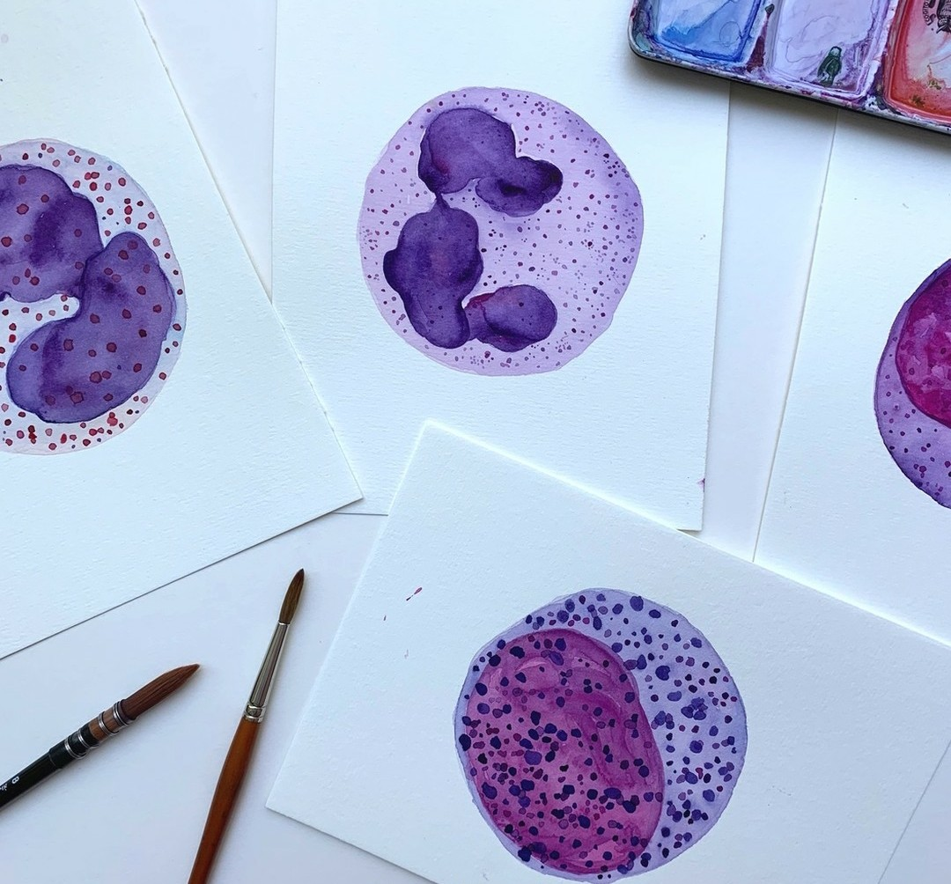
“REALITY IS INFINITELY DIVERSE(…AND) REALITY RESISTS CLASSIFICATION”
THANK YOU!

