Slide 1
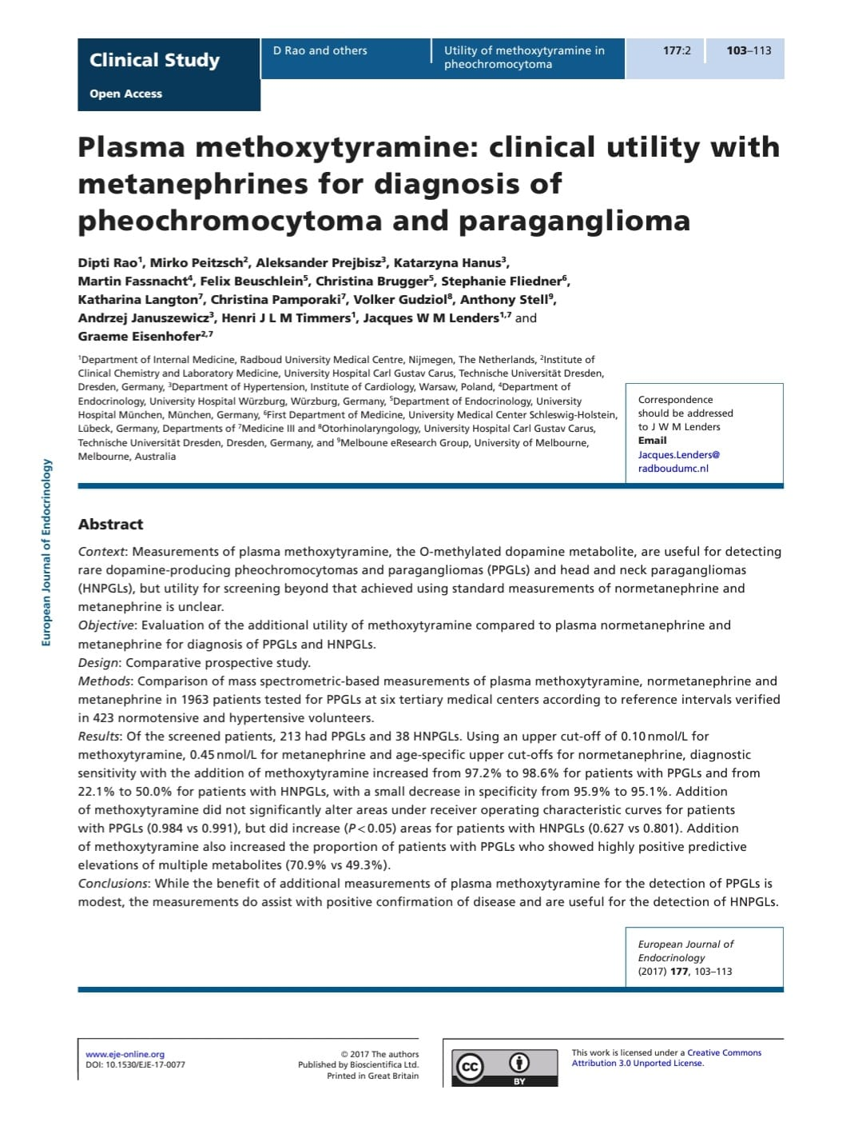
JOURNAL CLUB PRESENTATION
PRESENTOR – Dr. Bubul Kalita
Post Graduate Resident
Department of Biochemistry
Gandhi Medical College, Bhopal
MENTOR – Dr. Huma Nasrat
Assistant Professor
Department of Biochemistry
Gandhi Medical College, Bhopal

Slide 2
I searched PubMed Central and Scopus, for English language papers by using the keywords
“catecholamine-secreting Neuroendocrinal tumors”,
“Pheochromocytoma”, and
“Paraganglioma”
“Metanephrines” and “Normetanephrines” and also used a personal archive of references.

Slide 3
About the Journal
European Journal of Endocrinology is the official journal of the European Society of Endocrinology.
It publishes high-quality original clinical and translational research papers and reviews in pediatric and adult endocrinology, as well as clinical practice guidelines, and debates.
Notes:
However, they also consider case reports only if they represent exceptional insights or advances in clinical endocrinology.
In 1993 the journal became an official journal of the European Federation of Endocrine Societies (now European Society of Endocrinology)

Slide 4
About the Journal
Impact factor: 5.8 (2022)
SJR 1.6
Registered in 1948
ISSN (print): 0804-4643 ISSN (web): 1479-683X
Frequency: Monthly*
Indexing:
PubMed,
Medline,
EMBASE,
Scopus,
Science citation index Expanded
Notes:
Impact factor reflects the yearly average number of citations to recent articles published in a particular journal
An International Standard Serial Number (ISSN) is an eight-digit serial number used to uniquely identify a serial publication.
The SCImago Journal Rank (SJR) is a measure that reflects the scientific influence of scholarly journals. It acounts for both the number of citations received by a journal's articles and the prestige of the journals where such citations come from.
However, Research articles become available for open access of the journal is delayed, after 12 months.
scientific citation indexing services.

Slide 5
Editors
Editor-in-chief:
Professor Felix Beuschlein, M.D. Director of Department of Endocrinology, Diabetology and Clinical Nutrition, University Clinic Zurich, Switzerland
Deputy Editors
Bjørn Olav Åsvold, Head consultant, Department of Endocrinology, St Olavs Hospital, Trondheim University Hospital, Norway
Irina Bancos, Associate Professor of Medicine, Mayo Clinic College of Medicine, USA
Olaf Dekkers, Professor of research methodology, Endocrinologist and Epidemiologist, Leiden University Medical Center, Netherlands
Niki Karavitaki, Senior Clinical Lecturer in Endocrinology and Honorary Consultant Endocrinologist, Institute of Metabolism and Systems Research, University of Birmingham, UK
Markus Seibel, Professor of Endocrinology, Concord Medical School, University of Sydney;
Robert Semple, Professor of Translational Molecular Medicine, University of Edinburgh, UK
Notes:
The editorial board consists of well-respected researchers and clinicians in endocrinology, contributing to the journal's high standards.

Slide 6
Critical appraisal of the Journal
Reliable journal (Peer reviewed)
Respectable impact factor
Covers a broad range of topics within endocrinology
Both subscription-based access and open access
Indexed in major databases
Clear Author Guidelines and Publication Ethics
Notes:
*ensuring that articles are evaluated by experts before publication. This adds to the credibility and reliability of the published research.
*which indicates that the journal's articles are frequently cited by other researchers. This measures of the journal's influence in the field of endocrinology.
*which ensures that it addresses a wide array of interests within the endocrinology community.
*Some articles are freely available, while others require a subscription or purchase.
which facilitates the visibility and accessibility of its articles to the global research community.
Author Guidelines: The journal provides clear guidelines for authors regarding manuscript preparation, submission, and ethical considerations. This ensures the quality and integrity of the published research.
Publication Ethics: Adherence to ethical standards in research and publication is emphasized, with policies in place to handle issues like plagiarism, data fabrication, and conflicts of interest.

Slide 7
Title of the Article
Plasma methoxytyramine: clinical utility with metanephrines for diagnosis of pheochromocytoma and paraganglioma

Slide 8
Critical appraisal of the Title
Clear and specific about what is being studied and its intended purpose.
PICO:
Population (P): Population not mentioned.
Intervention (I): Intervention clearly mentioned
Comparison (C): Use of plasma metanephrines as a comparative diagnostic measure.
Outcome (O): Outcome is clearly mentioned
Specificity: Clearly identifies the biomarkers and the diseases of interest.
Notes:
Intervention (I): Measurement of plasma methoxytyramine levels.
Outcome (O): Improved diagnostic accuracy for pheochromocytoma and paraganglioma.
Clearly identifies the biomarkers (plasma methoxytyramine and metanephrines) and the diseases (pheochromocytoma and paraganglioma) of interest.

Slide 9
About the Authors
Dipti Rao, Department of Internal Medicine, Radboud University Medical Centre, Nijmegen, The Netherlands
Mirko Peitzsch, Institute of Clinical Chemistry and Laboratory Medicine, Dresden, Germany,
Aleksander Prejbisz and Katarzyna Hanus, Department of Hypertension, Institute of Cardiology, Warsaw, Poland
Martin Fassnacht, Department of Endocrinology, University Hospital Würzburg, Würzburg, Germany
Felix Beuschlein and Christina Brugger, Department of Endocrinology, University Hospital München, München, Germany,
Stephanie Fliedner, First Department of Medicine, University Medical Center Schleswig-Holstein, Lübeck, Germany,
Katharina Langton, Medicine III, University Hospital Carl Gustav Carus, Technische Universität Dresden, Dresden, Germany
Notes:
The study was conducted by a team of 7 authors
The authors are affiliated with prestigious institutions, which is renowned for its research in endocrinology.

Slide 10
Critical appraisal of Authors
Each author's name is clearly mentioned
Credentials and affiliations of each author are listed, indicating their professional background and institutional support.
The affiliations highlight relevant areas of expertise.*
The collaboration between a variety of reputable institutions across Europe suggests a comprehensive and well-rounded investigation.
Notes:
such as internal medicine, clinical chemistry, hypertension, and endocrinology, which are pertinent to the study’s focus on diagnostic biomarkers.
imposing diverse strengths and expertise.

Slide 11
Reason for choosing the article
Focus on improving the diagnosis of rare endocrine tumors for better treatment outcomes.
By evaluating the clinical utility of plasma methoxytyramine alongside metanephrines, the article explores a potentially more effective diagnostic method
Given the rapid evolution of endocrinology in India, adopting novel diagnostic approaches as discussed in the article can empower Indian practitioners to deliver advanced patient care.
The article’s findings on the utility of plasma methoxytyramine, if proven cost-effective, could offer a more efficient diagnostic approach.
Notes:
The article focuses on improving the diagnosis of pheochromocytoma and paraganglioma, which are rare but significant endocrine tumors. That’s why Accurate and early diagnosis is crucial for effective treatment and patient outcomes.
This could lead to advancements in how these conditions are diagnosed, offering new insights and possibly improving diagnostic accuracy.
Endocrinology is a rapidly evolving field in India. Incorporating new diagnostic methodologies, as discussed in the article, can help Indian endocrinologists stay at the forefront of medical advancements
Indian healthcare often faces challenges related to resource constraints. The article’s findings on the utility of plasma methoxytyramine, if proven cost-effective, could offer a more efficient diagnostic approach, making better use of available medical resources and potentially reducing the burden on the healthcare system.

Slide 12
Abstract
Context: Measurements of plasma methoxytyramine, the O-methylated dopamine metabolite, are useful for detecting rare dopamine-producing pheochromocytomas and paragangliomas (PPGLs) and head and neck paragangliomas (HNPGLs), but utility for screening beyond that achieved using standard measurements of normetanephrine and metanephrine is unclear.
Objective: Evaluation of the additional utility of methoxytyramine compared to plasma normetanephrine and metanephrine for diagnosis of PPGLs and HNPGLs.
Design: Comparative prospective study.
Methods: Comparison of mass spectrometric-based measurements of plasma methoxytyramine, normetanephrine and metanephrine in 1963 patients tested for PPGLs at six tertiary medical centers according to reference intervals verified in 423 normotensive and hypertensive volunteers. Results: Of the screened patients, 213 had PPGLs and 38 HNPGLs. Using an upper cut-off of 0.10 nmol/L for methoxytyramine, 0.45 nmol/L for metanephrine and age-specific upper cut-offs for normetanephrine, diagnostic sensitivity with the addition of methoxytyramine increased from 97.2% to 98.6% for patients with PPGLs and from 22.1% to 50.0% for patients with HNPGLs, with a small decrease in specificity from 95.9% to 95.1%. Addition of methoxytyramine did not significantly alter areas under receiver operating characteristic curves for patients with PPGLs (0.984 vs 0.991), but did increase (P < 0.05) areas for patients with HNPGLs (0.627 vs 0.801). Addition of methoxytyramine also increased the proportion of patients with PPGLs who showed highly positive predictive elevations of multiple metabolites (70.9% vs 49.3%).
Conclusions: While the benefit of additional measurements of plasma methoxytyramine for the detection of PPGLs is modest, the measurements do assist with positive confirmation of disease and are useful for the detection of HNPGLs.
Notes:
The abstract effectively sets the context by highlighting the role of plasma methoxytyramine in detecting rare dopamine-producing tumors and HNPGLs. It acknowledges the existing use of normetanephrine and metanephrine for such diagnoses and the uncertainty around the additional value provided by methoxytyramine.

Slide 13
Critical appraisal of Abstract
Structured
Indicative abstract
Comprehensive in its contents.
Appropriate in length (neither too short nor too long)
Notes:
Structured with clear sections including Context, Objective, Design, Methods, Results, and Conclusions.
The abstract provides a clear indication of the study's aims, methods, and results, allowing readers to grasp the key findings.
Comprehensive in its contents.
Appropriate in length (neither too short nor too long)

Slide 14
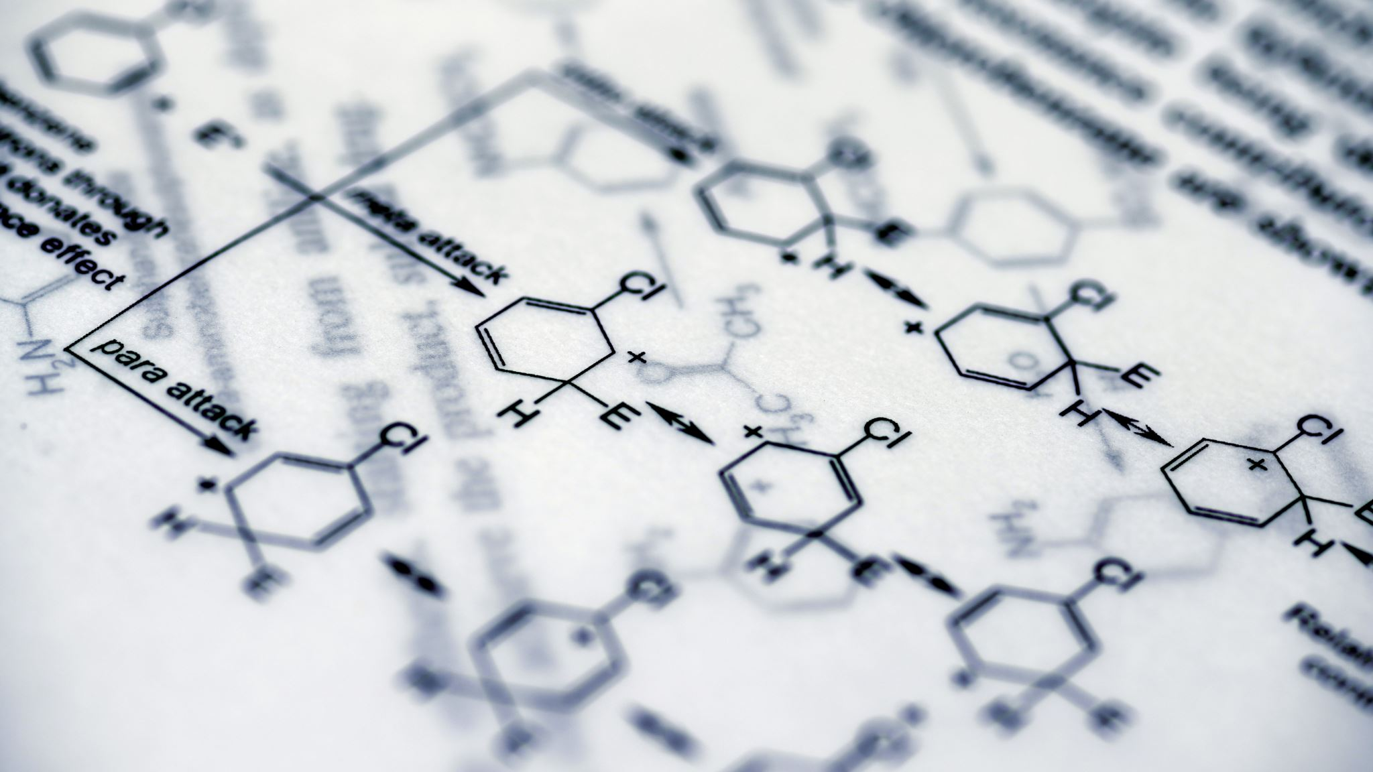
Catecholamine Biochemistry

Slide 15
CO₂
Dihydroxy-phenylalanine
Alanine
Phenylalanine
Norepinephrine
COOH
CH₃
Amino Acid
O₂
H4 Biopterin + O₂
H2 Biopterin + H2O
H₂
C
S-adenosyl Metheonine (SAM)
H
NH₂
NH
CH₂
HO
CH
CH₃
Phenylalanine hydroxylase
R
Dopamine β-Hydroxylase
(Cu²⁺, Vitamin C)
Tyrosine hydroxylase
Phenylethanolamine
N-methyltransferase
DOPA Decarboxylase
(PLP)
S-AdenosylHomocysteine (SAH)
H2 Biopterin + H2O
H4 Biopterin + O₂
HO
OH
Tyrosine
Epinephrine
Dopamine
DOPA
Notes:
Tyrosine Hydroxylase: Rate Limiting enzyme
Tyrosine and Phenylalanine Hydroxylase enzymes, along with Tryptoophane hydroxylase, belongs to a small family of monooxygenases. All three enzymes require tetrahydrobiopterin as a substrate to drive the hydroxylation reaction. They incorporate of one atom of molecular oxygen into a substrate, with the other being reduced to water.
Dopamine is formed in the cytoplasm and are transported into vesicular secretory granules. where the amine is concentrated and stored ready for exocytotic release as the principal neurotransmitters of central nervous system dopaminergic neurons.
The dopamine formed in noradrenergic neurons and chromaffin cells is further converted to norepinephrine by dopamine β-hydroxylase, an enzyme specially located in secretory granules
The additional presence of phenylethanolamine N-methyltransferase in adrenal medullary chromaffin cells leads to further conversion of norepinephrine to epinephrine.

Slide 16
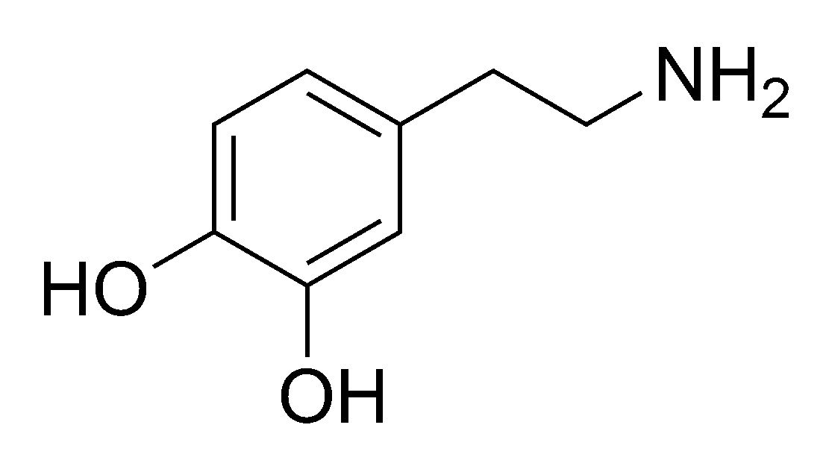
Dopamine
Norepinephrine
Epinephrine
COMT
SULT1A3
3-Methoxytyramine
(3-MT)
MT-SO4
Urinary
Excretion
MAO
MAO
AD
-COOH
AD
Dihydroxy-phenyl-acetic acid(DOPAC)
COMT
Homovanilic Acid (HVA)
-CHO
Notes:
Monoamine oxidase (MAO) is an enzyme that catalyzes the oxidative deamination of monoamines
MAO-A: This type primarily degrades serotonin, norepinephrine, and epinephrine.
MAO-B: This type primarily degrades phenylethylamine and benzylamine. Both types can degrade dopamine.
Sulfotransferase Family 1A Member 3, catalyzes the transfer of a sulfo group
For COMT, SAM is the methyl donor to the hydroxyl group of catecholamines

Slide 17
Dopamine
Norepinephrine
Epinephrine
Sympathetic nerves
Extraneuronal
tissues
Adrenal Chromaffin cells
MAO, AR
COMT
COMT
Dihydroxy-phenyl-glycol
(DHPG)
Normetanephrine
(NMN)
NMN-SO4
SULT1A3
MAO, AR
COMT
Methoxy-hydroxy-phenyl-glycol
(MHPG)
ADH, AD
Vanillylmandelic acid
(VMA)
Urinary Excretion
Notes:
For COMT, SAM is the methyl donor to the hydroxyl group of catecholamines

Slide 18
Dopamine
Norepinephrine
Epinephrine
Extraneuronal
tissues
Adrenal Chromaffin cells
COMT
COMT
Metanephrine
(NMN)
MN-SO4
SULT1A3
MAO, AR
Methoxy-hydroxy-phenyl-glycol
(MHPG)
ADH, AD
Vanillylmandelic acid
(VMA)
Urinary Excretion

Slide 19
Introduction
According to The Endocrine Society Clinical Practice Guidelines, initial biochemical testing for PPGLs should include measurements of plasma-free metanephrines or urinary fractionated metanephrines, along with plasma or urinary catecholamines
The majority of the dopamine found in urine are due to renal absorption and decarboxylation of circulating L-dopa. Hence additional catecholamine measurements can be useful for diagnosis of dopamine-producing tumors.
Consequently, measurements of plasma methoxytyramine are superior to urinary dopamine for the detection of dopamine-producing tumors.

Slide 20
Cont.
Measurements of plasma methoxytyramine have been introduced for identifying patients with metastatic PPGLs, HNPGLs and tumors due to mutations of genes encoding succinate dehydrogenase subunits
Previuosly, it was difficult to measure the very low concentrations of free methoxytyramine in plasma. This problem is now overcome by a new generation of mass spectrometers that offer higher analytical sensitivity.
However, even with this problem solved, it remains unclear how much additional diagnostic utility, if any, measurements of methoxytyramine add to standard measurements of metanephrines.

Slide 21
Critical appraisal of Introduction
Clear, concise, and easy to follow.
The language used is appropriate for the target audience of clinical endocrinology researchers and practitioners.
relevant references are cited throughout to support the background information provided.
Cites relevant guidelines recommending measurement of plasma/urinary metanephrines as the initial test for PPGLs
Research question and hypothesis is not mentioned.

Slide 22
Subjects and Methods
Multicenter prospective study
Subjects:
1963 patients screened for Paragangliomas at 6 tertiary centers.
Inclusion Criteria:
(1) signs and symptoms of catecholamine excess;
(2) therapy-resistant hypertension;
(3) findings of an incidentaloma;
(4) hereditary risk of PPGL
423 normotensive and hypertensive volunteers as reference population
213 patients confirmed to have PPGLs, 38 with head/neck paragangliomas (HNPGLs)
Notes:
(from germany, Netherlands and Poland)

Slide 23
Subjects and Methods
Blood Sampling/Biochemical Testing:
Plasma free normetanephrine, metanephrine, methoxytyramine measured by Liquid chromatography with tandem mass spectrometry.
Blood drawn after 20 min supine rest and overnight fast.
Reference Interval Determination:
Age-specific Upper Cut-offs (UCs) for normetanephrine based on previous large population
UCs for metanephrine (0.45 nmol/L) and methoxytyramine (0.10 nmol/L) from 99.5th percentiles

Slide 24
Subjects and Methods
Tumor Diagnosis:
PPGLs confirmed by pathology or functional imaging
HNPGLs diagnosed based on testing/imaging for hereditary risk
Statistical Analysis:
Diagnostic sensitivity/specificity calculated.
ROC curves constructed.
Positive predictive values calculated across prevalence rates.

Slide 25
Critical appraisal of Methodology
Strengths:
All major aspects of the methodology are covered.
Generalizability
Well-defined criteria and methods for diagnosing PPGLs and HNPGLs
Inclusion of a separate reference population.
Appropriate preanalytical procedures are explained.
Reference intervals determined using statistically sound approaches
Comprehensive statistical analysis plan
Notes:
including subject recruitment, blood sampling, biochemical analyses, diagnostic criteria, and planned statistical analyses.
Multi-center prospective study design with a large sample size of nearly 2000 patients across 6 tertiary centers, increases generalizability.
Well-defined criteria and methods for diagnosing PPGLs and HNPGLs, involving pathological confirmation or functional imaging.
Inclusion of a separate reference population of over 400 normotensive and hypertensive individuals to establish appropriate reference intervals.
with blood drawn after 20 min supine rest (to account for posture effects) and overnight fasting (for methoxytyramine).
Comprehensive statistical analysis plan covering diagnostic performance metrics, ROC curves, and positive predictive value modeling.

Slide 26
Cont.
Potential Limitations:
No details provided on the LC-MS/MS method
Limited information on clinical characteristics of the patient and reference populations.
Criteria for enrolling patients at "risk for PPGLs" based only on broad categories like hypertension or hereditary risk
No mention of sample size calculations or study power.
Notes:
, its validation, quality control or inter-assay imprecision.-
more granular criteria could have strengthened case selection.

Slide 27
Results
Table: Plasma concentrations (medians with ranges) for methoxytyramine, normetanephrine and metanephrine across the reference population
Notes:
Plasma concentrations of normetanephrine did not differ between men and women, whereas concentrations of metanephrine and methoxytyramine were respectively 30% and 9% higher in men than women.
It also shows the values stratified by age groups, demonstrating that normetanephrine in particular increased with age.
Finally, it compares normotensive (n=161) vs. hypertensive (n=262) individuals in the reference population:
Methoxytyramine and metanephrine were similar between groups
Normetanephrine was higher in hypertensives (0.362 nmol/L) than normotensives (0.288 nmol/L)

Slide 28
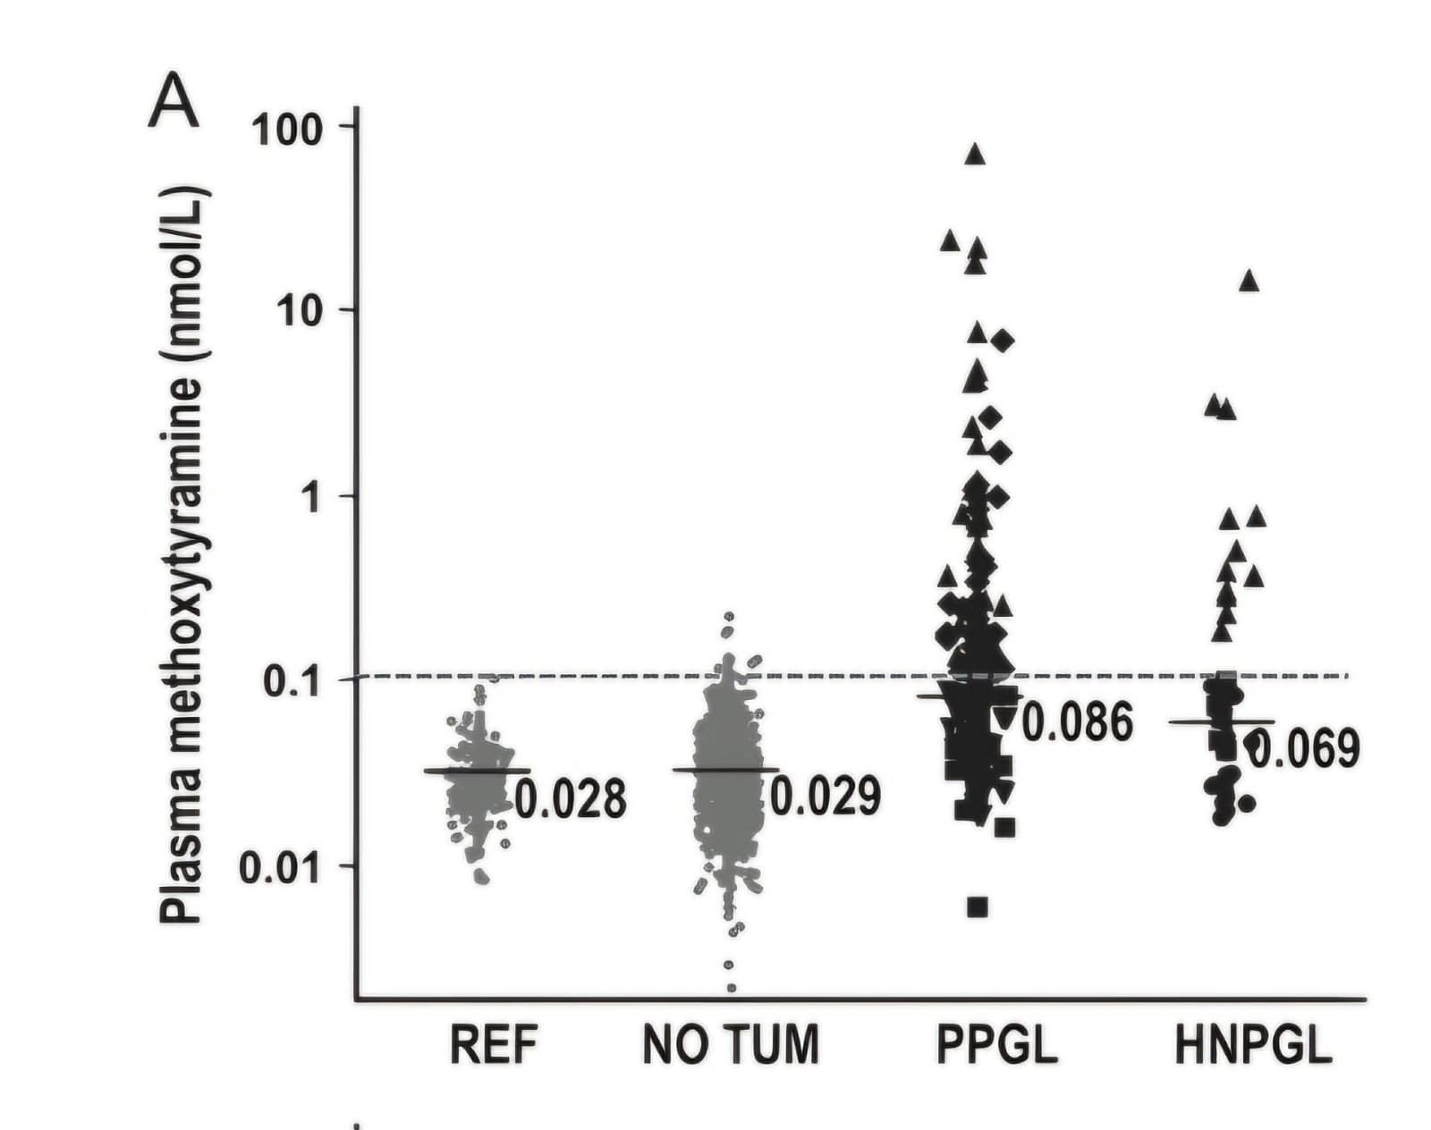
Using the defined UCs, Methoxytyramine was increased in 45.5% of PPGL patients and 31.6% of HNPGL patients compared to 1.1% of patients without tumors

Slide 29
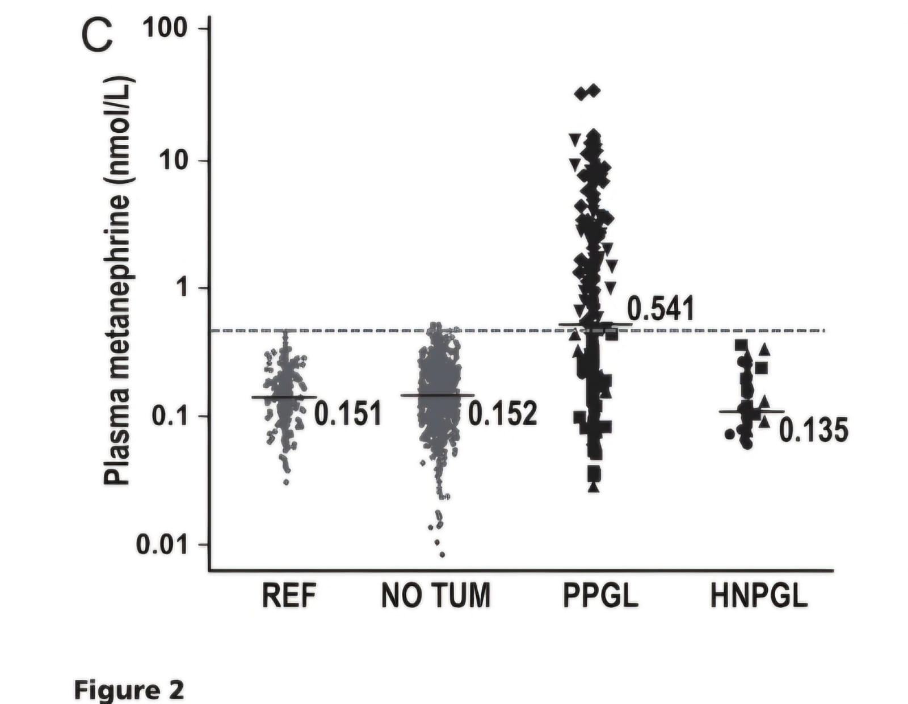
Metanephrine was increased in 53.5% of PPGL patients but none with HNPGLS compared to 0.4% of patients without tumors

Slide 30
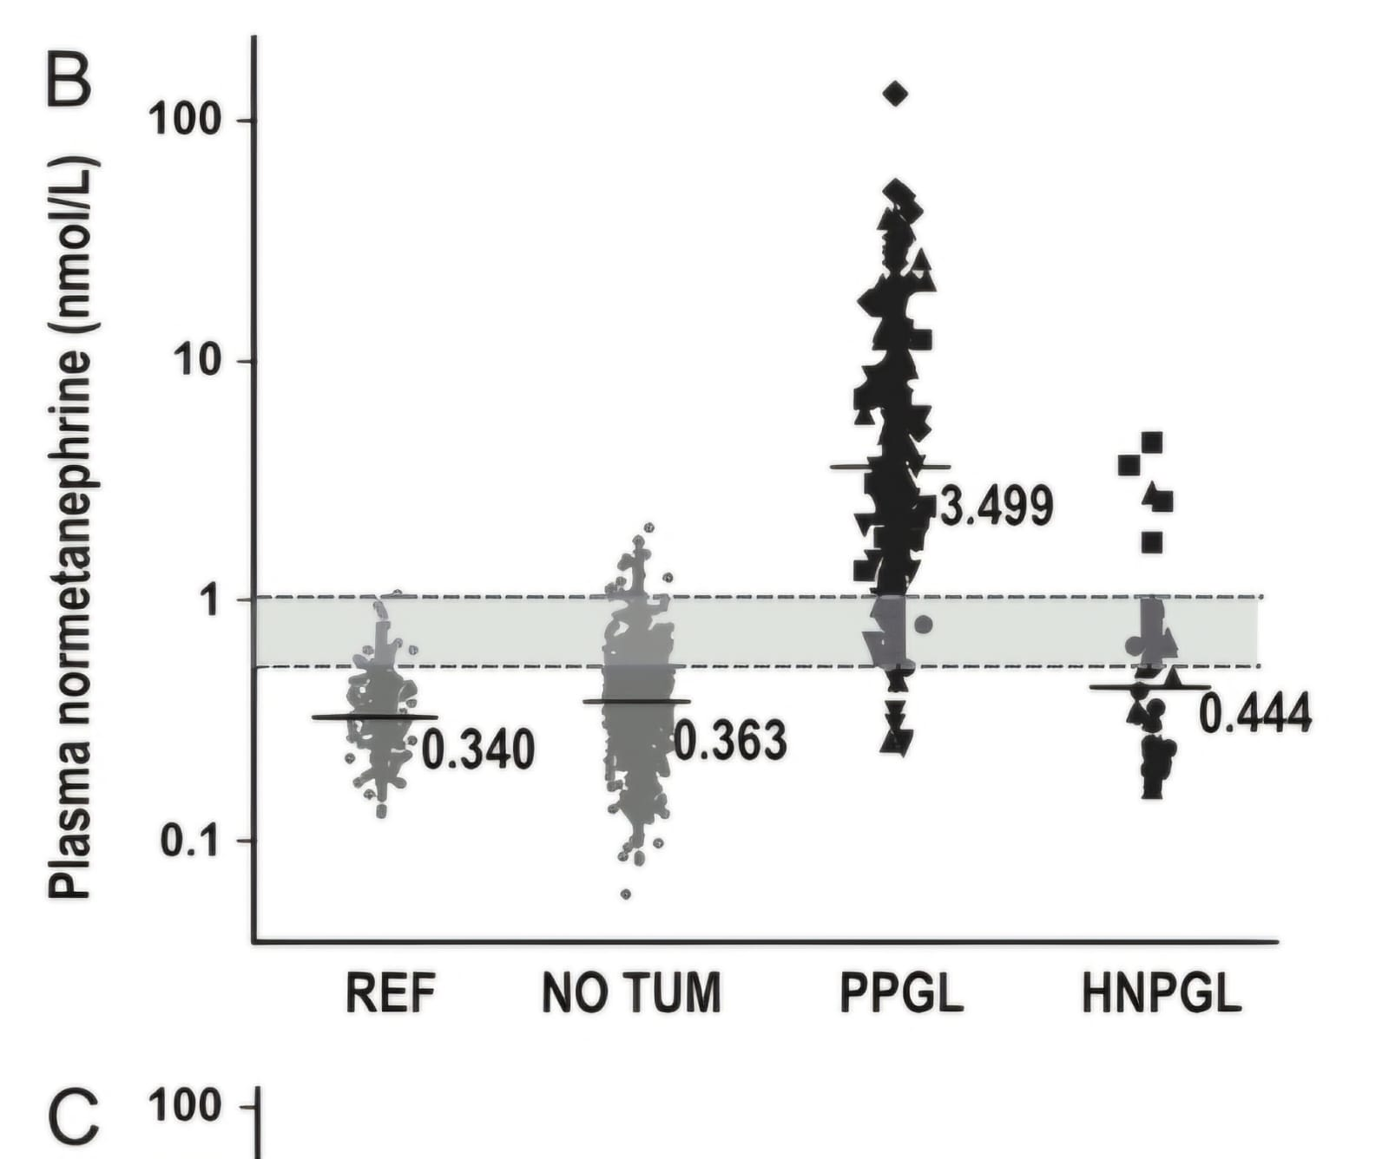
Normetanephrine (with age-adjusted UCs) was increased in 93% of PPGLs and 21.1% of HNPGLs

Slide 31
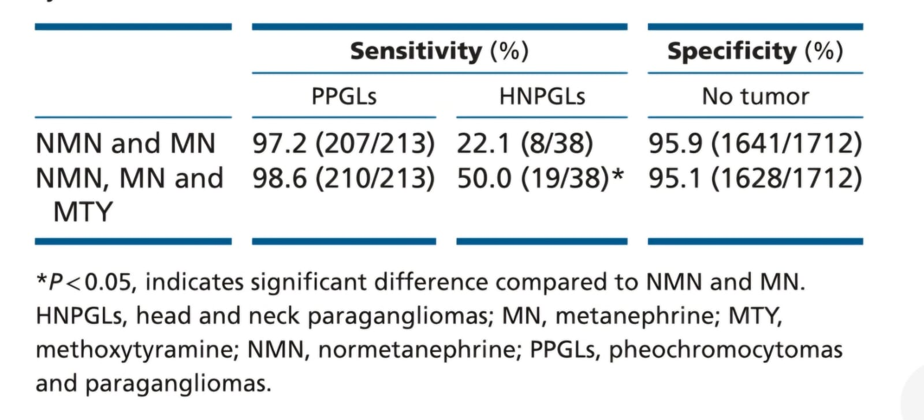
Results
Table: Diagnostic sensitivity and specificity of measurements of plasma metanephrines with and without methoxytyramine

Slide 32
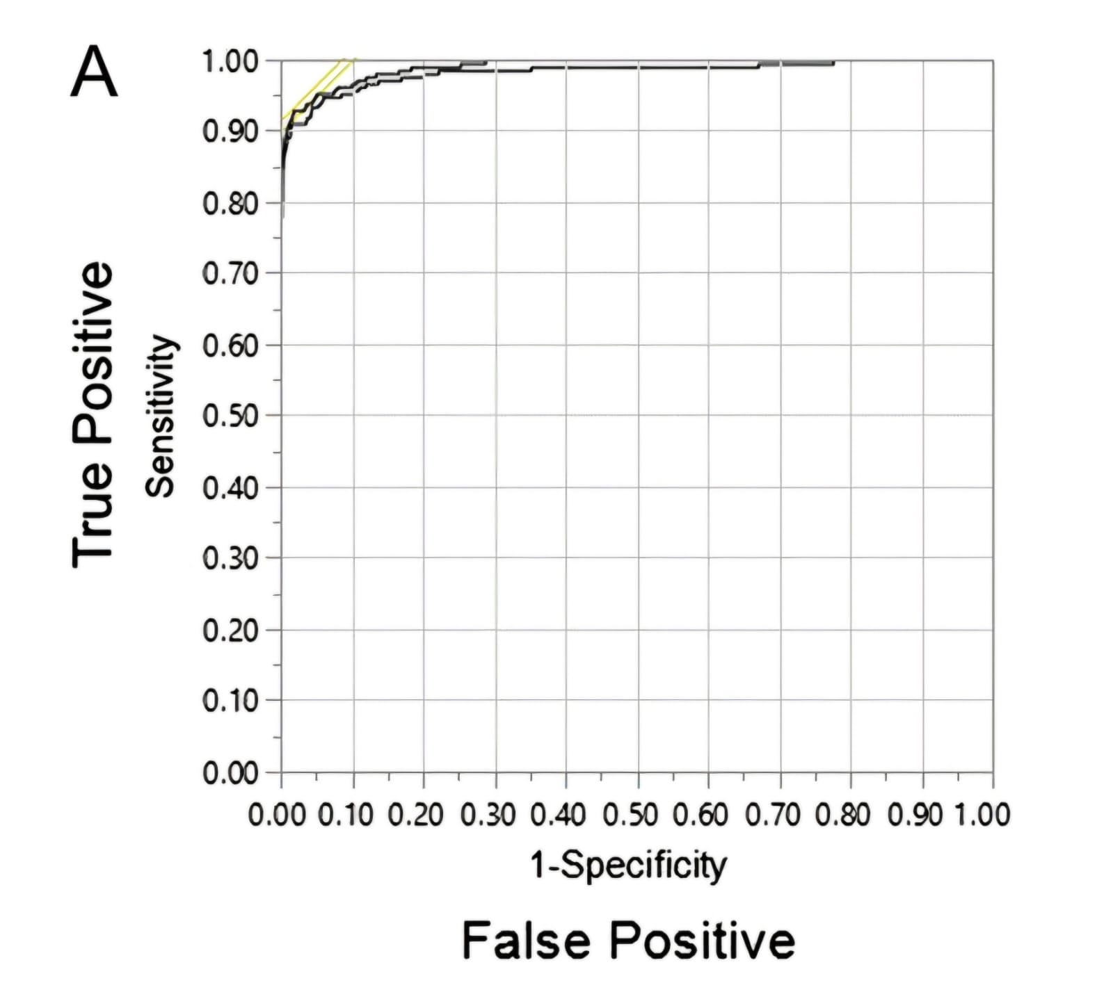
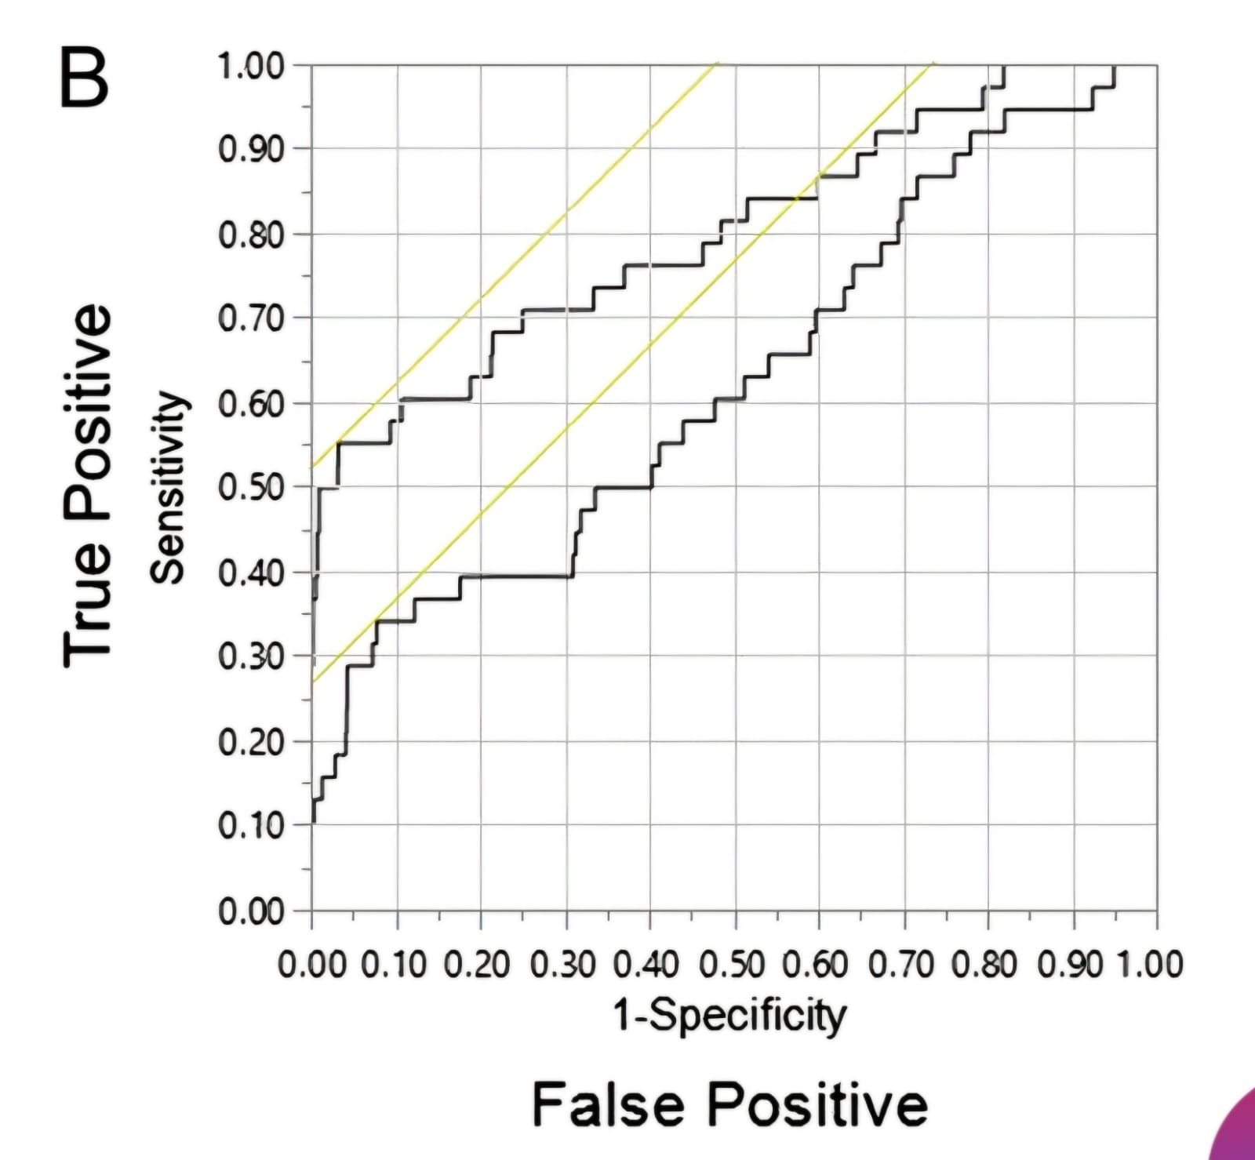
AUC for the 3-metabolite panel was not significantly different than normetanephrine + metanephrine for PPGLs, but higher for HNPGLs (0.801 vs 0.627)

Slide 33
Cont.
False Negatives:
Only 3/213 PPGL patients had false negative results for all 3 metabolites
More common in HNPGLs (50% false negatives)
Positive Predictive Value:
At 0.5-5% pretest prevalence, single positive results had 9-57% posttest probability
Combinations like normetanephrine+metanephrine positives had 58-94% posttest probability
Triplet positive results indicated 66-95% probability of PPGLs
Notes:
When the initial likelihood of having the condition (pretest prevalence) is between 0.5% and 5%:
A single positive test result means there's a 9% to 57% chance you actually have the condition after the test (posttest probability).
If two specific tests (normetanephrine and metanephrine) are both positive, there's a 58% to 94% chance you have the condition.
If three specific tests are all positive, there's a 66% to 95% chance you have the condition (PPGLs, or pheochromocytoma/paraganglioma, which are types of tumors).

Slide 34
Critical appraisal of the Results
Strengths:
Clear and structured.
Appropriate use of tables and figures.
Appropriate statistical methods used.
All major findings related to the study objectives appear to be reported.
Notes:
Strengths:
The results are reported in a clear and structured manner, with effective use of sub-headings to organize the different components.
Appropriate use of tables (Table 2, Table 3) and figures (Figures 1-5) to summarize data visually and complement the text.
Appropriate statistical methods used, including ROC curve analyses, diagnostic sensitivity/specificity calculations, and positive predictive value modeling across different pretest probabilities. This allows thorough assessment of methoxytyramine's additive clinical value.
All major findings related to the study objectives appear to be reported. This includes analyses comparing single vs multi-metabolite positives, head/neck vs other PPGLs, and across different prevalence scenarios.

Slide 35
Critical appraisal of the Results
Potential Limitations:
Limited clinical details provided about the PPGL and HNPGL cases
Methods of adjudicating the final tumor diagnosis are not described in detail.
Follow-up for excluding PPGLs was not available for over a third of patients without tumors initially.
Notes:
Potential Limitations:
Limited clinical details provided about the PPGL and HNPGL cases, such as tumor sizes, locations, genetic mutations, etc. This context could have further elucidated methoxytyramine's value in specific subgroups.
No formal sample size/power calculations reported. While the large sample aids study validity, ensuring adequate statistical power would have been ideal.
Methods of adjudicating the final tumor diagnosis are not described in detail, which is crucial for properly defining the reference standards used.
Follow-up for excluding PPGLs was not available for over a third of patients without tumors initially. This could potentially affect specificity estimates if any cases were missed.

Slide 36
Discussion.
While adding methoxytyramine modestly improves overall diagnostic sensitivity for PPGLs, its main utility is enabling detection of rare dopamine-producing tumors and head/neck paragangliomas (HNPGLs).
Including methoxytyramine increases the proportion of PPGL patients showing highly positive predictive elevations of multiple metabolites (70.9% vs 49.3% with just normetanephrine and metanephrine).
These multi-metabolite positive results carry high (>90%) posttest probability of confirming PPGLs even at low pretest prevalence.
For HNPGLs specifically, adding methoxytyramine significantly improves diagnostic sensitivity (50% vs 22.1%) and overall test performance (AUC 0.801 vs 0.627).
Measurements of methoxytyramine, beyond just screening, can also provide clues about metastatic disease or specific genetic mutations like SDHx deficiencies.
False negatives are rare for PPGLs with plasma metanephrines/methoxytyramine, but can occur with small tumors, non-functional tumors, or HNPGLs.
High diagnostic specificity requires proper preanalytical handling (supine sampling, fasting) and implementing rigorously validated reference intervals.
While the benefit is modest for PPGLs, methoxytyramine allows more definitive positive confirmation of disease and is useful for detecting HNPGLs missed by metanephrines alone.

Slide 37
Critical appraisal of the Discussion
Well-written, with clear and concise language.
Appropriate use of sub-headings and logical flow from one point to the next.
Technical terminology is used precisely
Both strengths and limitations of adding methoxytyramine are objectively covered.
Relevant comparisons are made to prior literature and clinical practice guidelines.
Future research implications, like examining methoxytyramine's value for specific genetic contexts, are proposed.
Notes:
The discussion is well-written, with clear and concise language that effectively communicates the key implications of the study findings.
Appropriate use of sub-headings and logical flow from one point to the next.
Technical terminology is used precisely
Both strengths (improved sensitivity, positive predictive value) and limitations (modest overall benefit for PPGLs) of adding methoxytyramine are objectively covered.
Relevant comparisons are made to prior literature and clinical practice guidelines.
Future research implications, like examining methoxytyramine's value for specific genetic contexts, are proposed.

Slide 38
Critical appraisal of the References
Total of 29 references, which is a reasonable and appropriate number for a study of this nature.
Majority of references come from reputable, peer-reviewed journals in the fields of endocrinology, clinical chemistry, hypertension, and related medical disciplines.
A couple of the references appear to be from the authors' own prior published work
Vancouver reference style
Citation matches references
80% (24 out of 29) of the references are from the prior 5-10 years.
Notes:
Most of the references are relatively recent, with over 80% (24 out of 29) published in 2010 or later. The oldest reference cited is from 2001.
One could perhaps argue for inclusion of a couple of even more recent references from 2017-2022, but this is a relatively minor point.

Slide 39
Strengths of the Study
Large, multi-center prospective design with nearly 2000 patients screened across 6 tertiary centers, increasing generalizability.
Rigorous tumor diagnosis protocols involving pathological confirmation or functional imaging.
Use of mass spectrometry (LC-MS/MS) for high analytical sensitivity/specificity in metabolite measurements.
Appropriate pre-analytical procedures like supine sampling and fasting before blood draws.
Robust statistical analyses including ROC curves, predictive value modeling across prevalence scenarios.
Comprehensive evaluation of diagnostic performance for single vs multi-metabolite positives.
Separate analyses for PPGLs vs HNPGLs, revealing methoxytyramine's added value for the latter.
Transparent reporting of false-negatives and full exploration of methoxytyramine's real-world utility.
Established an approach to use multi-metabolite positives for high predictive value results.
Successful prospective validation of prior age-specific normetanephrine reference intervals.

Slide 40
Weakness of the Study
Limited information on clinical characteristics of the different patient populations.
No formal sample size/power calculations reported for statistical analyses.
Lack of cost-effectiveness data to inform real-world implementation of expanded 3-metabolite testing.
No discussion of potential confounding factors like medications that could impact metabolite levels.

Slide 41
Thank You

