Slide 1
Role of Procalcitonin in Antimicrobial Stewardship
DR. GITALI BHAGAWATI
MBBS, MD(MICROBIOLOGY), PGDHM, CIC
Consultant and Head-Microbiology & Infection Control
Dharamshila Narayana Superspeciality Hospital, Vasundhara Enclave, Delhi

Slide 2
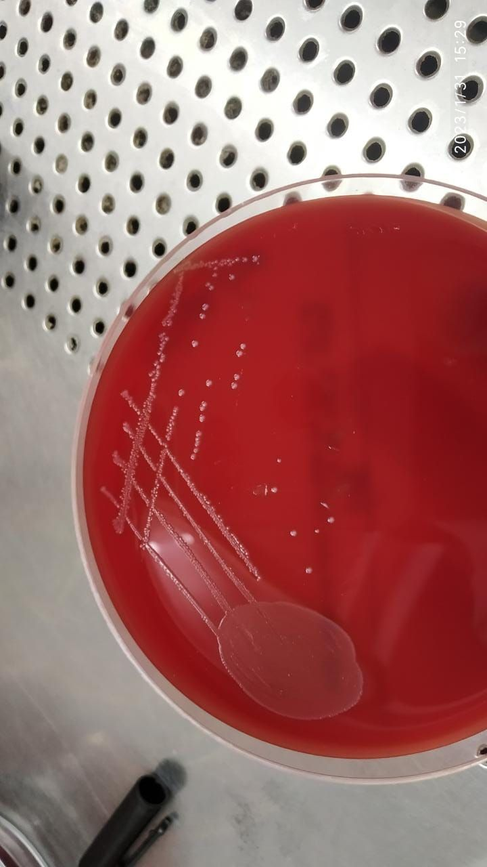
CDC prioritized bacteria in our set up:
Urgent Threats
■ Clostridium difficile
■ Carbapenem-resistant Enterobacteriaceae (CRE)
Serious Threats
■ Multidrug-resistant Acinetobacter
■ Fluconazole-resistant Candida
■ Extended spectrum β-lactamase producing Enterobacteriaceae (ESBLs)
■ Vancomycin-resistant Enterococcus (VRE)
■ Multidrug-resistant Pseudomonas aeruginosa
■ Methicillin-resistant Staphylococcus aureus (MRSA)
■ Drug-resistant TB
Concerning Threats
■ Vancomycin-resistant Staphylococcus aureus (VRSA)

Slide 3
Human says Covid-19 causes pandemic but they don’t know that we are also doing the same!

Slide 4
OVERLOOKED PANDEMIC

Slide 5
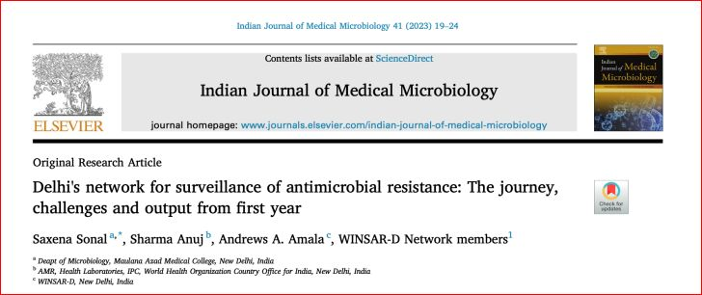

Slide 6
AMR: Man Made Phenomenon
Over prescription of antibiotics (>30%)
Incomplete course of treatment
Over the counter sale of antibiotics
Poor infection control practices (Improper Hand hygiene)
Poor sanitation
Use of antibiotics in live stock

Slide 7
Role of Antibiotic stewardship program (AMSP) in AMR
Antibiotic stewardship (AS) encompasses all activities intended to improve patient outcomes from infection while minimizing negative consequences such as AMR.

Slide 8
5 ‘D’s of Antibiotic stewardship
Optimal Diagnosis
Drug selection
Dosage
De-escalation and
Duration

Slide 9
Biomarkers in AMSP
BMs are helpful for 3 D’s are
Optimal Diagnosis
De-escalation and
Duration

Slide 10
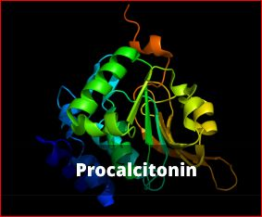
PCT in Bacterial infection
Bacterial cell wall releases Cytokines and endotoxins Blunting of final step in conversion of PCT to calcitonin PCT (cytokines IL-6, TNF-$α$, IL-1$β$)

Slide 11
PCT as Biomarker

Slide 12
Kinetic of PCT in Bacterial infection

Slide 13
This study carried out in Sheffield Teaching Hospitals NHS Foundation Trust
They recommend- withholding antibiotics in patients with low serum procalcitonin (PCT), [ 0.25 ng/mL].
Results showed reduced antibiotic consumption in patients with PCT 0.25 ng/mL with no increase in mortality, alongside a reduction in subsequent carbapenem prescriptions during admission.

Slide 14
PCT concentration
PCT $α Severity of infection$

Slide 15
PCT in Antibiotic Stewardship
Initiation of antibiotic therapy
Discontinuation of antibiotic therapy

Slide 16
Guideline for use of PCT

Slide 17
Other causes of increase in PPT
Major surgery
Severe trauma
Severe burns
Prolonged cardiogenic shock
Medication which stimulate cytokine release e.g., OKT3 (Muromonab-CD3), antilymphocyte globulins, Alemtuzumab, IL-2, granulocyte transfusion etc.
Newborn babies (baseline PCT is higher than adults)
Chronic kidney disease
Notes:
Newborns, PCT increases further over 1st 2 days of life. In infections it is significantly higher
Baseline PCT in CKD-stage 5 patients who are not on RENAL REPLACEMENT THERAPY IS 01-1.8 MICROGRAM/L

Slide 18
Dysregulated PCT production
Paraneoplastic syndromes due to medullary thyroid, small cell CA Lung etc.

Slide 19
Low or Normal PCT
Early course of bacterial infection
Localised infection like Osteomyelitis, empyema etc.
Subacute infective endocarditis

Slide 20
Advantages of PCT over other Biomarkers:
Rapidly increases after the onset of infection
Rapid decline within 48 hours in non-infected patients
PCT has higher specificity in mixed bacterial infections
PCT is not affected by the use of Non-steroidal anti-inflammatory agents
PCT is not affected by the use of Steroids
PCT levels have not shown to be affected by comorbidities like SLE, Gout etc.

Slide 21
Sepsis panel
Procalcitonin
Paired Blood culture

Slide 22
Take Home Message
PCT can be considered as a standard and convincing BM for Initiation and Discontinuation of Antibiotics
If it is <0.5 µg/L- antibiotics discouraged

