Slide 1
Acid-Base Chemistry
Normal Blood pH 7.35 to 7.45
Dr Srinivas H
MD, DNB, PhD(AIIMS, New Delhi), MNAMS
Diploma in Community Mental Health ( NIMHANS)
Assistant professor
Department of Biochemistry
MAMC, New Delhi

Slide 2
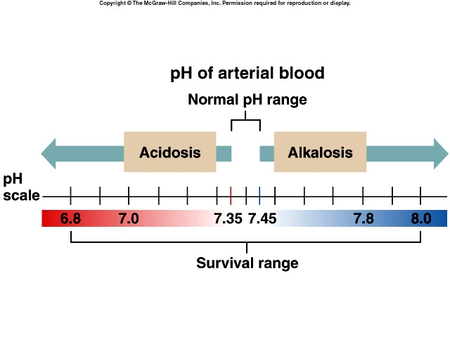
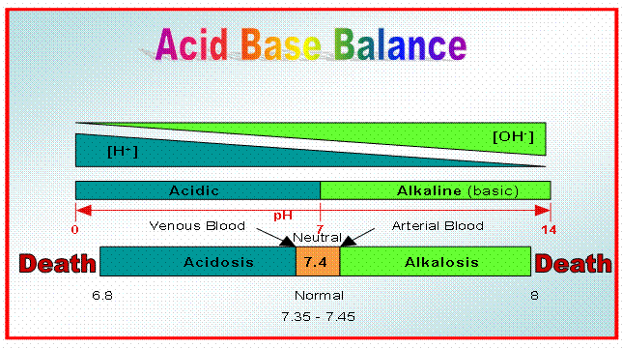

Slide 3
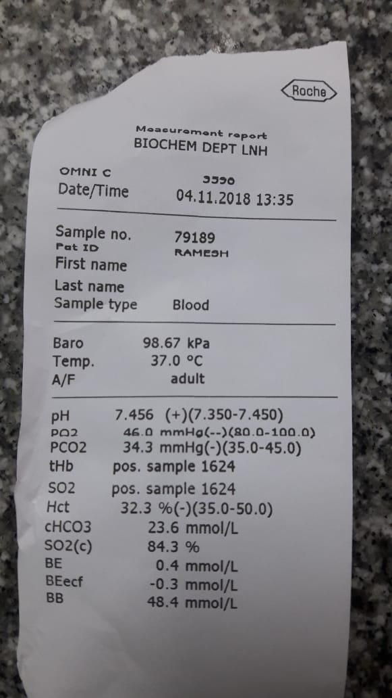
Normal Arterial Blood Gas Values
pH 7.35 - 7.45
PaCO₂ 35 - 45 mm Hg
PaO₂ 80 - 100 mm Hg
SaO₂ 93 - 98%
HCO₃¯ 22 - 26 mEq/L
Notes:
ABG/ VBG the difference is 0.02 in pH but the pco2 and o2 has difference. Heparinised blood within 30 mins on ice if more time is required. No contact with atmospheric air during collation or during estimation

Slide 4
Assessment of A-B balance
 | Arterial blood |  | Mixed venous blood
 |  | range |  | range
pH | 7.40 | 7.35-7.45 | pH | 7.33-7.43
pCO | 40 mmHg | 35 – 45 | pCO₂ | 41 – 51
pO₂ | 95 mmHg | 80 – 95 | pO₂ | 35 – 49
Saturation | 95 % | 80 – 95 | Saturation | 70 – 75
BE | ±2 |  | BE
HCO₃⁻ | 24 mEq/l | 22 - 26 | HCO₃⁻ | 24 - 28
Notes:
Same side rule

Slide 5
pH is constantly “impaired” by metabolism
> Volatile acid : carbonic acid→ respiration via CO2
> Fixed acid: lactate, ketoacid, sulfuric acid, phosphoric acid→ buffered and later execrated via renal in the form of H+
> Lactate and keto are produced at constant amount
> Sulfuric and phosphoric acid depended on the dietary protein
Total CO₂:
= [HCO₃] + [H₂CO₃]
+ [carbamino CO₂]
+ [dissolved CO₂]

Slide 6
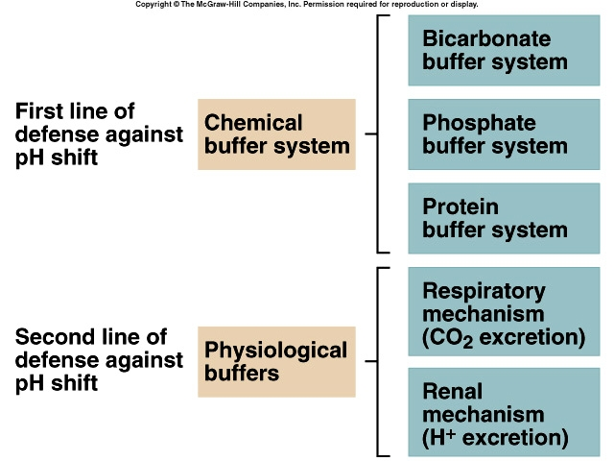

Slide 7
Important principles
H⁺ secreted = HCO₃⁻ reabsorbed
H⁺ excreted = titratable acidity + urinary NH₄⁺
Most of the H⁺ secreted is used to “reclaim” filtered HCO₃⁻
Filtered HCO₃⁻ is not reabsorbed as such; it is destroyed in tubule and resynthesized in tubular cell
Plasma [HCO₃⁻] depends on the rate of renal H⁺ secretion
↑ H⁺ secretion → ↑ plasma [HCO₃⁻] (metabolic alkalosis)
↓ H⁺ secretion → ↓ plasma [HCO₃⁻] (metabolic acidosis)
Healthy kidney maintains the constancy of plasma [HCO₃⁻] by maintaining constancy of H⁺ secretion (irrespective of moderate acid or alkaline assaults)

Slide 8
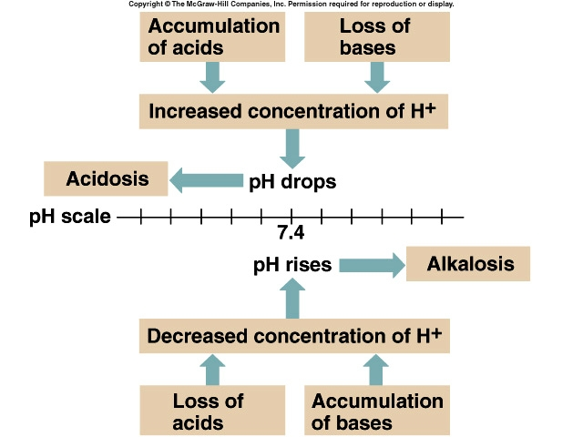

Slide 9
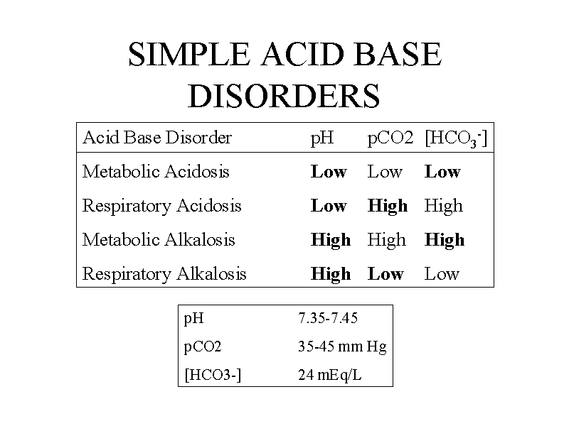

Slide 10
Clinically acid base disturbance are divided into
Uncompensated
Partially compensated
Fully compensated

Slide 11
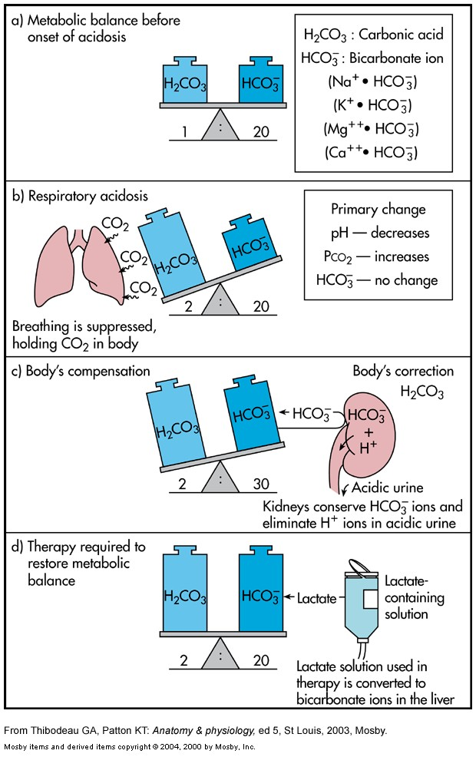

Slide 12
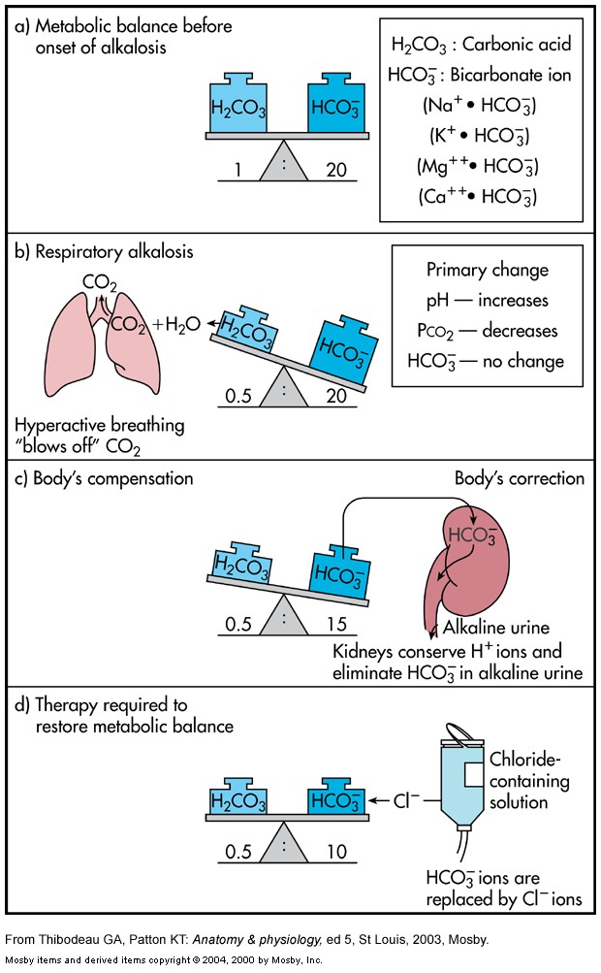

Slide 13
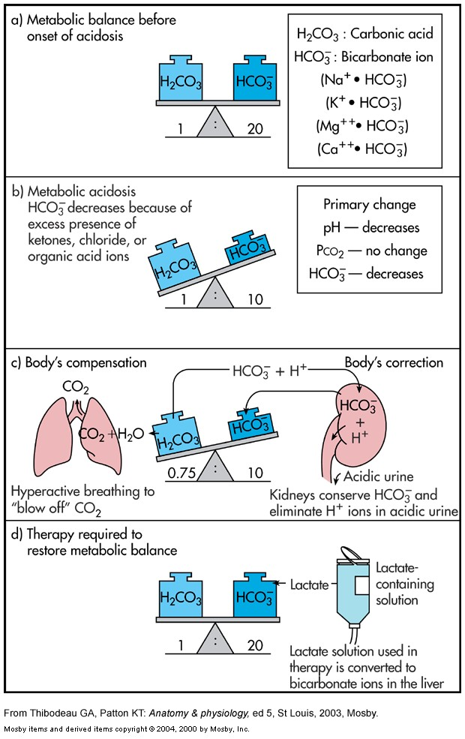

Slide 14
