Slide 1
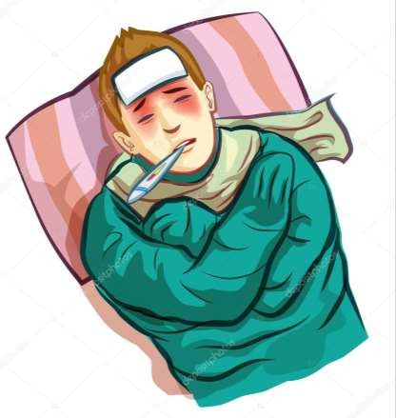

PYREXIA OF UNKNOWN ORIGIN

Slide 2

INTRODUCTION
BODY TEMPERATURE
Body temperature is normally maintained within a range of 37 – 38°c , normal body temperature is generally considered to be 37°c .

Slide 3
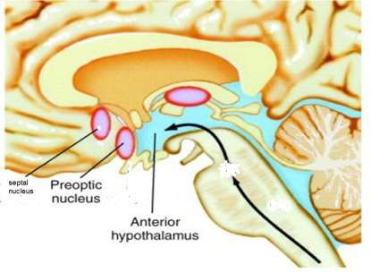
PHYSIOLOGY
Normal body temperature is maintained by a complex regulatory system in the anterior hypothalamus, preoptic area, temperature sensitive area, thermal set point.

Slide 4
PATHOGENESIS
PYROGENS
Substances the mediate the elevation of core body temperature There are two types; exogenous and endogenous pyrogens.
EXOGENOUS PYROGENS
It is derived from outside of the host, such as microorganisms, toxins and
microbial products
They are generally large molecules – cannot pass blood brain barrier
They induce the release of endogenous pyrogens from macrophages.

Slide 5
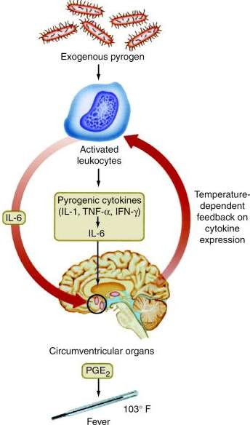
PATHOGENESIS
ENDOGENOUS PYROGENS
Endogenous pyrogens are derived from the macrophages.
They are small molecules – can pass blood brain barrier
Pyrogen cytokines trigger the hypothalamus to release PGE2, resulting in:
  Resetting of thermostatic temperature
  Activation of vasomotor center
  Vasodilatation
  Heat production

Slide 6




















PYREXIA OF UNKNOWN ORIGIN
ORIGINAL DEFINITION
(Petersdotf anf Beeson, 1961)
Temperature ≥ 38.3ºC (101ºF) on several occasions
Fever ≥ 3 weeks
Failure to reach a diagnosis despite 1 week of inpatient investigations or
3 outpatient visits
NEW DEFINITION
(Petersdotf anf Beeson, 1961)
Temperature ≥ 38.3ºC (101ºF) lasting for more than 14 days without an obvious cause despite a complete history, physical examination and routine screening with laboratory evaluation

Slide 7
FACTORS
FACTORS THAT MAY HAVE CONTRIBUTED TO
THE DIFFICULTY IN FINDING THE CAUSE OF FEVER INCLUDE:
A common illness that does not have the usual symptoms – may be asymptomatic
Illness whose symptoms appear later
Illnesses with possibly delayed positive test
Person is unable to communicate about other symptoms
Genetic condition that causes periodic fever.

Slide 8





COMMON CAUSES
COMMON CAUSES OF PYREXIA OF UNKNOWN ORIGIN
Infection (40%)
Autoimmune Disease (15%)
Undiagnosed (10%)
Malignancy (25%)
Others/ Miscellaneous (10%)
10%
10%
40%
15%
25%

Slide 9
CLASSIFICATION
DURACK AND STREET’S CLASSIFICATION
Classical
Nosocomial
Neutropenic
Pyrexia of unknown origin with HIV infection

Slide 10
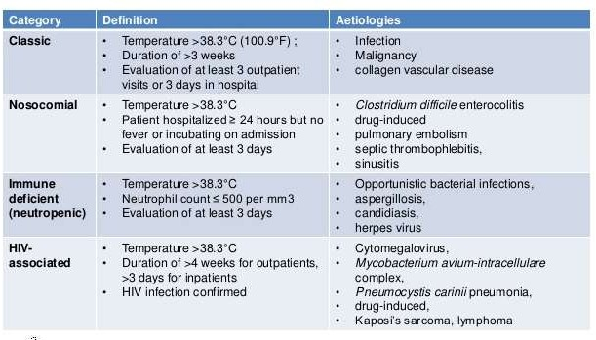
CLASSIFICATION

Slide 11
1. CLASSICAL
CLASSIC PYREXIA OF UNKNOWN ORIGIN
Temperature >38.3°C (100.9°F)
Duration of >3 weeks
Evaluation of at least 3 outpatient visits or 3 days in hospital
AETIOLOGIES
  Infections
  Malignancies
  Collagen vascular disease
  Others / miscellaneous which includes drug-induced fever

Slide 12
1. CLASSICAL
A. INFECTIONS
Bacterial
Abscesses, tuberculosis, uncomplicated UTI, endocarditis, osteomyelitis, sinusitis, prostatitis, cholecystitis, empyema, biliary tract infection, brucellosis, typhoid, etc.
Viral
Cytomegalovirus, infectious mononucleosis, HIV, etc.
Parasites
Malaria, toxoplasmosis, leishmaniasis, etc.
Fungal
Histoplasmosis, etc.
As the duration of fever increases, infectious etiology decreases. Malignancy and factitious fevers are more common in patients with prolonged pyrexia of unknown origin

Slide 13
1. CLASSICAL
B. MALIGNANCIES
HEMATOLOGICAL
NON-HAEMATOLOGICAL
Lymphoma
Chronic leukemia
Renal cell cancer
Pancreatic cancer
Colon cancer
Hepatoma

Slide 14
1. CLASSICAL
C. COLLAGEN VASCULAR DISEASE / AUTOIMMUNE DISEASE
Temporal arthritis
Rheumatoid arthritis
Rheumatoid fever
Inflammatory bowel disease
Reiter’s syndrome
Systemic lupus erythematosus
Polyarthritis nodosa
Giant cell arthritis
Kawasaki disease

Slide 15
1. CLASSICAL
C. MISCELLANEOUS
Hyperthyroidism
Alcoholic hepatitis
Inflammatory bowel disease
Deep venous thrombosis
DRUGS
Allopurinol
Captopril
Cimetidine
Clofibrate
Erythromycin
Heparin
Hydralazine
Hydrochlorothiazide
Isoniazid
Meperidine
Methydopa
Nifedipine
Nitrofurantoin
Penicillin
Phenytoin
Procainamide
Quinidine

Slide 16
1. CLASSICAL
C. MISCELLANEOUS
FACTITIOUS FEVER
Munchausen syndrome Munchausen by proxy
THERMOREGULATORY DISORDER
Central
Brain tumor
Hypothalamic dysfunction
Peripheral
Hyperthyroidism
Pheochromocytoma

Slide 17
FEVER PATTERN
Intermittent Fever
  Any fever characterized by intervals of normal temperature
  Malaria, pyaemia, septicemia
Continuous Fever
  Temperature remains above normal throughout the day and does not fluctuate more than 1C in 24 hours
  Lobar pneumonia, Typhoid, Meningitis, UTI, Brucellosis
Remittent Fever
  A fever pattern in which temperature varies during each 24 hour
period but never reaches normal.
  Enteric Fever, Bacterial Endocarditis, Viral Pneumonia

Slide 18
FEVER PATTERN
Relapsing Fever
An acute infection with recurrent episodes of fever caused by spirochetes of the genus Borrelia which are borne by ticks or lice.
Undulant Fever
An infectious disease due to the bacteria Brucella.
It is called undulant because the fever is typically undulant, rising and falling like a wave.
It is also called brucellosis after its bacterial cause

Slide 19
FEVER PATTERN
Relapsing Fever
An acute infection with recurrent episodes of fever caused by spirochetes of the genus Borrelia which are borne by ticks or lice.
Undulant Fever
An infectious disease due to the bacteria Brucella.
It is called undulant because the fever is typically undulant, rising and falling like a wave.
It is also called brucellosis after its bacterial cause

Slide 20
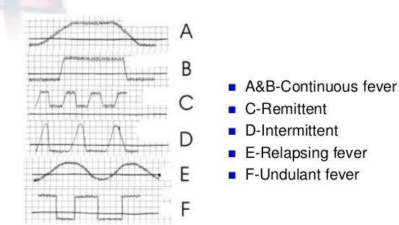
FEVER PATTERN

Slide 21
2. NOSOCOMIAL
NOSOCOMIAL PYREXIA OF UNKNOWN ORIGIN
Temperature > 38.3°C
Patient hospitalized ≥ 24 hours but no fever or incubating on admission
Evaluation of at least 3 days
More than 50% of patients with nosocomial PUO are due to infection
Focus on sites where occult infections may be sequested, such as:
  Sinusitis of patients with NG or Oro-tracheal tubes
  Prostatic abscess in a man with urinary catheter
25% of non-infectious cause includes:
  Acalculous colecystitis
  Deep vein thrombophlebitis
  Pulmonary embolism

Slide 22
3. NEUTROPENIC
IMMUNE DEFICIENT / NEUTROPENIC PUO
Temperature >38.3°C
Neutrophil count ≤ 500 per mm³
Evaluation of at least 3 days
Patients on chemotherapy or immune deficiencies are susceptible to:
  Opportunistic bacterial infection
  Fungal infections such as candidiasis
  Infections involving catheters
  Perianal infections
Examples of etiological agent:
  Aspergillus
  Candida
  CMV
  Herpes simplex

Slide 23
4. HIV-ASSOCIATED
IMMUNE DEFICIENT / NEUTROPENIC PUO
Temperature > 38.3°C
Duration of > 4 weeks for outpatients, > 3 days for inpatients
HIV infection confirmed
HIV infection alone may be a cause of fever
Common secondary causes include:
  Tuberculosis
  CMV infection
  Non-hodgkin lymphoma
  Drug-induced fever

Slide 24
CLINICAL APPROACH
PYREXIA OF UNKNOWN ORIGIN : A CLINICAL APPROACH
HISTORY OF PRESENTING ILLNESS
Onset
  Acute
  Gradual
Character
Antecedents
  Dental extraction
  Urinary catheterization

Slide 25
CLINICAL APPROACH
PYREXIA OF UNKNOWN ORIGIN : A CLINICAL APPROACH
4. Associated symptoms
Chills and rigors
Night sweats
Loss of weight
Cough and dyspnea
Headache
Joint pain
Abdominal pain
Bone pain
Sore throat
Dysuria and rectal pain
Altered bowel habit
Skin rash

Slide 26
CLINICAL APPROACH
PYREXIA OF UNKNOWN ORIGIN : A CLINICAL APPROACH
PAST MEDICAL HISTORY PAST SURGICAL HISTORY
DRUG HISTORY FAMILY HISTORY

Slide 27
CLINICAL APPROACH
PYREXIA OF UNKNOWN ORIGIN : A CLINICAL APPROACH
Travel
Residential area
Occupation
Contact with domestic / wild animals / birds
Diet history
Sexual orientation
Close contact with TB patients

Slide 28











PHYSICAL EXAMINATION
GENERAL
Pattern of fever – continuous, intermittent, relapsing
Ill or not ill
Weight loss – chronic illness
Skin rash
HANDS
  Stigmata of infective endocarditis
  Vasculitis changes
  Clubbing
  Presence of arthropathy
  Raynaud’s phenomenon

Slide 29










PHYSICAL EXAMINATION
ARMS
Drug injection sites (IV drug usage)
Epithrochlear and axillary nodes (lymphoma, sarcoidosis, focal infection)
Skin
HEAD AND NECK
Feel temporal arteries (tender and thicken)
Eyes – iritis / conjunctivitis
Jaundice (ascending cholangitis)
Fundus – choroidal tubercle (miliary TB), Roth’s spot (infective
endocarditis) and retinal hemorrhage (leukemia)
Lymphadenopathy

Slide 30














PHYSICAL EXAMINATION
FACE AND MOUTH
Butterfly rash
Mucous membranes
Seborrhoic dermatitis (HIV)
Mouth ulcers (SLE)
Buccal candidiasis
Teeth and tonsil infections (abscess)
Parotid enlargement
Ears – otitis media
CHEST
  Bony tenderness
  Cardiovascular – murmurs
  Respiratory – signs of pneumonia, tuberculosis, empyema and lung cancer

Slide 31



















PHYSICAL EXAMINATION
ABDOMEN
Rose colored spot – typhoid fever
Hepatomegaly
Splenomegaly – haemopoietic malignancy, IE, malaria
Renal enlargement – renal cell carcinoma
Testicular enlargement – seminoma
Penis & scrotum – discharge/rash
Inguinal ligament
Per-rectal exam
Mass / tenderness in rectum/pelvis (abscess, carcinoma, prostatitis)
Vaginal examination
Collection of pelvic pus/ pelvic inflammatory disease

Slide 32


PHYSICAL EXAMINATION
CENTRAL NERVOUS SYSTEM
Signs of meningism (chronic TB meningitis)
Focal neurological signs (brain abscess, mononeuritis multiplex in plyarthritis nodosa)

Slide 33























INVESTIGATION
STAGE 1 – SCREENING TESTS
Full blood count
ESR and CRP
BUSE
LFTs
Blood culture
Serum virology
Urinalysis and culture
Sputum culture and sensitivity
Stool FEME and occult blood
Chest x-ray
Mantoux test

Slide 34










INVESTIGATION
STAGE 2
Repeat history and examination
Protein electrophoresis
CT (chest, abdomen, pelvis)
Autoantibody screen
Electrocardiogram (ECG)
Bone marrow examination
Lumbar puncture
Temporal artery biopsy
HIV test counselling
Ultrasonography

Slide 35




























INVESTIGATION
STAGE 3
Chest radiograph
Tuberculosis, malignancy, Pneumocystis carinii pneumonia
CT of abdomen or pelvis with contrast
agent
Abscess, malignancy
Gallium 67 scan
Infection, malignancy
Indium-labeled leukocytes
Occult septicemia
Technetium Tc 99m
Acute infection and inflammation of bones and soft tissue
MRI of brain
Malignancy, autoimmune conditions
Malignancy, inflammation
Transthoracic or transesophageal echocardiography
PET scan
Venous Doppler study
Bacterial endocarditis
Venous thrombosis

Slide 36



INVESTIGATION
STAGE 4
Treat TB
Endocarditis
Vasculitis
Trial of aspirin / steroids

Slide 37
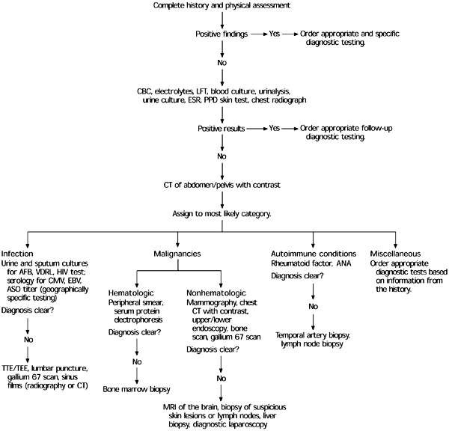

Slide 38
DIAGNOSIS
More invasive testing, such as LP or biopsy of bone marrow, liver, or lymph nodes, should be performed only when clinical suspicion shows that these tests are indicated or when the source of the fever remains unidentified after extensive evaluation.
When the definitive diagnosis remains elusive and the complexity of the case increases, an infectious disease, rheumatology, or oncology consultation may be helpful.

Slide 39
THERAPEUTIC TRIALS
WHAT IS THE BEST THERAPEUTIC TRERAPY FOR PUO PATIENTS?
Therapeutic trials consist of combination of broad spectrum antibiotics and are given in :-
Patient who is very sick to wait.
All tests have failed to uncover the etiology.

Slide 40
PROGNOSIS
WHAT IS THE BEST THERAPEUTIC TRERAPY FOR PUO PATIENTS?
Prognosis is determined primarily by the underlying disease.
Outcome is worst for neoplasms.
PUO patients who remain undiagnosed after extensive evaluation generally have a favorable outcome and the fever usually resolves after 4 - 5 weeks

Slide 41
SUMMARY
WHAT IS THE BEST THERAPEUTIC TRERAPY FOR PUO PATIENTS?
PUO is often a diagnostic dilemma, quandary.
Infections comprise ~30% of cases
Bone marrow biopsies are of low diagnostic yield
Diagnostic approach should occur in a step-wise fashion based on the H&P
Patient’s that remain undiagnosed generally have a good prognosis

Slide 42
REFERENCES
WHAT IS THE BEST THERAPEUTIC TRERAPY FOR PUO PATIENTS?
Nelson Essenssials Of Pediatrics 6th Edition
Harrison’s Principles Of Internal Medicine 18th Edition.
Mandell, Bennet & Dolin’s, Principle Of Infectious Disease 6th Edition.

Slide 43
THANK YOU

