Slide 1
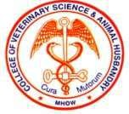
INNATE IMMUNITY
RAKESH SHARDA
Department of Veterinary Microbiology NDVSU College of Veterinary Science & A.H., Mhow

Slide 2
Innate Immunity - characteristics
Most primitive type of immune system found in
virtually all multicellular animals
high discrimination of host and pathogen
First line of defense against infection
no need for prolonged induction
act quickly
immediate direct response 0-4 hrs rapid induced 4-96 hrs
antigen-independent

Slide 3
Innate Immunity – characteristics (contd.)
dependence on germ line encoded receptors
always present and active, constitutively expressed
(some components can be up-regulated)
Nonspecific; not specifically directed against any particular infectious agent or tumor
no clonal expansion of Ag specificity
Same every time; no ‘memory’ as found in the adaptive immune system
failure ==> adaptive immune response

Slide 4
Components of Innate Immunity
First line
Second line
Physical barriers
Chemical & biochemical barriers
Biological barriers (Normal flora)
A- cells
Natural killer
Phagocytes
inflammatory cells
B- Soluble factors
C- Inflammatory barriers

Slide 5
Anatomical /Physical/Mechanical Barriers
System or Organ | Cell type | Mechanism
Skin | Squamous epithelium | Physical barrier (intact skin) Desquamation
Mucous Membranes | Non-ciliated epithelium (e.g. GI tract) | Peristalsis
 | Ciliated epithelium, hairs (e.g. respiratory tract) | Mucociliary elevator, Coughing, sneezing
 | Epithelium (e.g. nasopharynx) | Flushing action of tears, saliva, mucus, urine; blinking of eye lids

Slide 6
Biological Factors
System or Organ | Component | Mechanism
Skin and mucous membranes | Normal microflora | Antimicrobial substances
 |  | Competition for nutrients and colonization

Slide 7
Chemical Factors
(at surfaces and in body cavities)
System or Organ | Component | Mechanism
Skin | Sweat | Anti-microbial fatty acids, high salt conc.
Mucous Membranes | HCl (parietal cells) Tears and saliva | Low pH Lysozyme and phospholipase A
 | Defensins (respiratory & GI tract) | Antimicrobial
 | Sufactants (lung) | Opsonin

Slide 8
Chemical Factors
(Humoral Components)
Component
Mechanism
Complement
Lysis of bacteria and some viruses, Opsonin Increase in vascular permeability
Recruitment and activation of phagocytic cells
Coagulation system
Increase vascular permeability, Recruitment of phagocytic cells, β-lysin from platelets – a cationic detergent, antibacterial
Acute phase protein
Antibacterial
Lysozyme
Breaks down bacterial cell walls
Lactoferrin and transferrin
Compete with bacteria for iron
Cytokines
Various effects
Interferon
Anti-viral protein

Slide 9
Pathways of complement activation
CLASSICAL
PATHWAY
LECTIN PATHWAY
ALTERNATIVE PATHWAY
antibody
dependent
antibody
independent
Activation of C3 and generation of C5 convertase
activation
of C5
LYTIC ATTACK
PATHWAY

Slide 10
THE ACUTE PHASE PROTEINS
‘Acute
phase
proteins’
increases
are a large group of plasma (or decreases) (by 25% or
proteins whose more) during
concentration
inflammation (acute or chronic), such as injury and in disease states. Proinflammatory cytokines stimulate hepatocytes in the liver to synthesize
and secrete acute phase proteins.
Examples of acute phase proteins are CRP, MBP, haptoglobin, SAA,
fibrinogen, α₁-antitrypsin, and complement components C3 and C4.
C-reactive protein (CRP) binds to membrane phospholipids in microbial
membranes.
Mannose binding protein (MBP) binds to mannose sugars found in many
bacteria and fungi.
These functions as opsonins, soluble pattern-recognition receptors, activate
the complement pathway or be involved in sequestration of essential
nutrients.

Slide 11
Antimicrobial Peptides (AMPs)
Antimicrobial peptides forms pores in the cytoplasmic membrane of a variety of bacteria causing leakage of cellular needs, e.g. lysozymes, lactoferrins, defensins, protegrins, granulozymes, etc
Lysozyme, in serum, mucus, plasma, tissue fluids and tears,
breaks down the bacterial cell wall (peptidoglycan)
Beta-defensins are short peptides found in blood plasma and
mucous.
Transferrin & lactoferrin competitively binds iron in blood, tissues and milk thereby preventing its availability to microorganisms

Slide 12
Interferons (IFN)
Interferons (IFNs) comprise a family of secreted α-helical cytokines induced in response to specific extracellular biomolecules of viruses or other pathogens through stimulation of Toll-like receptors (TLRs).
Act in paracrine or autocrine modes for regulating innate and acquired immunity, resistance to viral infections, and normal and tumor cell survival and death.
There are five types of human interferon: alpha, beta, gamma, delta and
omega (α -IFN, β -IFN, γ-IFN, ξ-IFN, and ω-IFN, respectively) .
Virus infected cells produce IFN-α and IFN-β.
Interferons are host-cell-specific, but not virus-specific
Gamma-IFN, also called as immune interferon, activates neutrophils, NK cells
and macrophages.
Interferons also result in
resistance to viral replication; induce enzymes to degrade viral mRNA increased MHC I expression
activate NK cells, T-cells and macrophages

Slide 13
Interferons
Virus-infected cells (double-stranded RNA) Interferon
Uninfected cells
Induces enzymes (inactive) capable of degrading mRNA Uninfected cells become infected with a virus Activation of enzymes
Degradation of viral and cellular mRNA Blocks viral and cellular protein synthesis
Death of the infected cell

Slide 14
Cellular Components
Cell | Functions
Neutrophils | Phagocytosis and intracellular killing Inflammation and tissue damage
Macrophages | Phagocytosis and intracellular killing Extracellular killing of infected or altered self targets Tissue repair
NK cells | Killing of virus-infected and altered self targets
Eosinophils | Killing of certain parasites

Slide 15
Inflammation

Slide 16
Inflammation
Inflammation is an attempt
by the
and restore and
body to
eliminate the noxious agent
maintain homeostasis after injury to a tissue.
The injury is often caused by invading organisms.
It is the second line of defense.

Slide 17
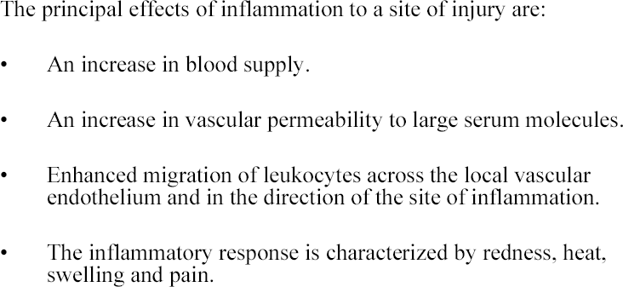
Inflammation (contd.)

Slide 18
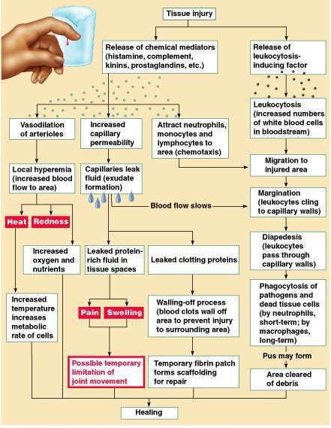
Chapter 21, Immune System

Slide 19
The Good Side of Inflammation
The inflammatory response to tissue damage is of great value by:
isolating the damaged area
mobilizing effector cells and molecules to the site, and
in the late stages — promoting healing
Inflammation protects the body (innate immunity)

Slide 20
The Bad Side of Inflammation
Often the inflammatory response is out of proportion to the threat it is dealing with. The result can be more damaging to the body than the agent itself would have produced.
Allergies and Autoimmune Diseases are examples of inflammation in response to what should have been a harmless, or at least noninfectious, agent

Slide 21
Phagocytosis

Slide 22
Phagocytosis
Phagocytosis is the ingestion of microorganisms or
particulate matter by a cell.
Phagocytosis is performed by phagocytes— certain types of white blood cells or derivatives of them.
All phagocytes eat, digest and extrude

Slide 24
Phagocytic Cells
Myeloid
Macrophage- Monocyte
Basophils
Neutrophils
Eosinophils
Rapid phagocytosis, but cannot phagocytose repeatedly
Slow but can phagocytose
repeatedly.
Has granules which contain
bactericidal enzymes
Contain bactericidal enzyme.
Short lived •Long lived
NO ABILITY TO PRESENT ANTIGEN •Selected cells HAVE
ability to present Ag.

Slide 25
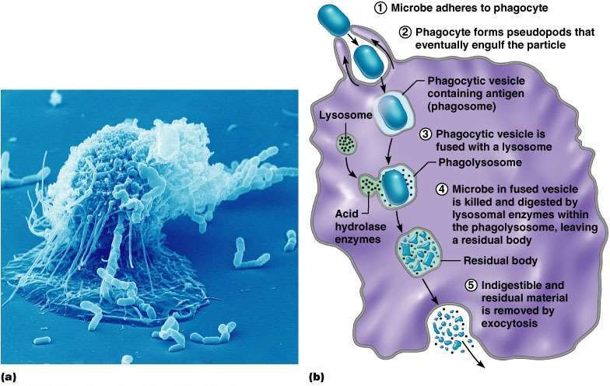
Mechanism of Phagocytosis
25

Slide 26
Chemotaxis & attachment
Attraction by chemotactic substances (microbes, damaged tissues,
complement components, vasoactive amines, etc )
Attachment by receptors on surfaces of phagocytes.
Ingestion and phagosome formation
Phagocytes’ produce pseudopodia surrounding organism forming
phagosome
Opsonins and co-factors enhance phagocytosis
Phagolysosome formation
Fusion of phagosome with lysosomal granules of phagocyte take place by help of cytoskeleton followed by the release digestive and degradative enzymes

Slide 27
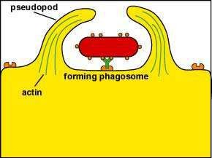
The Process of Phagocytosis - ingestion
Following attachment, polymerization and depolymerization of actin
molecules send pseudopods out to engulf the bacterium

Slide 28
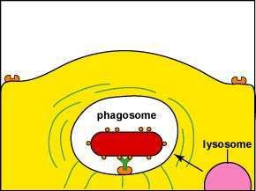
The Process of Phagocytosis - phagosome formation
Following engulfment, the bacterium is placed in a vesicle called a phagosome.

Slide 29
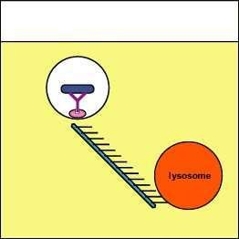
Lysosomes move along the cytoskeleton and fuse with phagosomes to form
phagolysosomes.

Slide 30
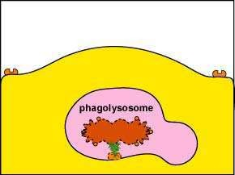
The Process of Phagocytosis - Destruction
The lysosome, its digestive enzymes and microbicidal chemicals fuses with the phagosome containing the ingested bacteria to form a phagolysosome and the bacterium is killed.

Slide 31
Intra-cellular killing (two microbicidal routes)
Oxygen-dependent system (powerful microbicidal agents)
Oxygen converted to superoxide anion, hydrogen peroxide,
activated oxygen and hydroxyl radicals.
Oxygen-independent system (anaerobic conditions) Digestion and killing by lysozyme, lactoferrin, low pH, cationic
proteins and hydrolytic and proteolytic enzymes

Slide 32
Pathways of Intracellular Killing
Intracellular Killing
oxygen-depenedent oxygen-independent
myloperoxidase-independent myeloperoxidase-dependent

Slide 33
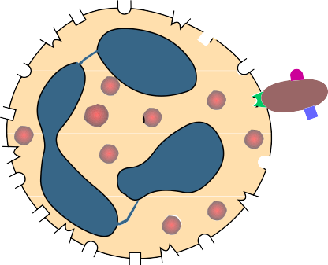
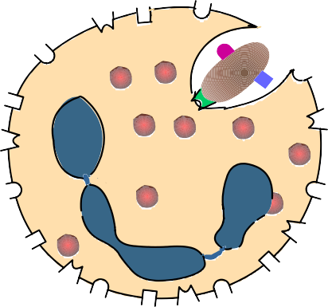
Respiratory Burst
Respiratory Burst
Oxygen-dependent Myeloperoxidase-independent Reactions
Glucose +NADP⁺
G-6-P-dehydrogenase
Pentose-P
+ NADPH
NADPH + O₂
Cytochrome
-
+
NADP + O
2
b558
-
2O + 2H
+
2
H O + ¹O
Superoxide dismutase
2 2
2
-
-
2O₂ + H₂O₂
.OH + OH + ¹O₂
Toxic compounds – Superoxide anion (O2 ⁻), Hydrogen peroxide (H₂O₂),
Singlet oxygen (¹O₂) and Hydroxyl radical (OH*)

Slide 34
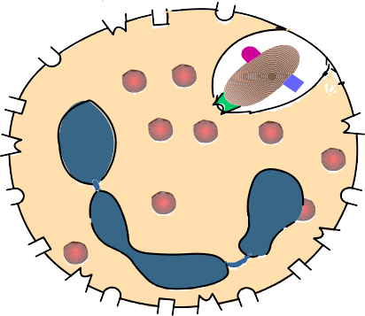
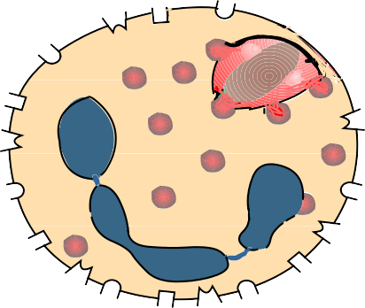
Respiratory Burst
Oxygen-dependent Myeloperoxidase-dependent Reactions
H O + Cl⁻
2 2
myeloperoxidase
OCl⁻ + H O
2
-
-
2OCL⁻ + H O
¹O₂ + Cl + H₂O
2
Toxic compounds
– Hypochlorous acid (OCl⁻)
- Singlet oxygen (¹O₂)

Slide 35
Respiratory Burst
Detoxification Reactions
Superoxide dismutase
-
H O + O
2O + 2H
+
2 2
2
2
Catalase
2 H₂O₂
H₂O + O₂

Slide 36
Mediators of Oxygen-independent Killing in the Phagolysosome
Effector Molecule
Cationic proteins (cathepsin)
Lysozyme Lactoferrin
Hydrolytic enzymes (proteases)
Function
Damage to microbial
membranes
Hydrolyses mucopeptides in the cell wall
Deprives pathogens of iron Digests killed organisms

Slide 37
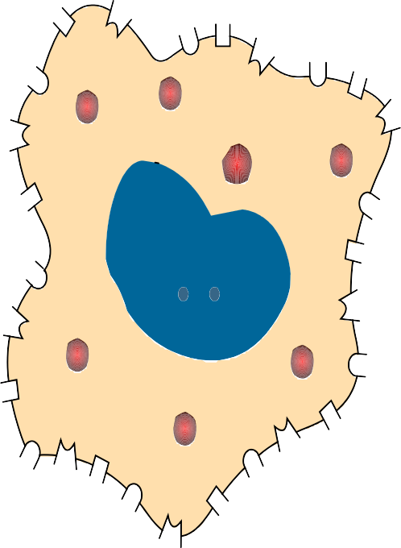
Nitric Oxide Dependent Killing
Some cytokines can also
induce cells,
phagocytic particularly
macrophages, to
Nitric Oxide produce nitric oxide
(NO), which is toxic to microorganisms and malignant cells

Slide 38
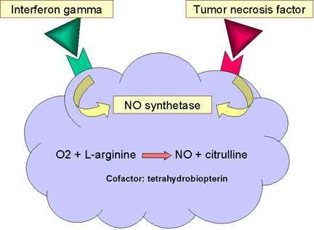

Slide 39
Nitric Oxide Dependent Killing
Nitric oxide also possess antiviral properties:
inhibition of viral RNA synthesis
inhibition of viral protein accumulation
inhibition of virus release from infected cell

Slide 40
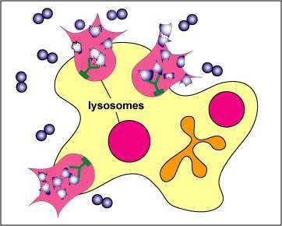
Extracellular Destruction of Bacteria by a Phagocyte
If
the phagocyte is
with
the
overwhelmed
microorganisms,
phagocyte will empty
the
contents of its lysosomes by
a
process
called
degranulation in order to kill
the microorganisms or cell
extracellularly.
These
released lysosomal contents,
however, also
kill
surrounding host cells and tissue. Most tissue destruction associated with infections is a result of this process

Slide 41
FACTORS AFFECTING PHAGOCYTOSIS
OPSONINS “natural ketchup”
Proteins which coat the antigen to facilitate phagocytosis
e.g.
Antibodies
Complement Components Certain Liver proteins
Generally both bacteria and cells that are suspended in body fluids have negative charges (Zeta Potential). Therefore they tend to repel each other. Opsonins, provide positive charges and coating with opsonins promotes phagocytosis.

Slide 42
ANTIGEN
OPSONIN
EFFICIENCY OF PHAGOCYTOSIS
None
+
Antibody
+++
Complement
+++
++++
Antibody Plus Complement

Slide 43
Fever

Slide 44
Fever
Activated macrophages and other leukocytes release
proinflammatory cytokines such as TNF-alpha, IL-6, and IL-1
These cytokines stimulate the anterior hypothalamus of the brain to produce prostaglandins that lead to an increase in body temperature – fever.
Fever increases the physiological temperature above the optimum growth temperature for many microorganisms.
Fever leads resulting in cytokines.
to the production of heat shock proteins the production of inflammation-promoting
Fever elevates the temperature of the body increasing the rate of enzyme reactions, and speeding up metabolism within the body

Slide 45
Fever and Immune Activation
LYMPHOCYTE ACTIVATION
(T, B, NK)
Alternate pathway of C’
BACTERIA
Mac
SLEEP
APPETITE
MOTILITY OF
NEUTROPHILS
GROWTH OF BACTERIA
MUSCLE
PROTEOLYSIS
IL-1, IL-6, TNF-α
INCREASED AMINO ACIDS IN BLOOD
FEVER
INCREASES
NEUTROPHILS
LOWERS IRON, ZINC IN BLOOD
Stimulates
Hepatocytes
Stimulates Fibroblast Proliferation
ACUTE PHASE
PROTEINS

Slide 46
How innate Immunity Recognizes?

Slide 47
Pattern-Recognition Receptors
Innate immunity recognize a few highly conserved structures present in many different microorganisms - the pathogen- associated molecular patterns (PAMPs) as well as danger signals released from damaged or dying (necrotic) cells (DAMPs)
These PAMPs/DAMPs are recognized by pattern recognition
receptors (PRRs), expressed on/in the innate immunity cells.
PRRs can also recognize host molecules containing damage-
associated molecular patterns (DAMPs), molecules that are
often released from necrotic cells damaged by invading
pathogens
These PRRs include Toll-like
receptors
binding domain (NOD) and leucine-rich
(TLRs),
repeat
nucleotide-
containing
receptors (NLRs), and retinoic acid-inducible gene-I (RIG-)-like receptors (RLRs). lectins, and scavenger receptors.

Slide 48
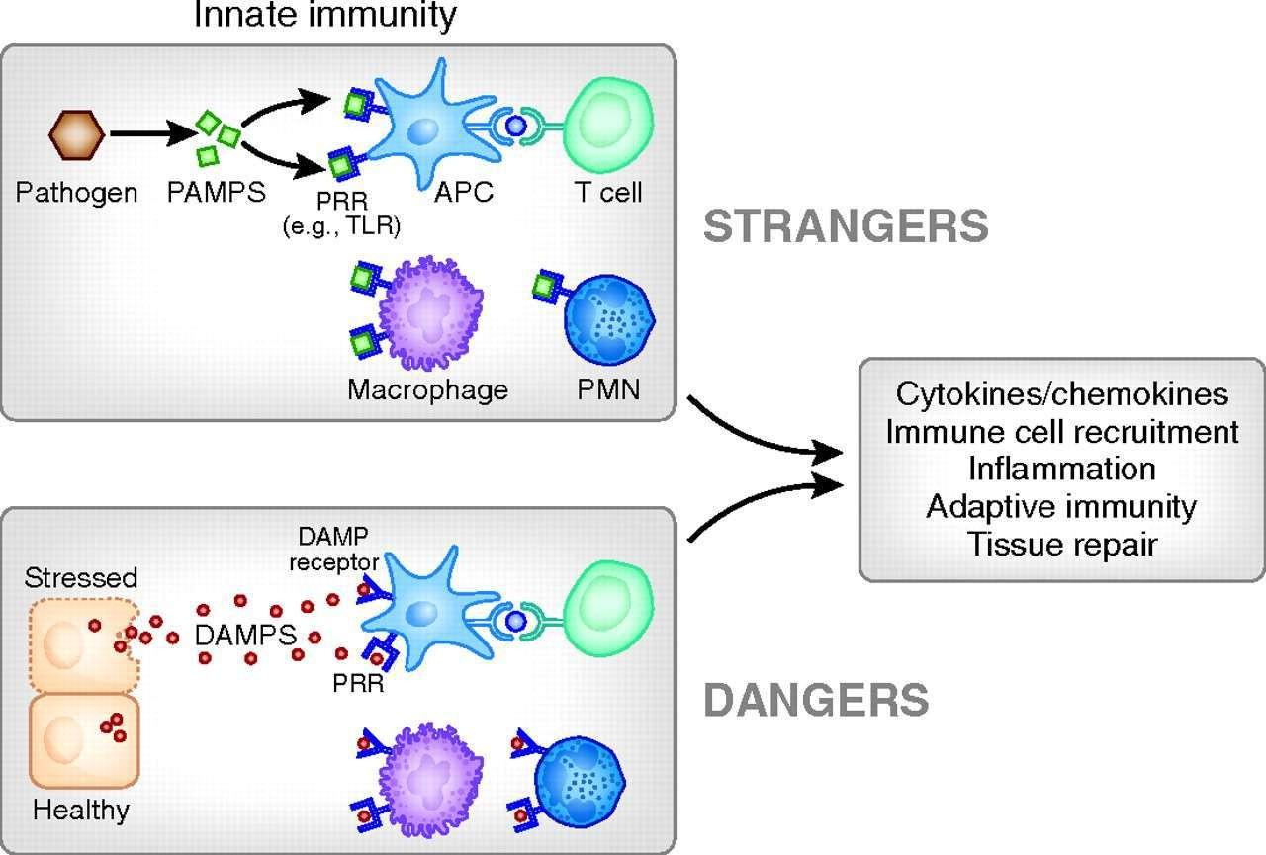

Slide 49
PAMPs
Lipopolysaccharide Peptidoglycan Lipoteichoic acids Mannose-rich glycans Flagellin
Pilin
Bacterial nucleic acid N-formylmethionine, Double-stranded RNA
Lipoteichoic acids, glycolipids, and zymosan Phosphorylcholine and other lipids

Slide 50
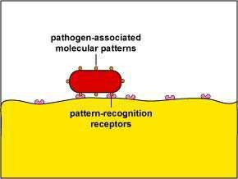
PAMPs binding to PRRs on defense cells
The PRRs recognize approximately 10³ molecular patterns

Slide 51
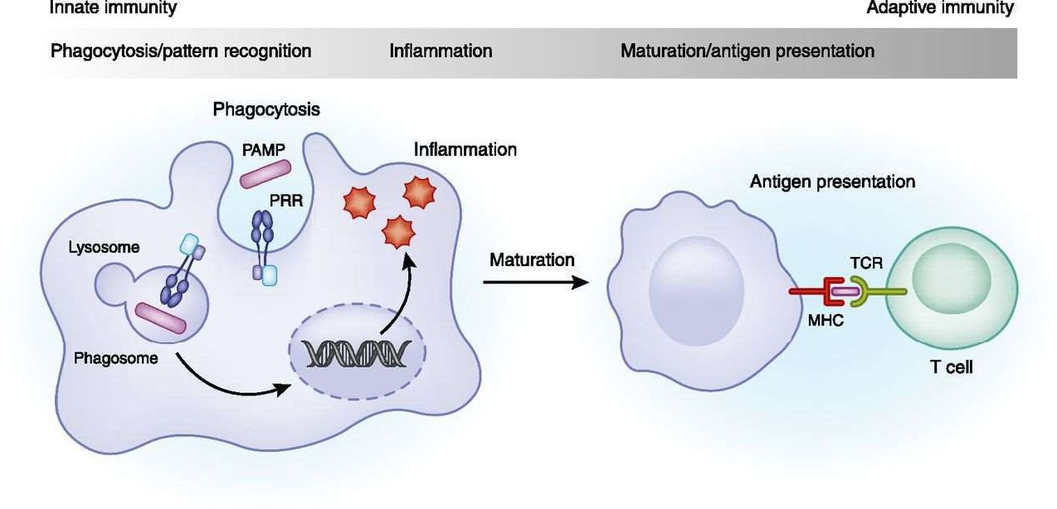
Innate immune responses encountered by microbes.
Microbes are detected by pattern recognition receptors (PRRs) expressed in innate immune cells, such as macrophages. The detection of microbes by the PRRs rapidly activates signalling cascades and generates inflammatory responses. Microbial encounter also leads to maturation of macrophages and dendritic cells into antigen presenting cells. PAMP, pathogen- associated molecular pattern; TCR, T-cell receptor.

Slide 52
PAMP | PRR | Biological Consequence of Interaction
Microbial cell wall components | Complement | Opsonization; Complement activation
Mannose-containing carbohydrates | Mannose-binding protein | Opsonization; Complement activation
Lipoproteins of Gram positive bacteria, yeast cell wall components | TLR-2 (Toll-like receptor 2) | Macrophage activation; Secretion of inflammatory cytokines
Double stranded RNA | TLR-3 | Production of interferon (antiviral)
LPS (lipopolysaccharide of Gram –ve bacteria | TLR-4 | Macrophage activation; Secretion of inflammatory cytokines
Flagellin (bacterial flagella) | TLR-5 | Macrophage activation; Secretion of inflammatory cytokines

Slide 53
DAMPs
Damage-associated molecular patterns (DAMPs) are endogenous danger molecules that are released released upon cellular stress or tissue injury from damaged or dying cells and activate the innate immune system by interacting with pattern recognition receptors (PRRs).
DAMPs activate the innate immune system by inducing potent
inflammatory responses during non-infectious inflammation
These DAMPs are recognized by macrophages, and inflammatory responses are triggered by different pathways, including TLRs and inflammasomes
DAMPs can originate from different sources and include:
extracellular proteins, e.g. biglycan and tenascin C,
intracellular proteins, e.g. high-mobility group box 1 (HMGB1),
histones, S100 proteins, heat-shock proteins (HSPs), and
plasma proteins, e.g. fibrinogen, Gc-globulin, and serum amyloid
A (SAA)

Slide 54
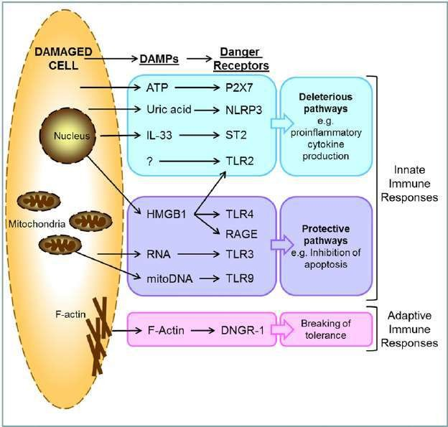
Induction of immune response by DAMPs

Slide 55
Toll-like receptors (TLRs) - 1
Play a major role in innate immunity and the
induction of adaptive immunity.
Different combinations of TLRs appear in different cell
types and seem to appear in pairs; 13 recognized so far
Different TLRs directly or indirectly bind different
microbial molecules.
TLRs are found both on the surface and within the
phagolysosomes of phagocytes.
Surface TLRs recognize molecules on the surface of
microbes such as cell wall components
Internal TLRs recognize microbial molecules released upon phagocytosis of the microbe.

Slide 56



