Slide 1
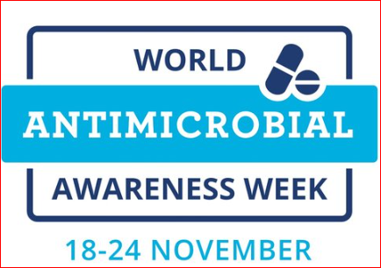
Dr. Gitali Bhagawati
MBBS, MD(MICROBIOLOGY), PGDHM, CIC
Consultant and Head-Microbiology & Infection Control, DNSH

Slide 2
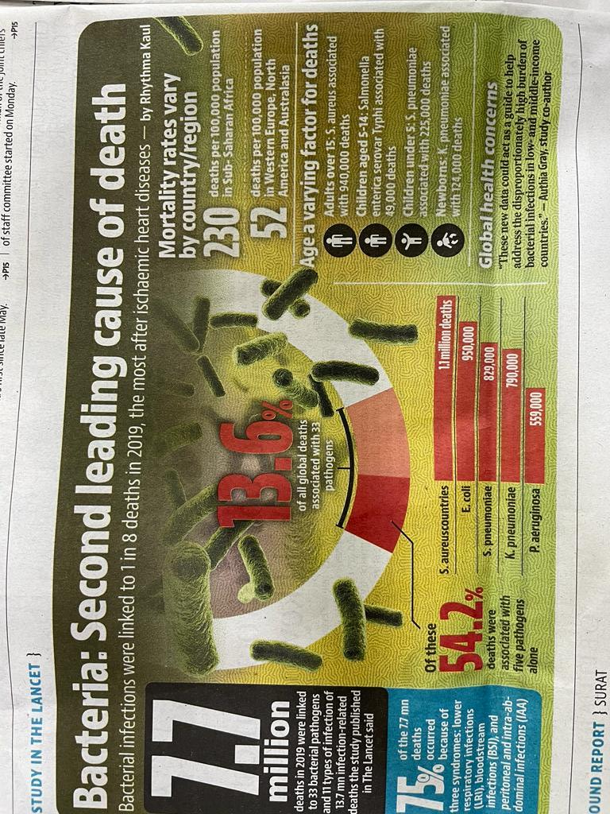

Slide 3
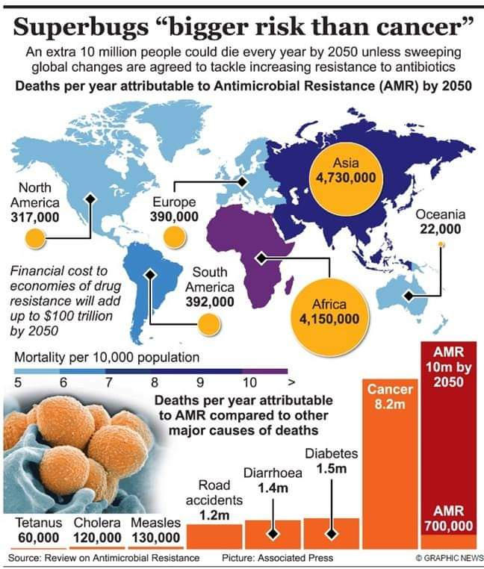

Slide 4
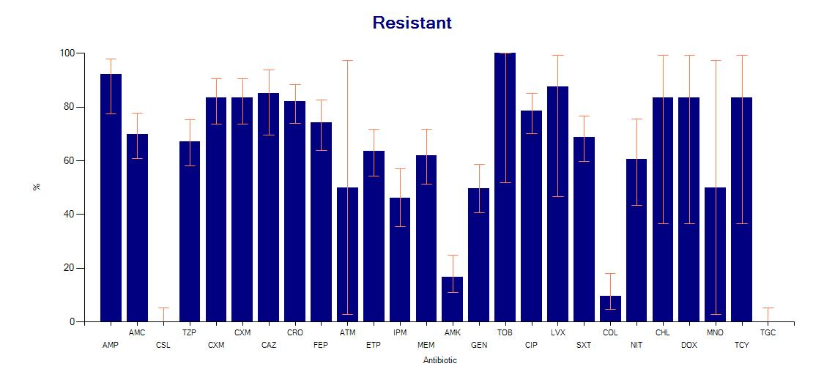
Klebsiella pneumoniae(n=131)[May –July, 2022]

Slide 5
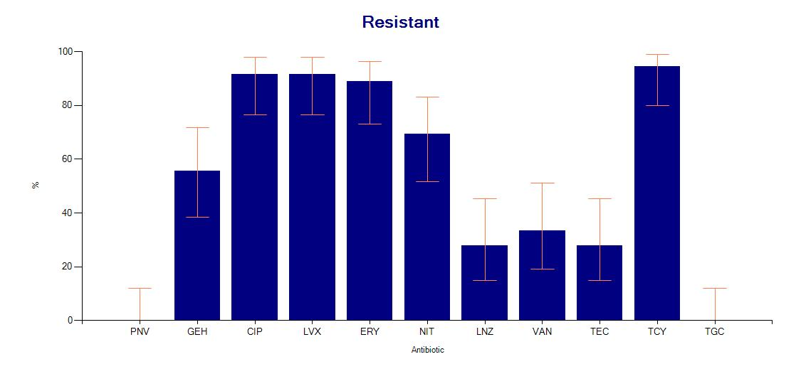
Enterococcus faecium (n=36) [May –July, 2022]

Slide 6
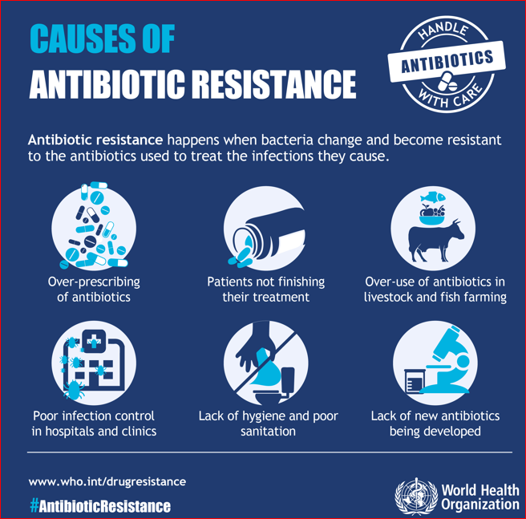

Slide 7
Other causes of Antibiotic Resistance..
No awareness about antibiotic resistance
No proper infra-structure for culture & sensitivity
Over the counter sale of antibiotics without prescription
No surveillance of Antimicrobial resistance
Expired antibiotics directly go with municipal waste
Molecular tests for resistance markers not available in all set up
Delay in FDA approval for any drug
No stringent regulation from higher authority

Slide 8


Slide 9
What are those small things…
As Dr-Pledge for Judicious use of antibiotics; Follow restricted antibiotic policy of the hospital
As Microbiologist-QC of lab, Selective reporting for best diagnosis and regular surveillance of AMR
As Patient- No self treatment; Complete the course of antibiotics
As Citizen- Proper disposal of Expired antibiotics
As HCW-Follow Hand Hygiene & Other Infection Control Practices like Isolation policy etc.

Slide 10
Thank you

